Slide 1
Stop Malaria!

Slide 2
Speaker’s notes: What is Malaria
Malaria is an illness caused by a parasite that is transmitted into the blood through the bite of a female (Anopheles) mosquito.
Malaria kills around 200 people per day in Tanzania, mostly young children.
When pregnant mothers get malaria, it can cause their babies to be born small. This can make babies more likely to get sick. It can also increase other risks for the baby during and after pregnancy.
When young children or people with other serious diseases like (HIV/AIDs, cancer) get malaria it can make them extremely sick or kill them.

Slide 3
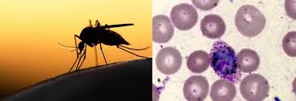
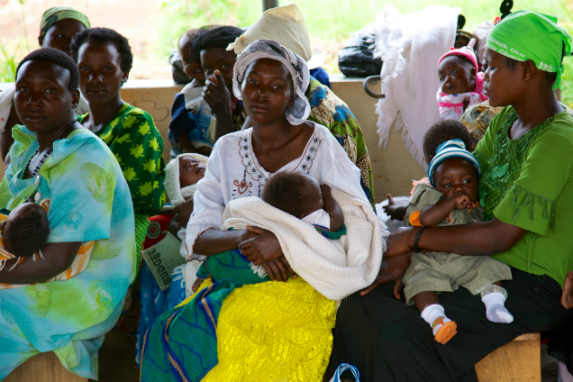
What is Malaria?

Slide 4
Speaker’s Notes: Transmission
Through a bite from a Mosquito infected with malaria –
These mosquitos are often silent & usually active 10pm-5am
Most harmful to pregnant women and young children
You cannot get malaria from someone who has malaria

Slide 5
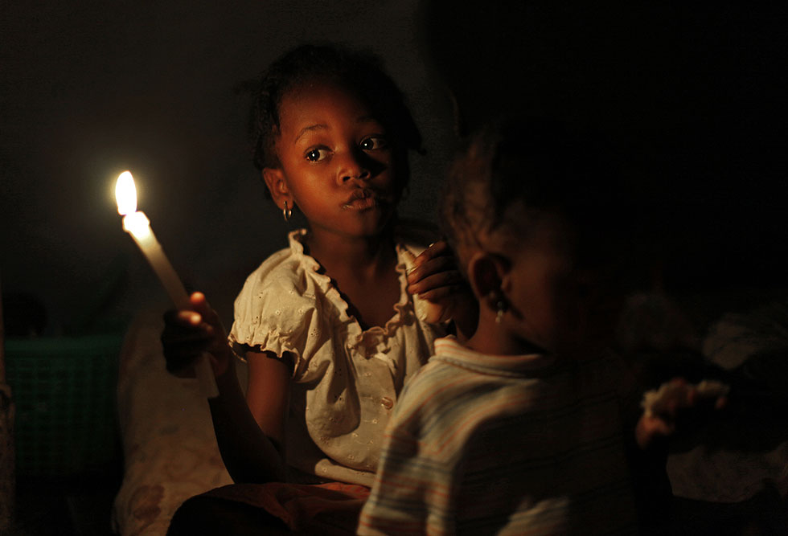
Anopheles Mosquito Bites in the Night

Slide 6
Speaker’s notes: Signs & Symptoms
GENERAL SIGNS:
SEVERE SIGNS:
Feelings weak and dizzy
High fever
Failure to eat or drink (in children)
Refuse to breastfeed
Abdominal pain
Headaches
A bitter taste in the mouth
Feeling weak in the joints
Nausea and sometimes vomiting
Diarrhea or generally loose stools
Convulsions
Difficulty breathing
Very pale tongue and eyes (severe anemia)
Sunken eyes (dehydration)
Not able to eat/drink or breastfeed for children
Continuous vomiting

Slide 7
Signs of Malaria

Slide 8
Speaker’s notes: Prevention
It is cheaper to prevent malaria than to treat it
Everybody should sleep under a bed net
Barrier between mosquito and person to stop mosquito bites
Bed nets have a small amount of insecticide which is harmful to mosquitoes but not to parents and children

Slide 9
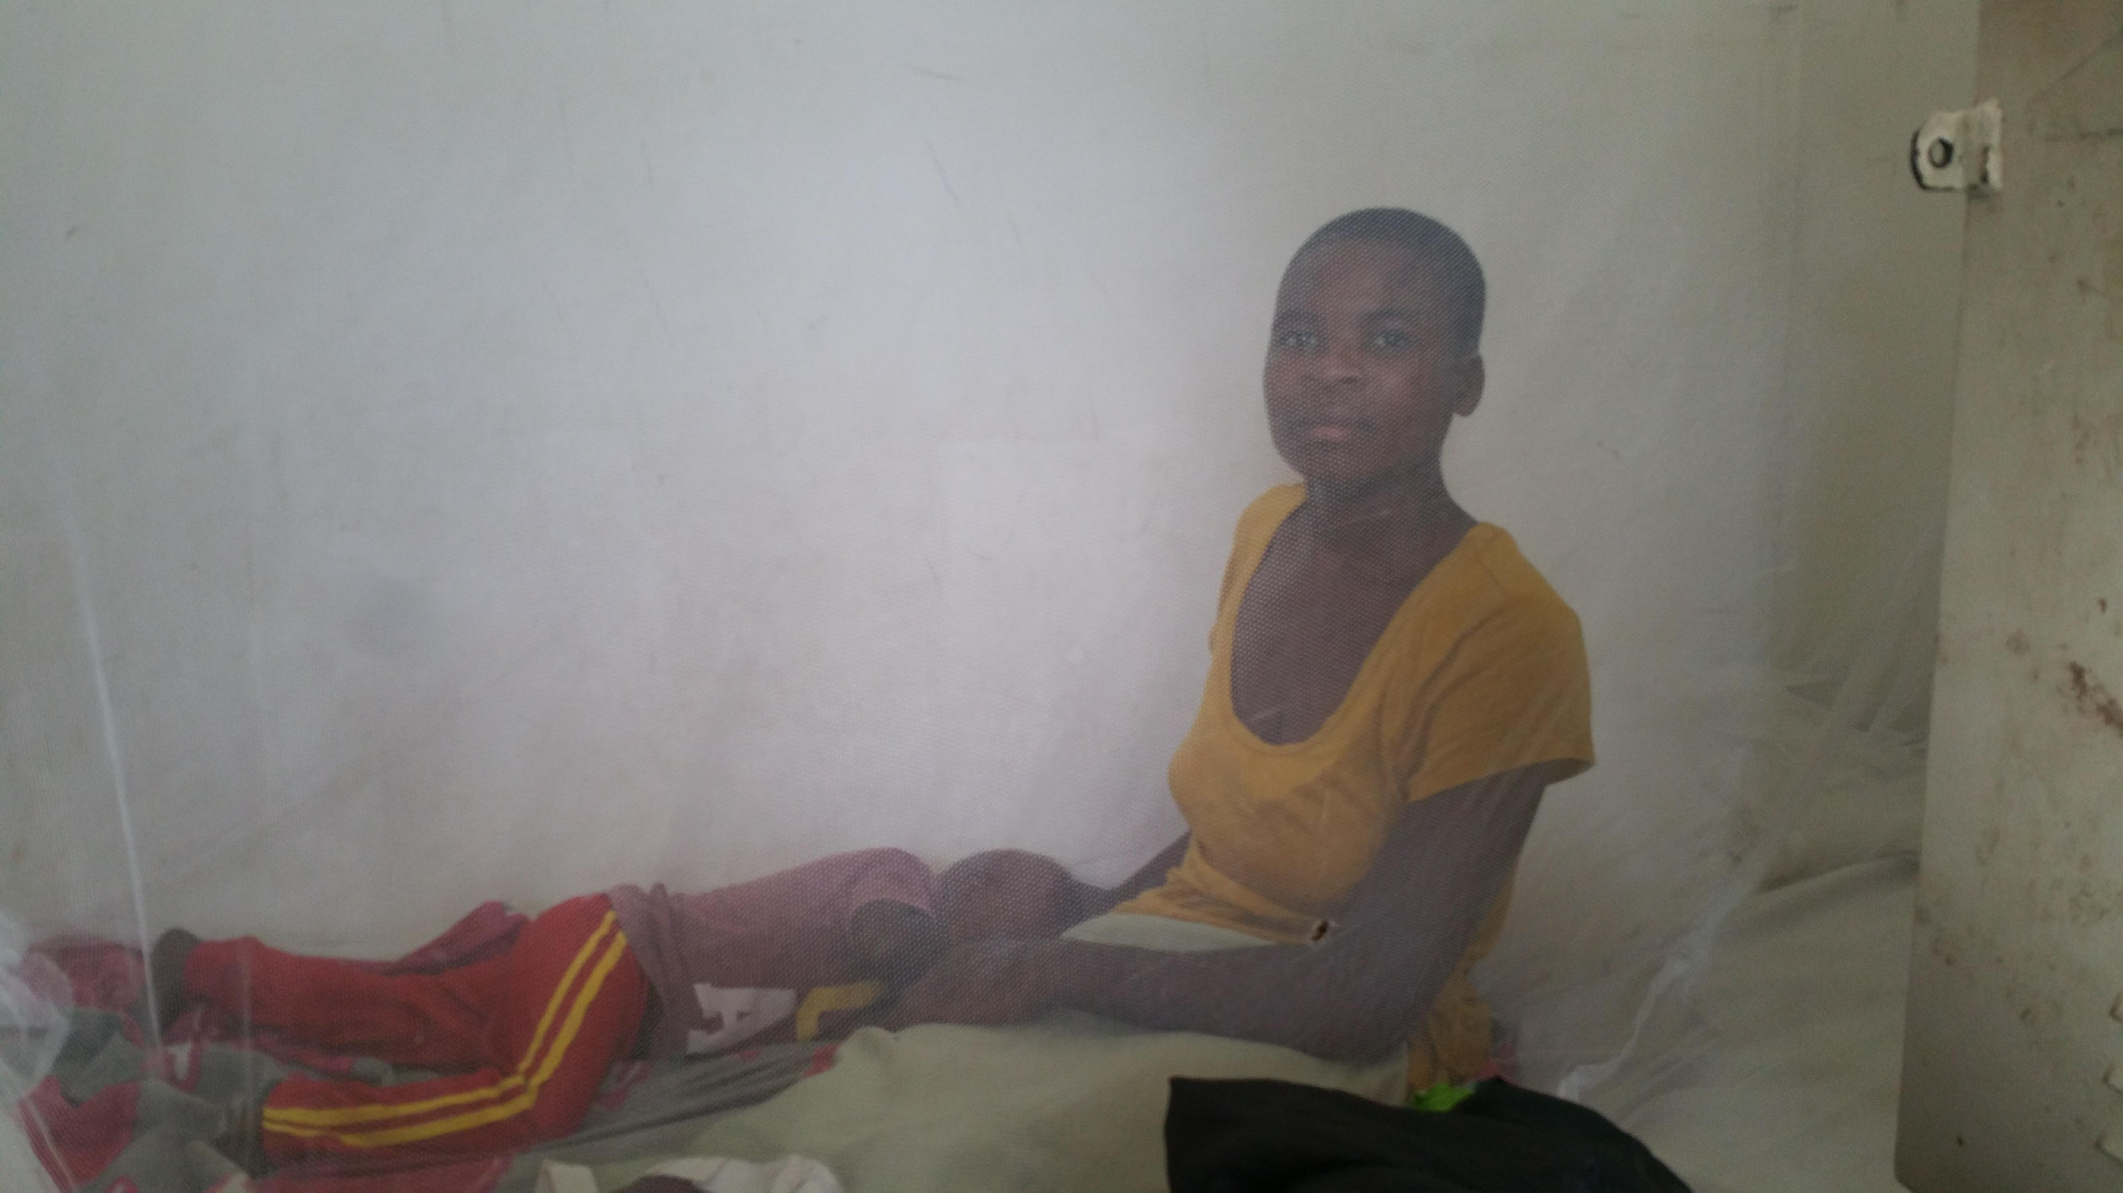
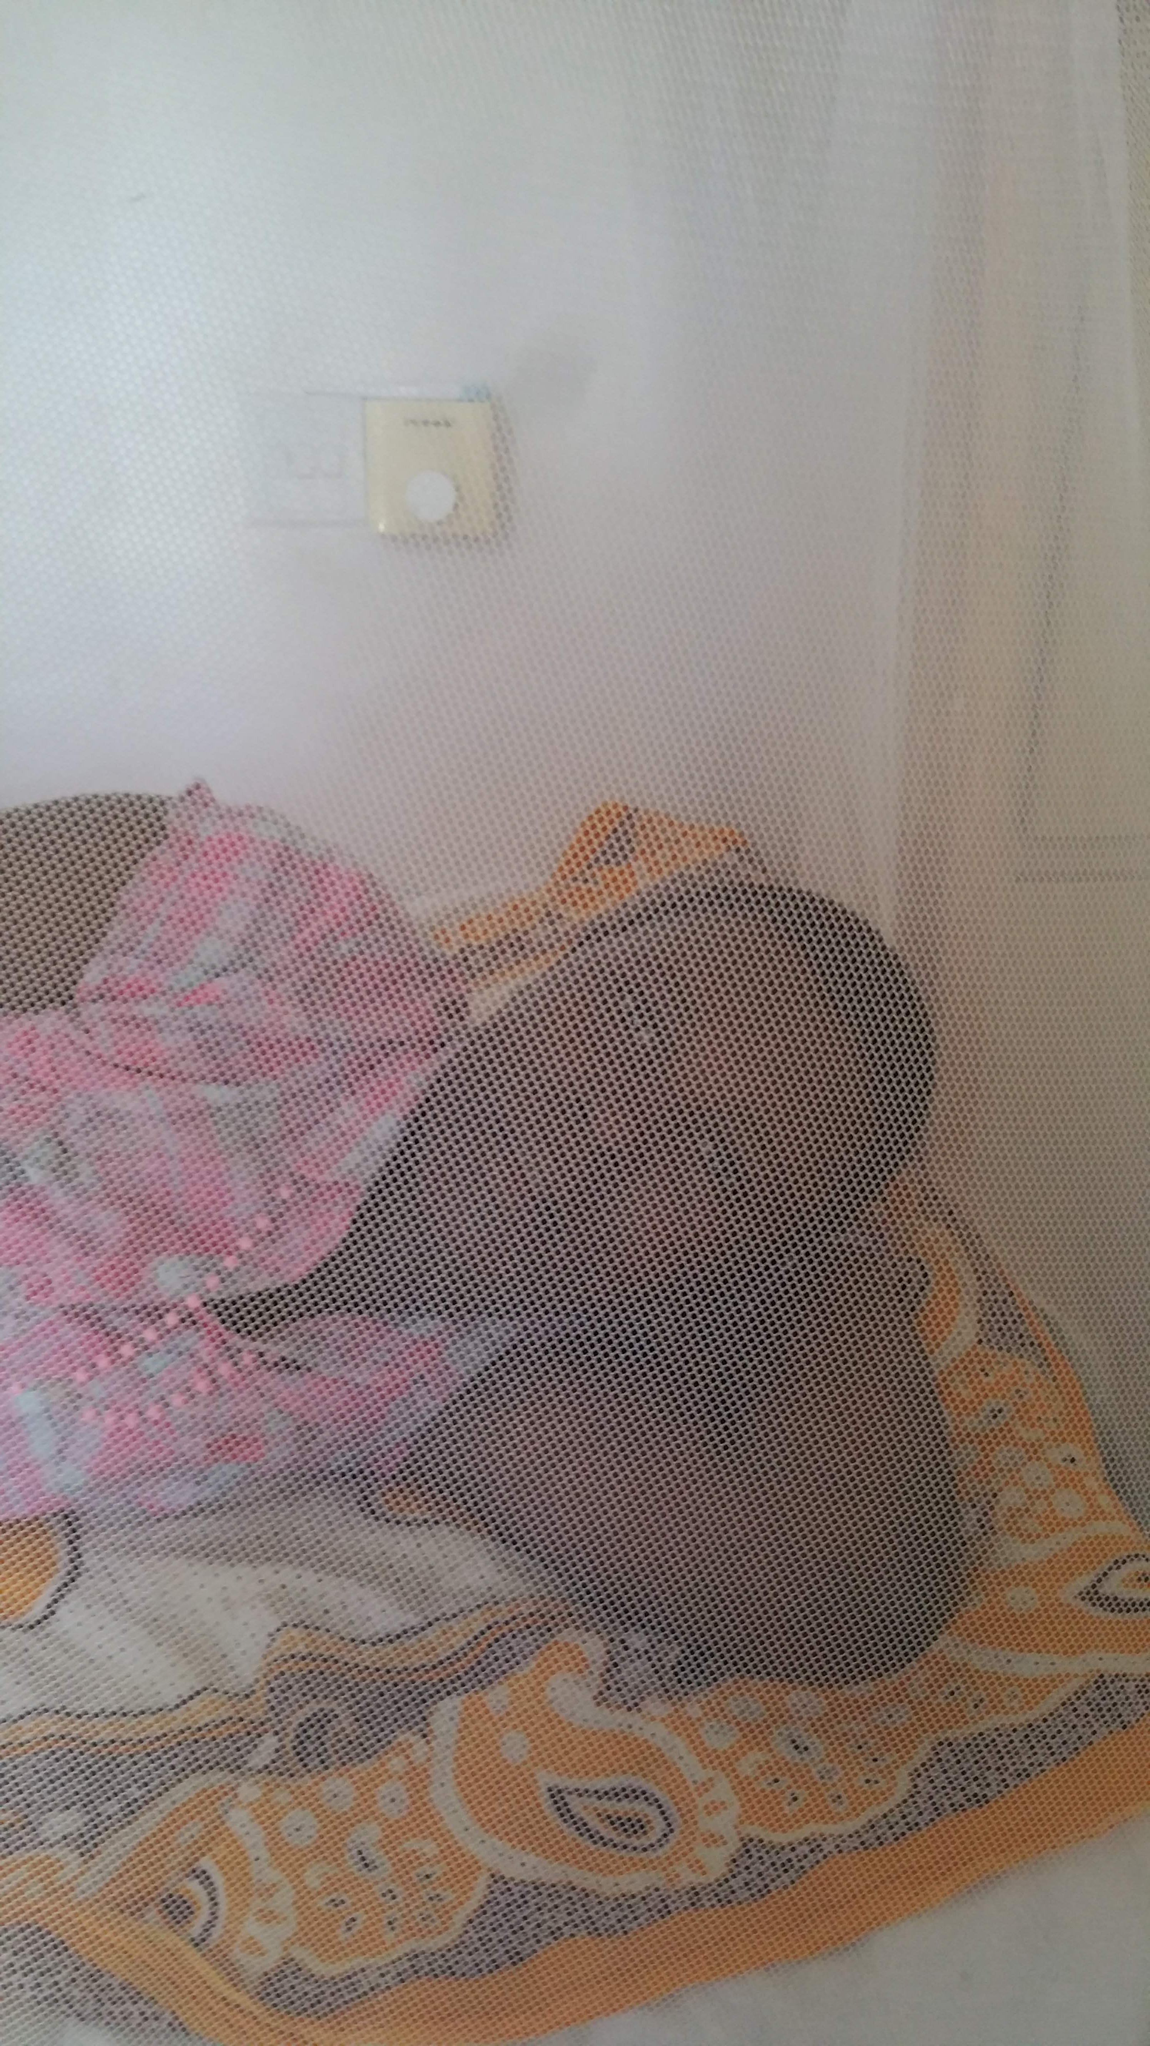
Prevention is Cheaper than Treatment

Slide 10
Speaker’s notes: At Risk Groups
It is especially important for children under 5 years old, pregnant women and people with HIV/AIDS to sleep under a bed net because they are most at risk of getting malaria
All pregnant women should get 3 doses of antimalarial medicine (Intermittent Preventive Treatment in Pregnancy - IPTp) starting from month four, each dose at least one month apart

Slide 11
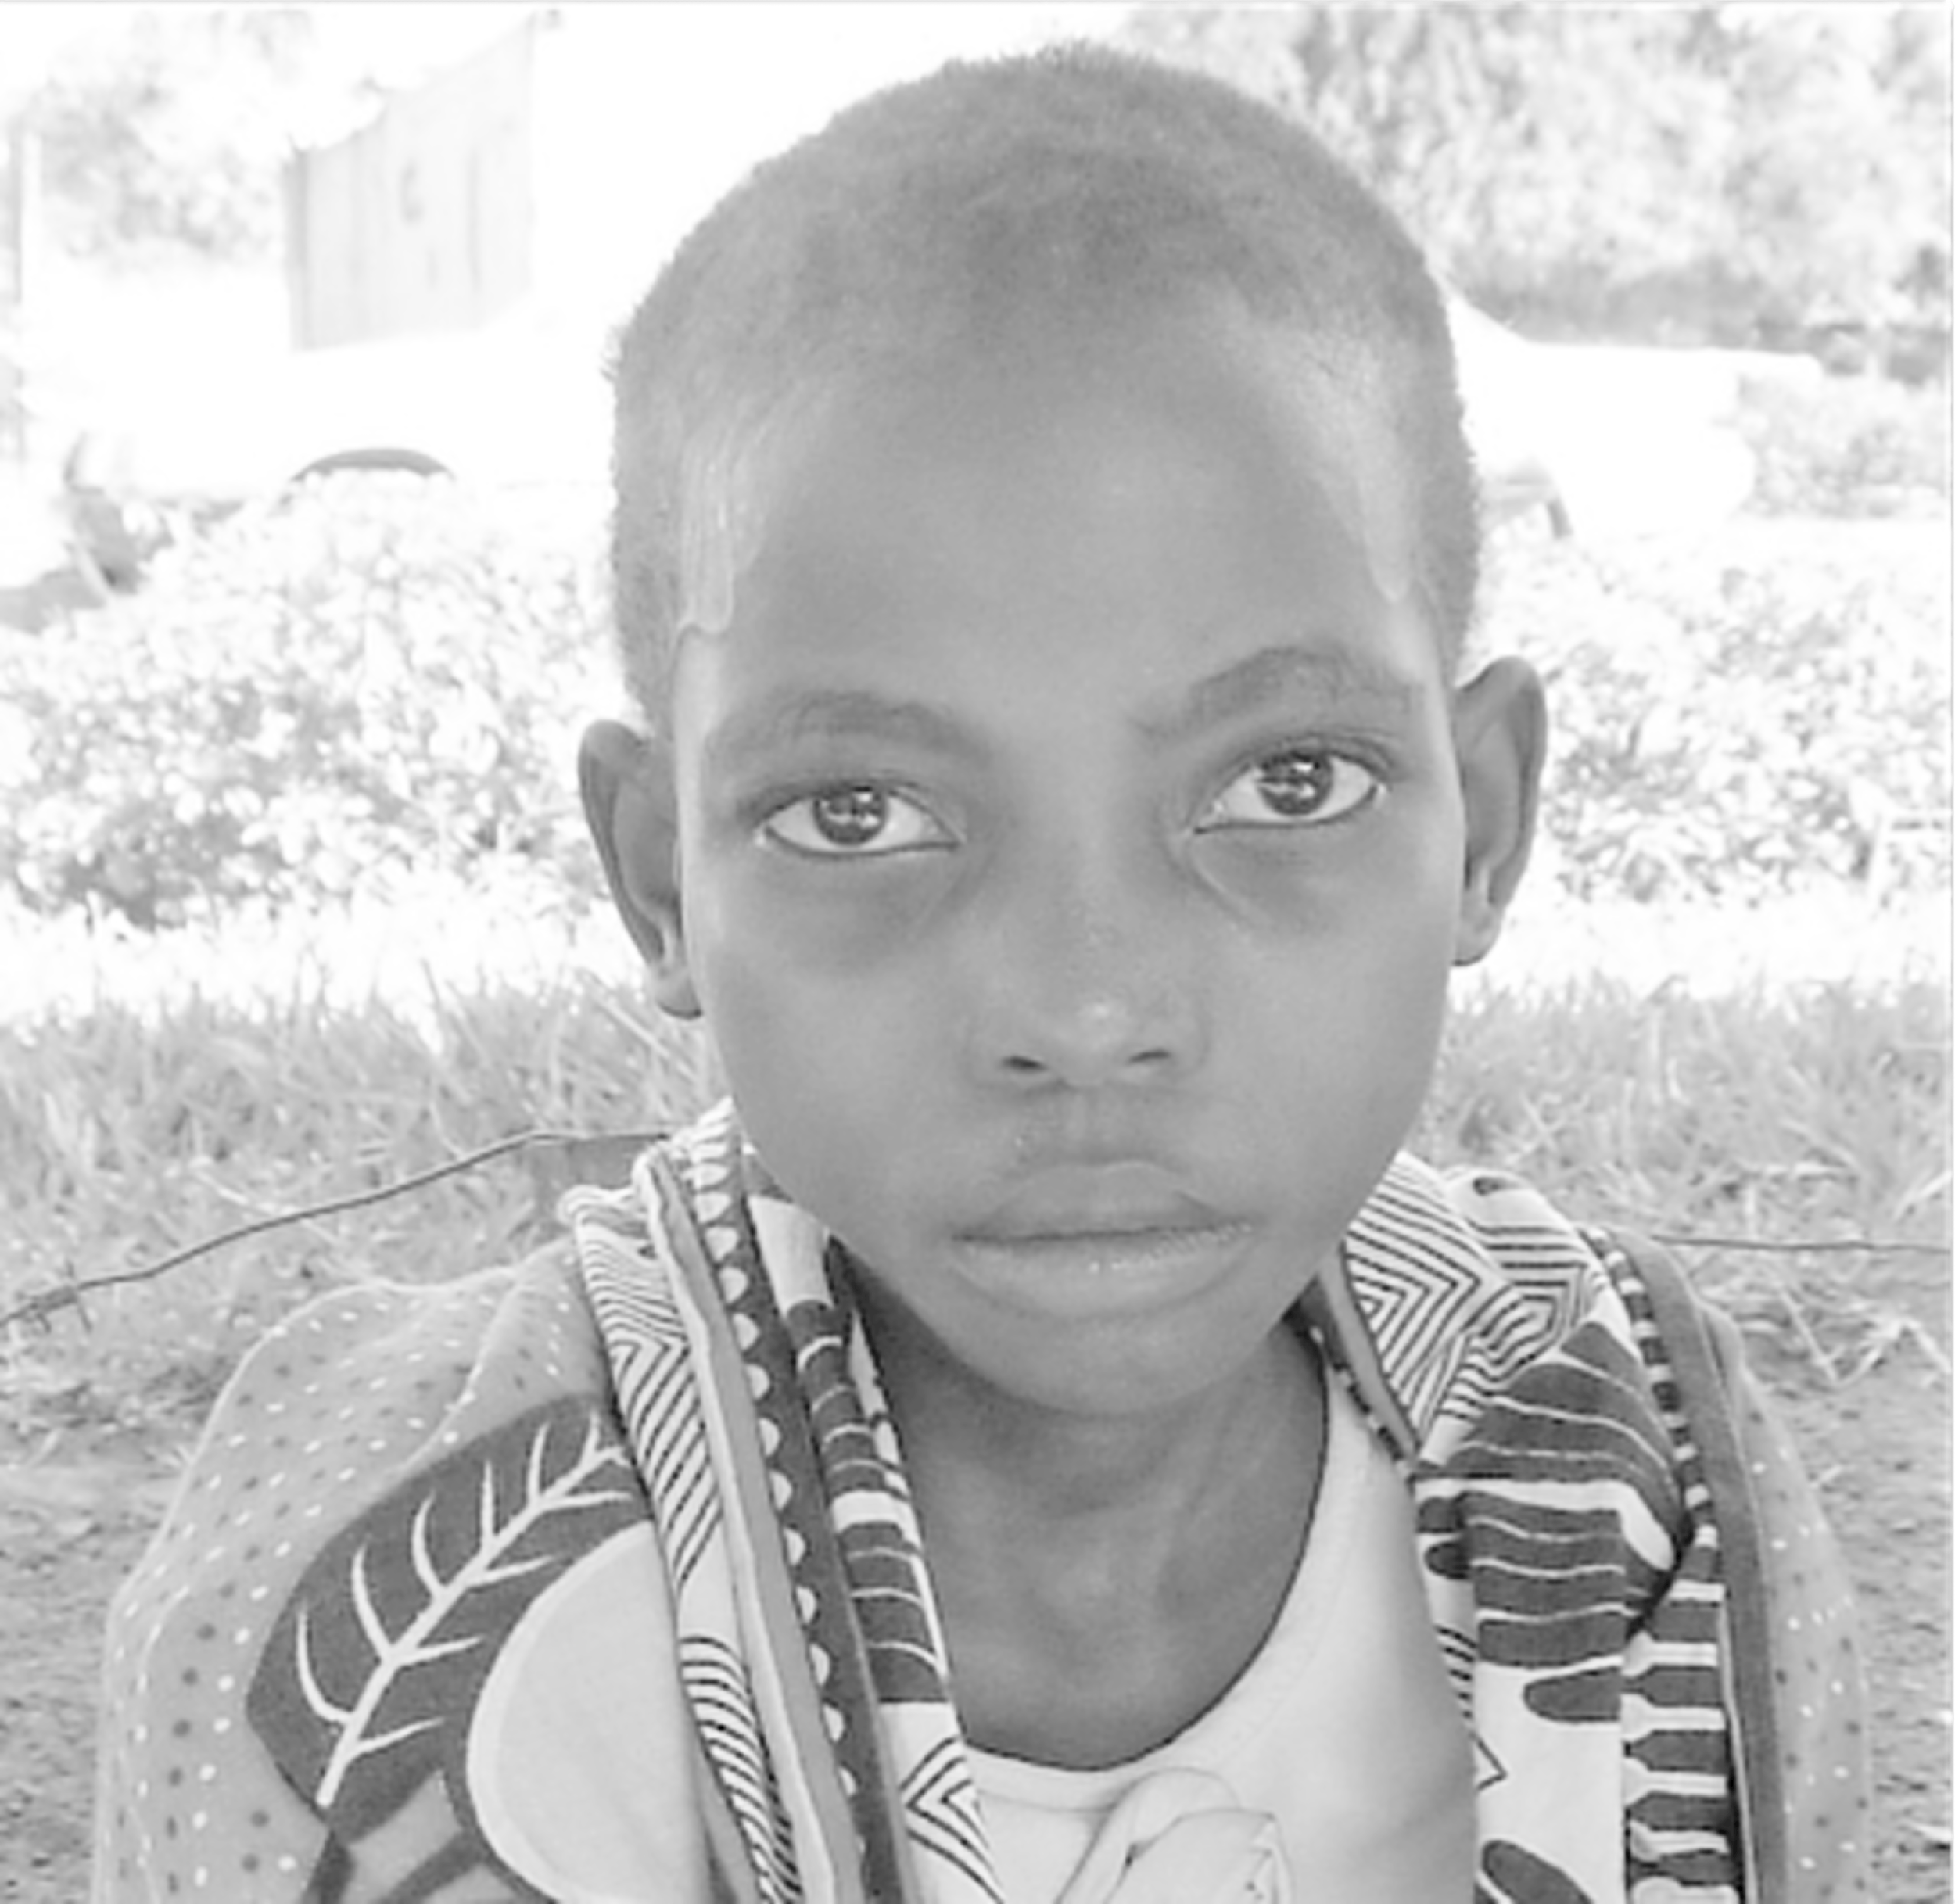
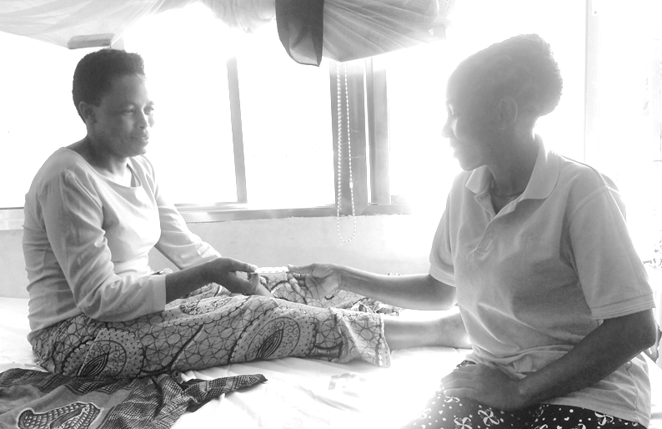
Children, Pregnant Mothers and Those with Serious Disease

Slide 12
Speaker’s Notes: Net Use
Using the net correctly every night is the cheapest and most effective way to prevent malaria
Hang your net properly. Nets come in many shapes and sizes, so the way the net is hung should be customized to fit the room/bed. Use the loops on the net to hang it from sticks attached to the corners of the bed or hung from walls or ceiling using nails and strings.
Lower the net to cover the users every night. Tuck the edges under the mattress or sleeping mat so no mosquitoes can sneak in.
Tie up the net in the daytime to prevent it from being snagged and torn.
Sleep under the net every night of the year, including dry season

Slide 13
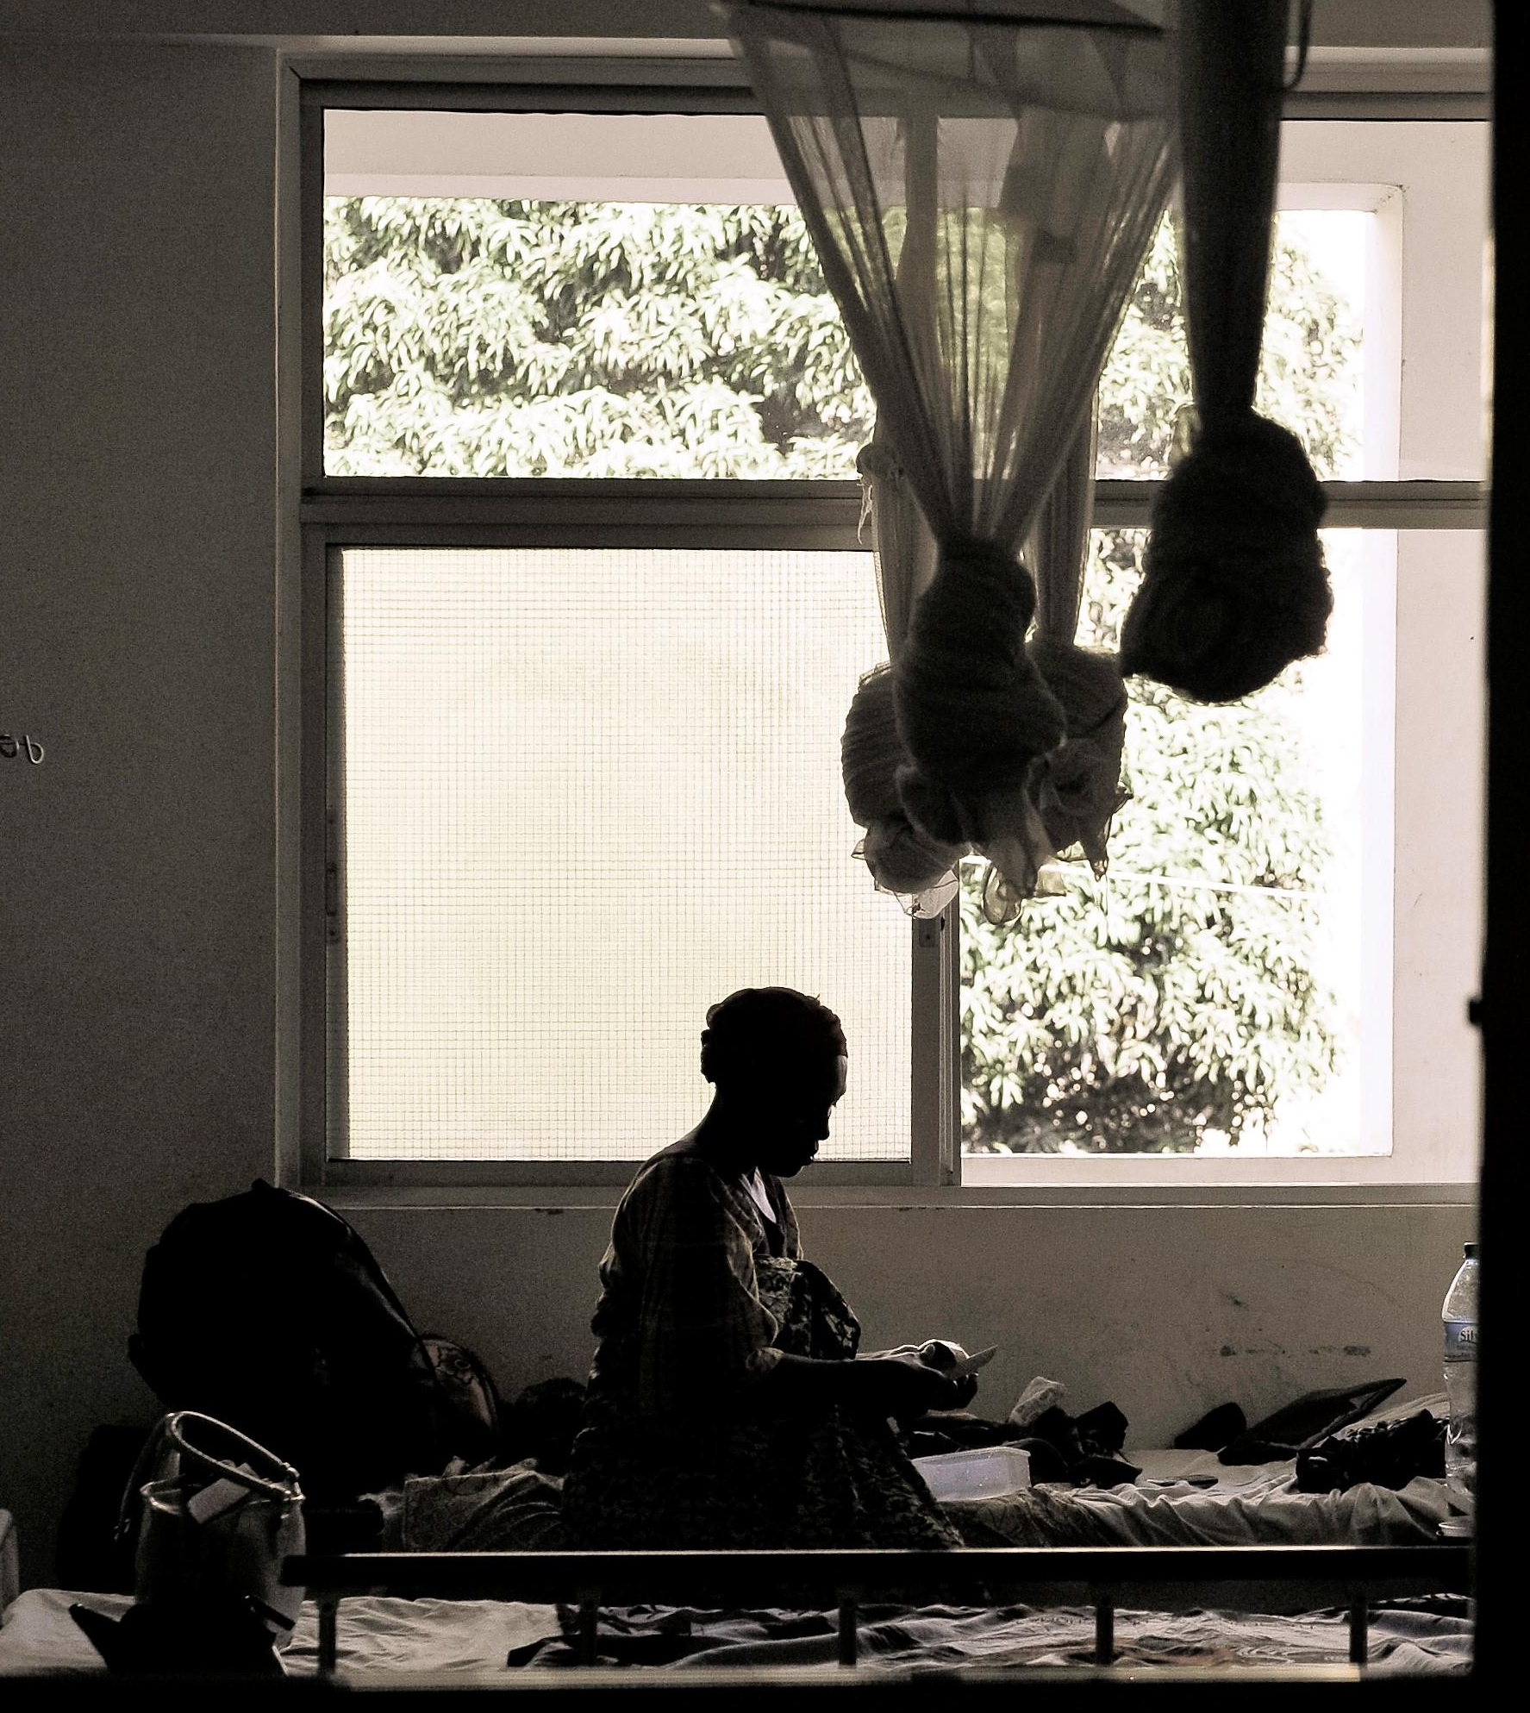
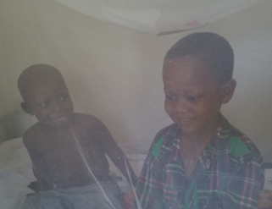
Net maintenance: Hang, Tuck, Repair, Repeat!

Slide 14
Speakers Notes: Routine Net Care
Gently wash your bed net when it is dirty. Only use soap and water and do not wring it, to avoid washing out the insecticide.
After washing, lay your net flat in a shaded area to dry. Do not place the net in direct sunlight or hang it off a line.
Your bed net can last for up to 3 years if they are washed 4-5 times per year and maintained properly

Slide 15
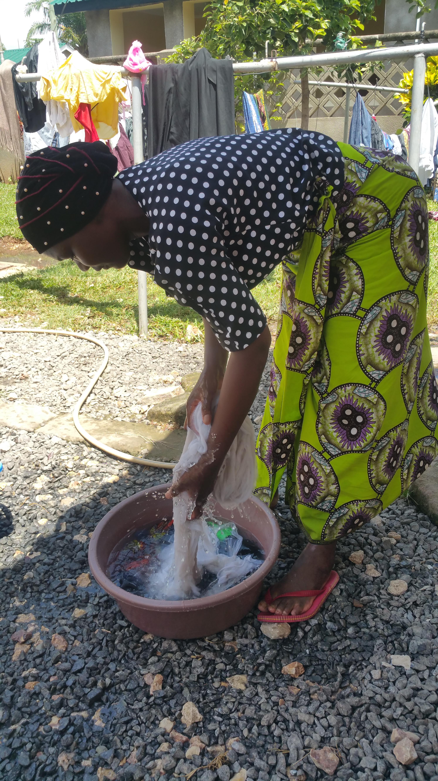
Wash and Lay Flat to Dry

Slide 16
Speaker’s notes: Net Maintenance
If holes appear, you can sew the net as you would any other fabric. Make sure to repair and small holes/ tears as soon as they occur so they do not get larger and make the net unusable.
Avoid closeness to open fires such as candles. While the net will not burn quickly, it can still catch fire.
Tie up your net during the day to prevent damage

Slide 17
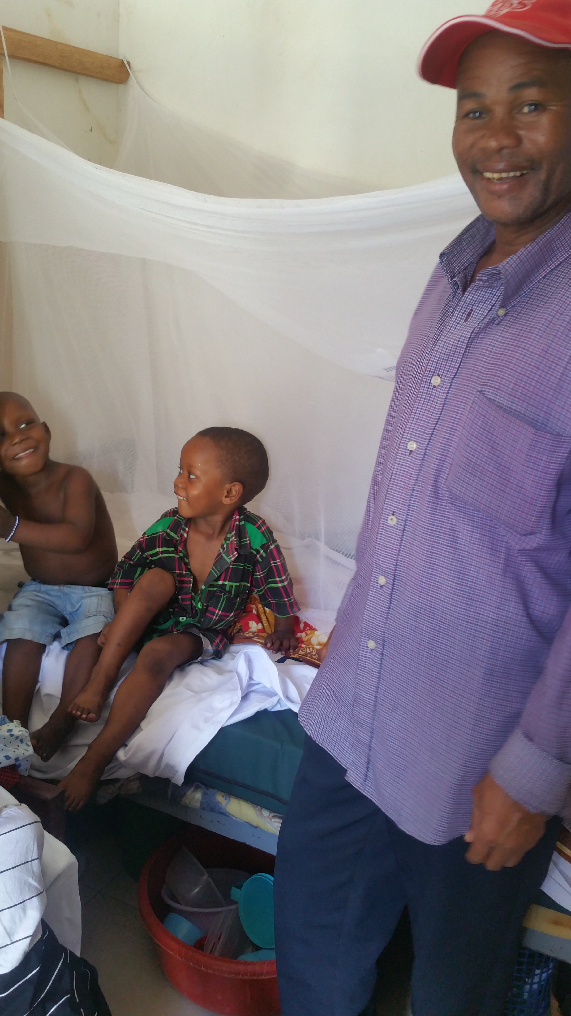
Keep your Bed Net in Good Condition for your Family

Slide 18
Speaker’s notes: Diagnosis & Treatment of Malaria
A person who is showing signs or symptoms of malaria should see a health facility within 24 hours-
PREVENT DELAYS = SAVE LIVES
Early testing and treatment can prevent severe malaria and death
It is extremely important to make sure you have malaria confirmed by blood testing before taking treatment
This makes sure you are getting the right treatment for the right illness
It is very important that you do not give the wrong treatment for the wrong illness because it will not work and you will get sicker the longer you wait for the correct treatment

Slide 19
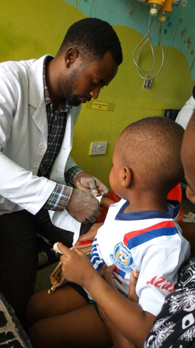
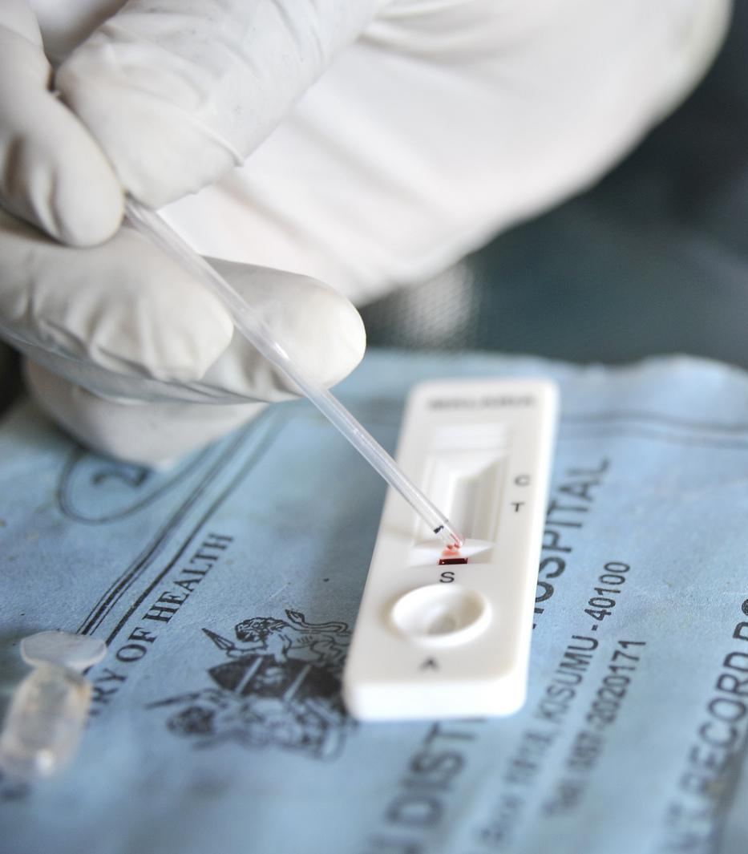
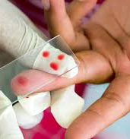
Getting Tested!

Slide 20
Speaker’s Notes: Treatment
It is then important to get your medicine from a health facility, not a local therapist or herbal remedy.
Finish the entire treatment even if the person is feeling better to prevent
the malaria coming back
AND
Resistance to treatment from spreading
If a person has severe malaria, they must be seen at a health centre to prevent complications or death
It is very important for proper diagnosis and treatment to prevent more severe illness.

Slide 21
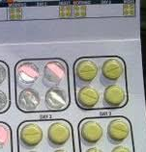
Take the correct Treatment and Finish it all

Slide 22
Speaker’s Notes: Child with Fever
Fever is when temperature goes up and the body becomes hot
This happens when the body has an infection or other problem and in healthy children it can be managed in other ways, HOWEVER……
Children who have had cancer should be taken to a health facility straight away if they have a fever, you must alert them to your child’s health history of cancer
When your child has had cancer treatment, you must never ignore a fever as it can be the only sign your child has a life threatening infection!
Cancer treatment can make it difficult for your child’s body to fight infection on its own – DO NOT IGNORE FEVER

Slide 23
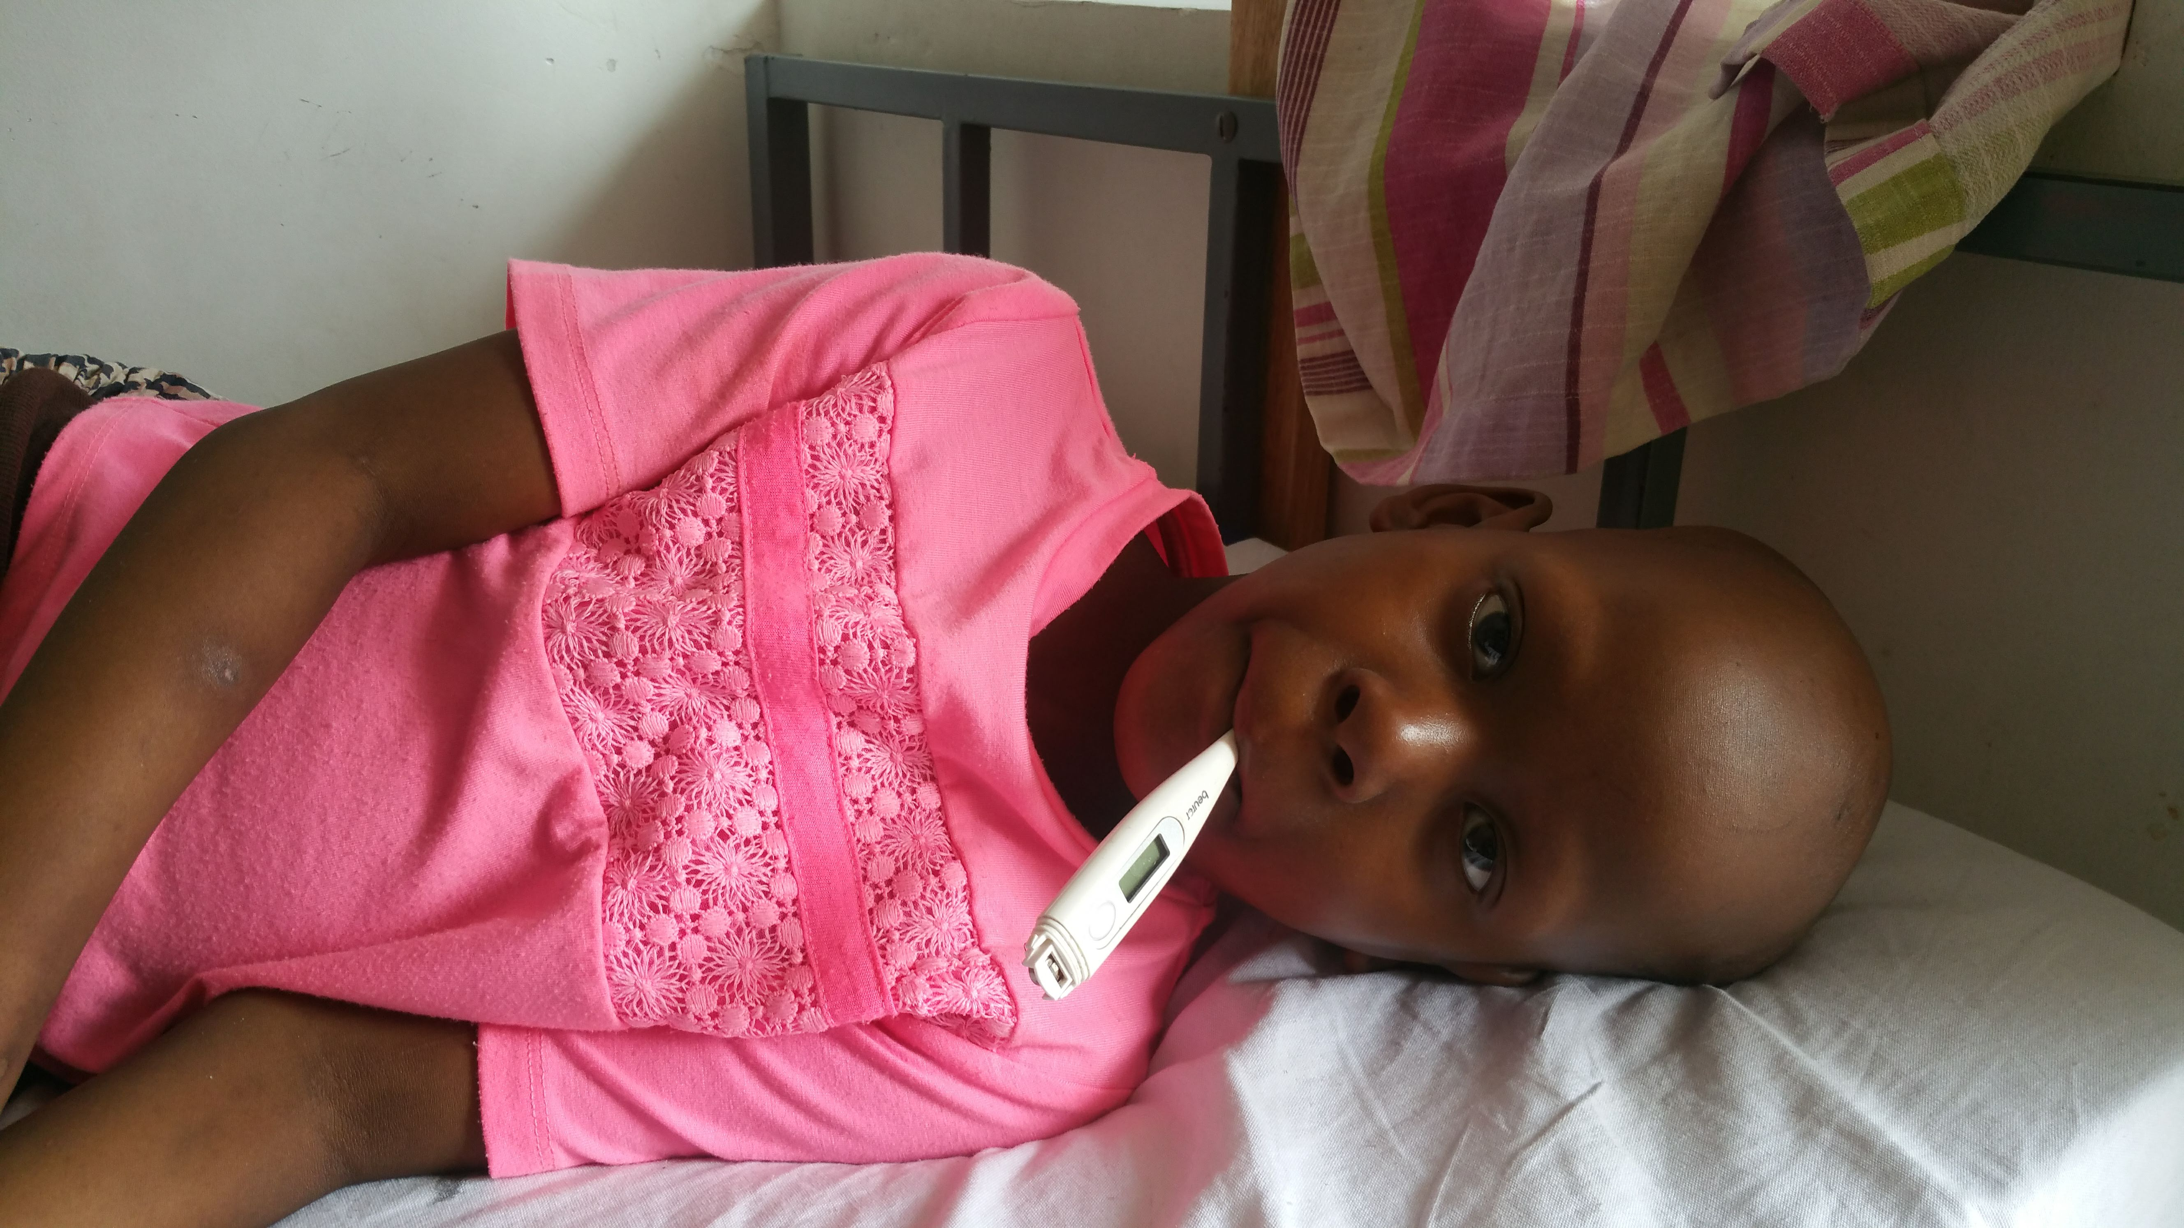
Fever in your Child

Slide 24
Speaker’s Notes: Common Myths
Myth: I can get malaria from eating mangoes
Truth: Malaria is only transmitted through the bite of an Anopheles Mosquito.
Myth: I can cure malaria through herbal medicines.
Truth: Herbal medicines will not cure malaria.
Myth: The IPTp medicine makes you sick
Truth: Taking the medicine on an empty stomach may make you feel sick but eating something before you take the treatment will easily fix this

Slide 25
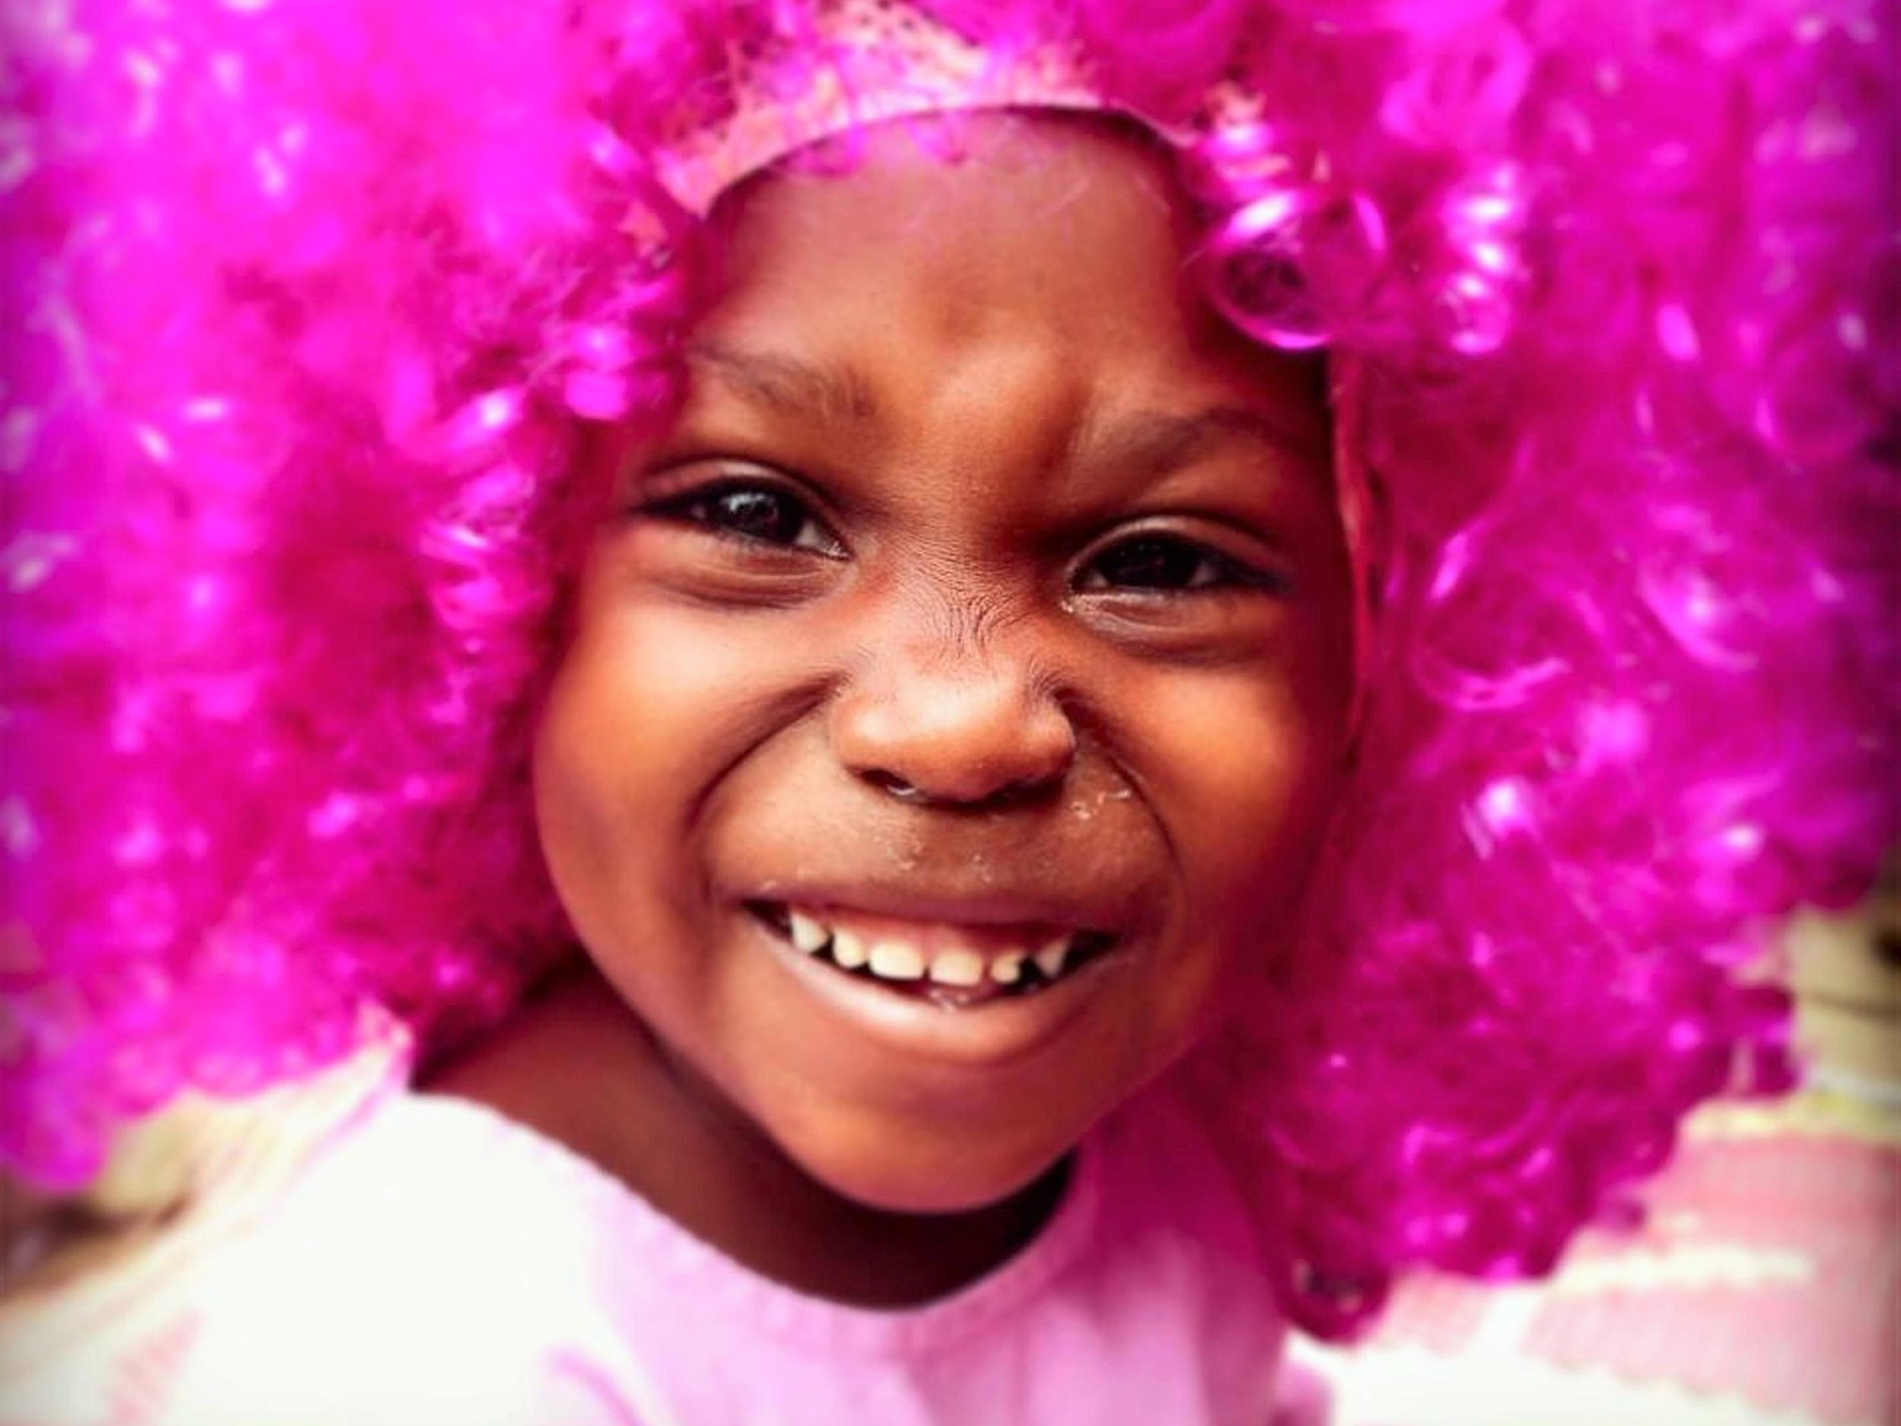
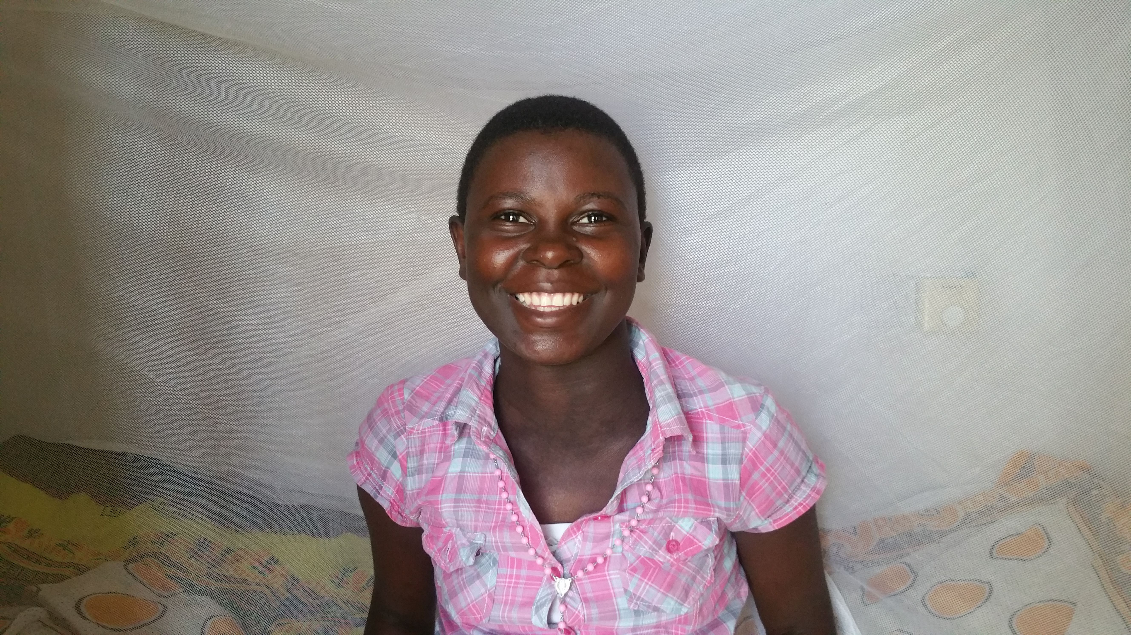
Myths around Malaria

Slide 26
Speaker’s Notes: Myths continued….
Myth: When I use the bed net, I still hear mosquitoes buzzing which means the bed net is not working.
Truth: The female Anopheles mosquito does not make a buzzing sound (That’s the male making all the noise - ;-)!!) The treated bed nets are designed to only kill the Anopheles mosquito but will stop you getting bitten by other mosquitoes. The buzzing is merely a nuisance.
Myth: All fevers are caused by malaria.
Truth: Fevers are caused by many different illnesses (including malaria) such as pneumonia, malaria, measles, meningitis, flu, diarrhoea, ear infection, skin infection, HIV/AIDS or others. Only a test can let you know for sure that the fever is caused by malaria.

Slide 27
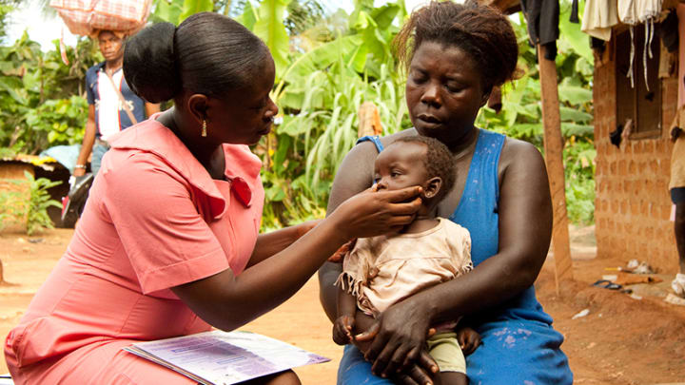
Fever can be a Symptom of many things! Get checked

Slide 28
Speaker’s notes: Myths continued…
Myth: Men should sleep under the bed net because they are the head of the household
Truth: Children under five and pregnant women are the most vulnerable to malaria. While they should be given the priority, everyone in the household should sleep under a bed net.
Myth: I only need to sleep under a bed net during the rainy season.
Truth: Malaria can be transmitted any time during the year.
Myth: My baby can get sick from the insecticide in the bed net.
Truth: Although the insecticide in bed nets can kill mosquitoes, the amount used is so small that it is safe for pregnant women and children. Even if a baby puts the net in her mouth she will not get sick.

Slide 29
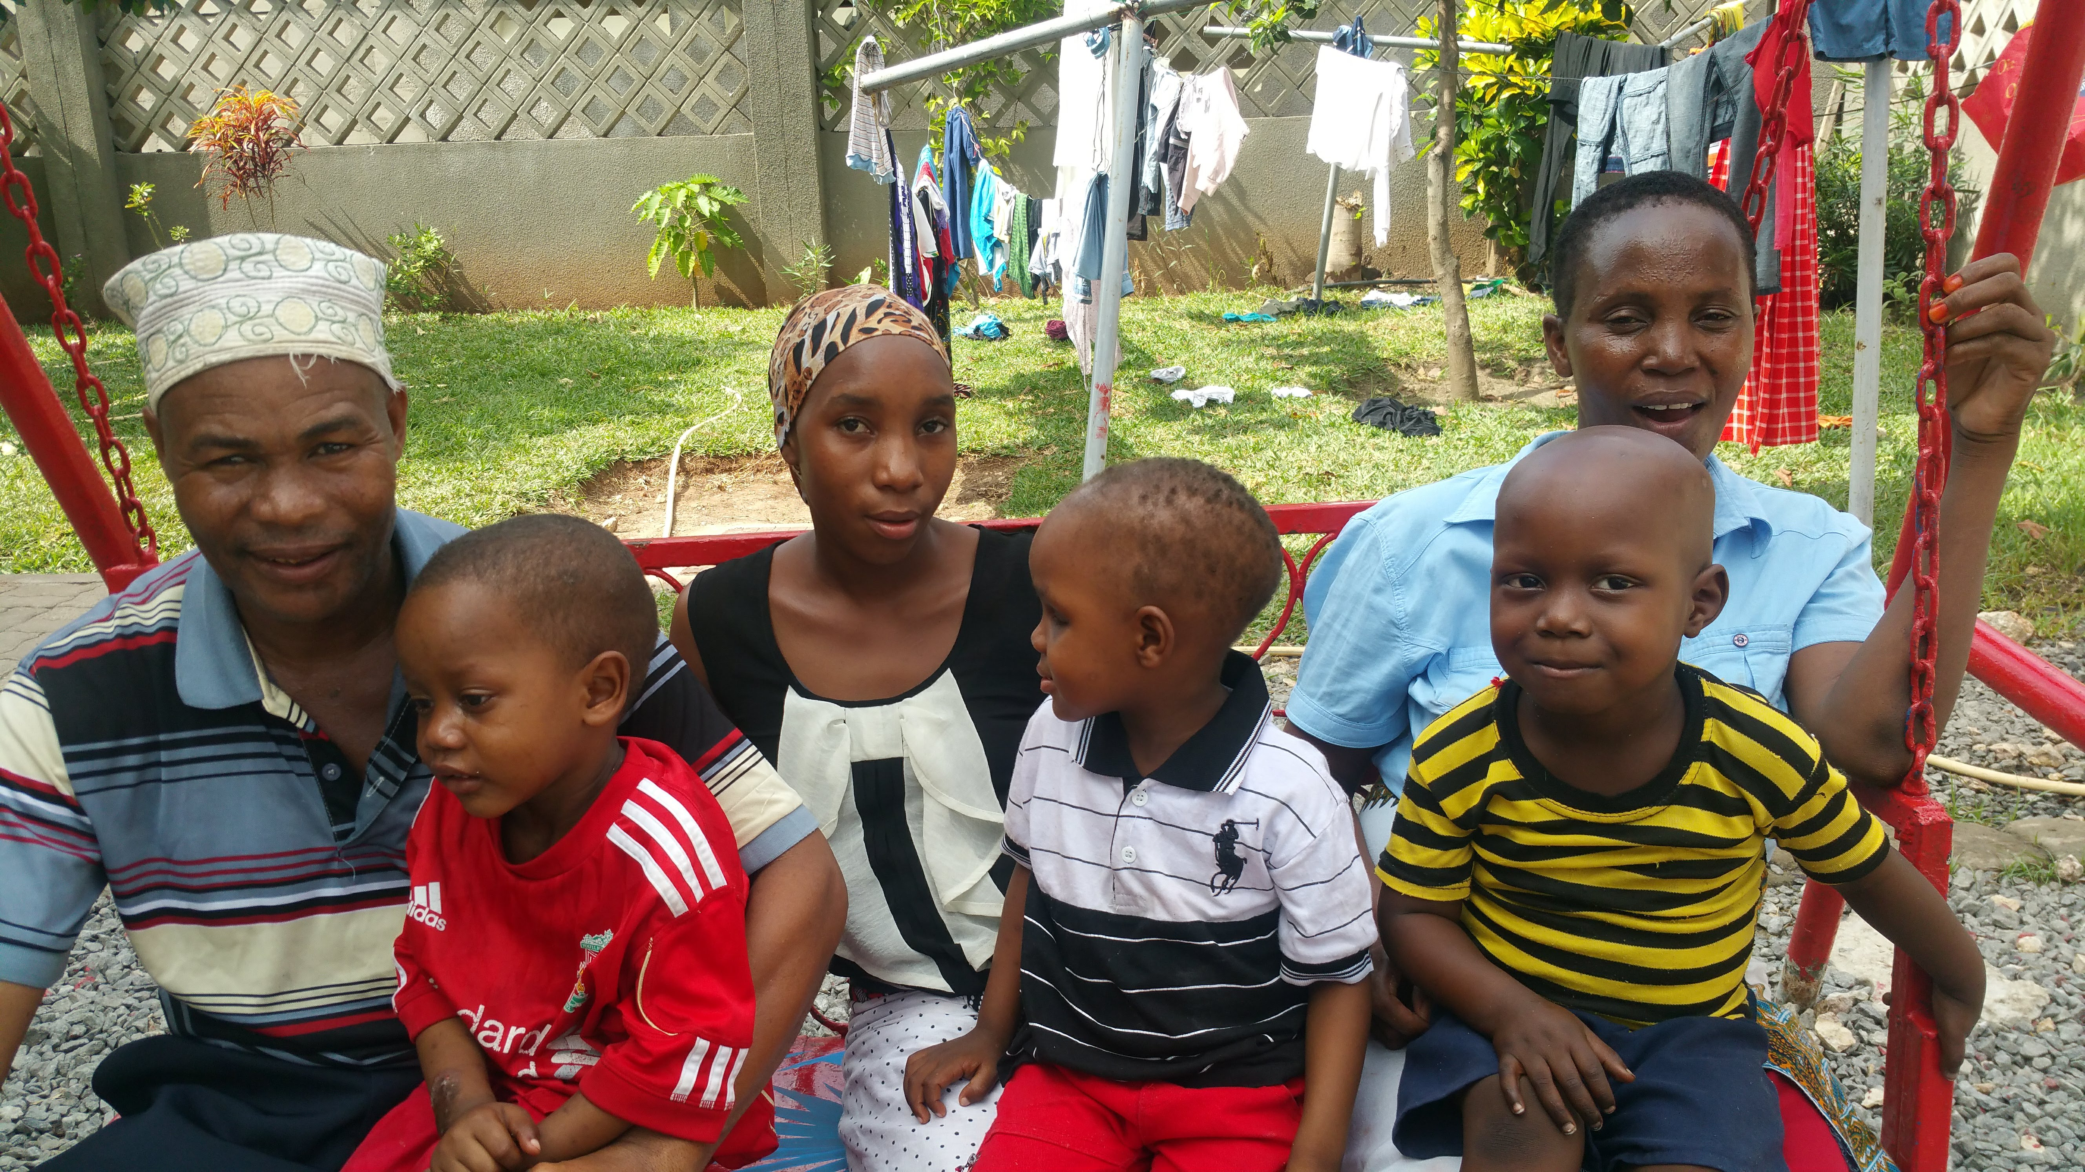
Protect all your Family, taking special care of Children and Pregnant Women

Slide 30
Speakers Notes: Quick Facts
Everyone can do something to prevent malaria! Using a bed net every night has been proven to prevent malaria in highly endemic countries like Tanzania.
A fever can be a sign of many different diseases (some life threatening). Only a test can let you know for sure that the fever is caused by malaria.
Malaria is caused by a parasite that is spread by the female Anopheles mosquito
Malaria treatment can be expensive. Prevention is cheaper!
Prevention:
Prevention efforts are simple and include using Long Lasting Insecticidal nets (LLINs) and care and repair of these nets
Pregnant women should attend Antenatal check ups and take IPTp
Treatment:
Go to a health facility within 24 hours of a fever starting, (with the exception kids with cancer, who should attend a health facility immediately at signs of a fever)
Diagnosis of malaria is crucial for ensuring the correct treatment
Take all medicine prescribed if you get malaria to prevent recurrence and resistance.

Slide 31
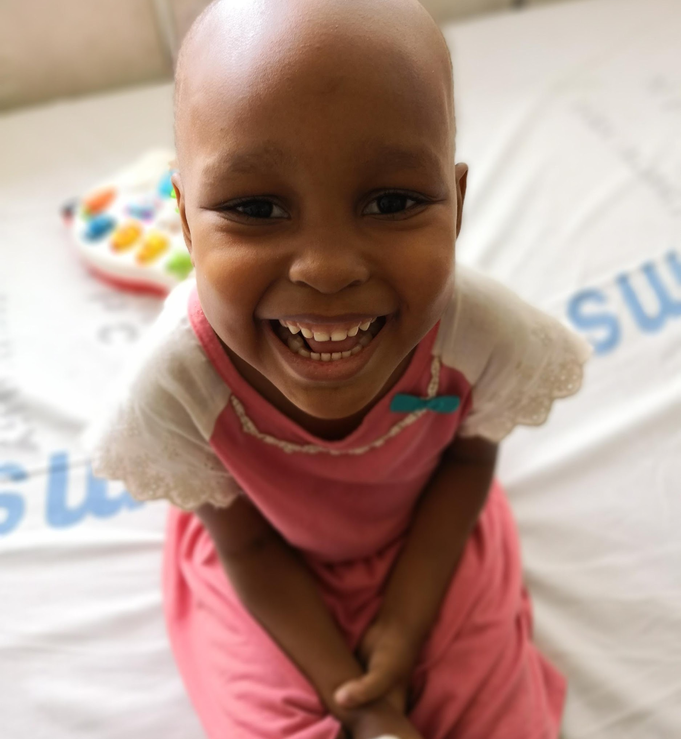
Thank you!

