Slide 1
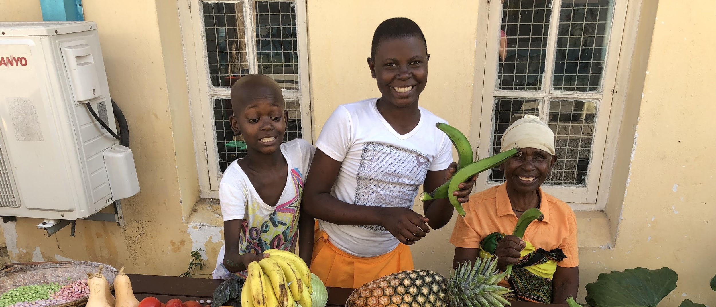
Food for Health and Strength
Healthy Food for Families

Slide 2
Speakers Notes: Introduction
Take time for welcome and introductions.
You may like to ask each person their name.
Share what the session will cover, topics such as:
Food your toddler eats
Every child has their own set of likes/dislikes as do their parents
Learning to choose healthy food is very important for long-term health, learning and enjoying life
Developing healthy eating skills
What foods to present to your child
Using food groups to guide your choices with good nutrition
Encouraging dental care
Develop safe and hygienic food practices
Physical activity
General health checks to keep child strong and healthy

Slide 3
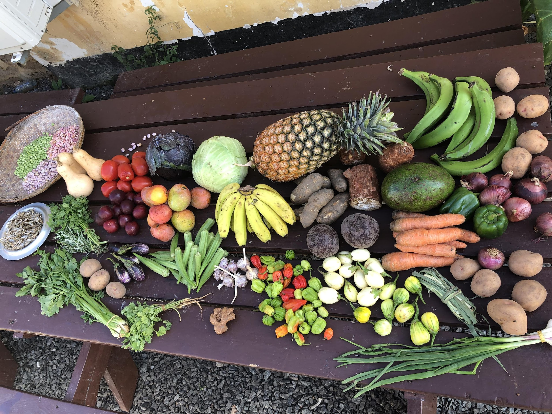
Kids Food – Grow us up strong!
Healthy Food –
Help us Grow Strong Kids!
Health Foo

Slide 4
Speakers Notes: Nutrition on Upendo Ward
Every child admitted to Upendo Ward has cancer
Many children are also malnourished as a result of their long or serious illness
This means that every Upendo Child needs special nutrition
Meals are provided 3 times a day on the ward
Nutritional supplements are also offered to every child in the form of fresh smoothies and porridge every day
The smoothie is packed with strength building calories and contain lots of wonderful ingredients needed to heal your child. These include:
Seasonal Fruit
Cashew Nuts
Mchicha
Honey
Spices
PLEASE encourage your child to finish these drinks as they work to speed up your child’s recovery and help the medicines to fight your child’s cancer
Luckily they are also delicious! If your child is struggling with food please tell a member of staff immediately!

Slide 5
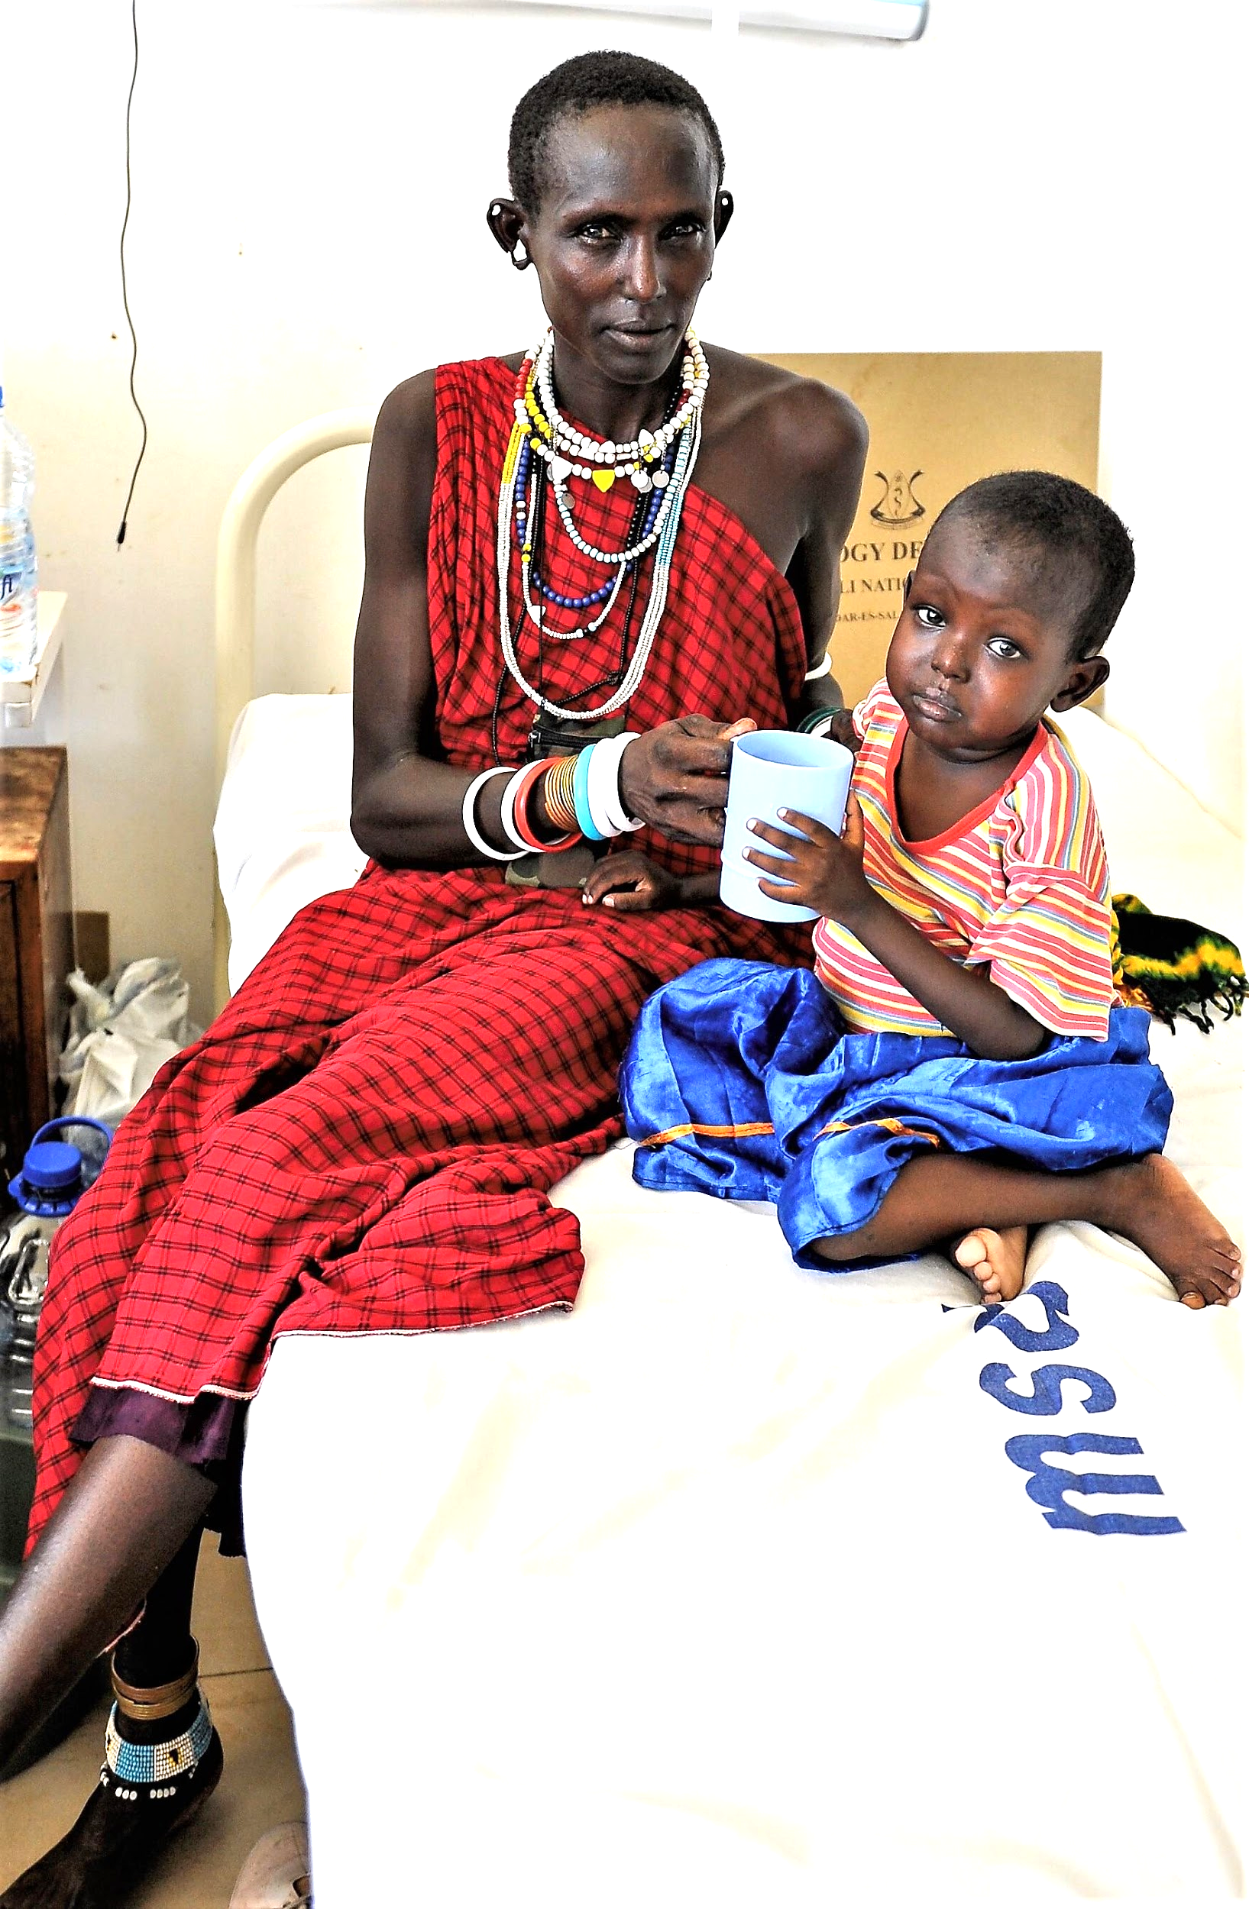
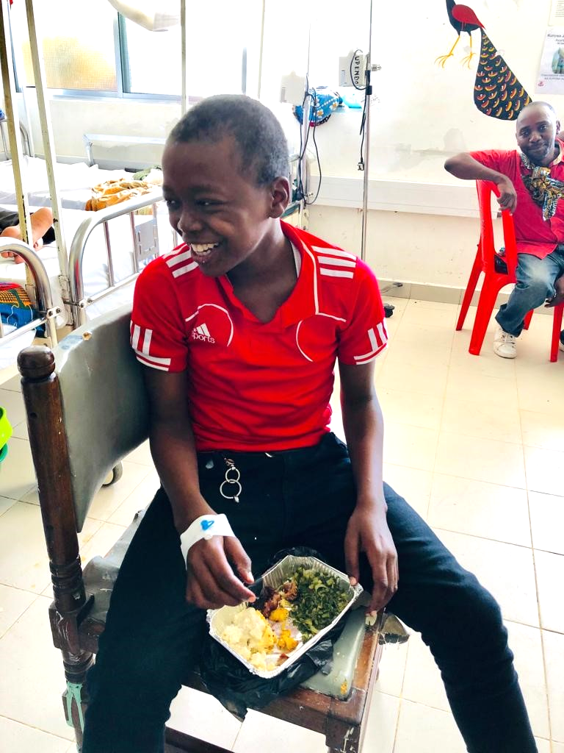
Upendo ward: Nutrition for the Child with Cancer

Slide 6
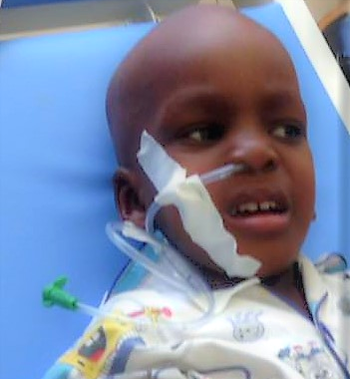
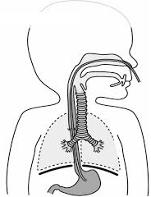
Supplemental nutrition for the sickest children

Slide 7
Speakers Notes: Nutrition in the sickest children
If your child is too weak or sick to eat listen carefully to what the doctors tell you.
If they have very serious tummy problems the doctors may ask you not to give your child anything at all to eat or drink for a few days
please listen and do what the nurses and doctors say
there may be a blockage in their bowel
it may be very dangerous to feed them
the pressure from the food might burst their little bowel.
Never try to feed your child by mouth if they are asleep or not responding to your voice. The food might go into their lungs and this is very dangerous.
If it is safe to eat but your child is too weak to try, or their poor mouth is too sore (from infections or chemotherapy), the doctors may suggest placing a tube from your child’s nose to their belly called a Naso-Gastric Tube (NGT):
This tube allows you to continue to give your child healing and strengthening nutrition even when your child is very, very sick.
You might be afraid when this is offered but please understand the good it will do your child – food is important for life, and to fight infections and beat cancer.
If your child is too weak to eat it doesn’t mean they don’t need nutrition. In fact they often need more.
Smoothies and milky porridge are perfect foods, high in calories and energy, to give by NGT.
Feed the sickest children small amounts very frequently (even every hour) to help them get the nutrition they need

Slide 8
Speaker’s notes: Healthy Foods
Ask participants to discuss what is healthy food and what it means to them
Choose food regularly from a wide variety of foods, including locally grown foods
Discuss the local foods they are familiar with, what they eat or grow and what food is local to the area
Healthy food gives children all the good things to make them strong and healthy

Slide 9
You are a role model! Children will follow your example…

Slide 10
Speaker’s notes: Eating together
Ask: “Do you eat with your child?”
Why or why not?
Suggest that by eating together the parents/carers are setting a great example
Remember that small children know when they are hungry and will stop when they are full.
Remember the “good enough eater” is the goal of the journey.
Fathers have a big influence on what is eaten in the home so dads can help by:
Being seen and involved in the preparation, presenting and eating the food
Sharing the role of growing or shopping for food, meal preparation and cooking within the family.

Slide 11
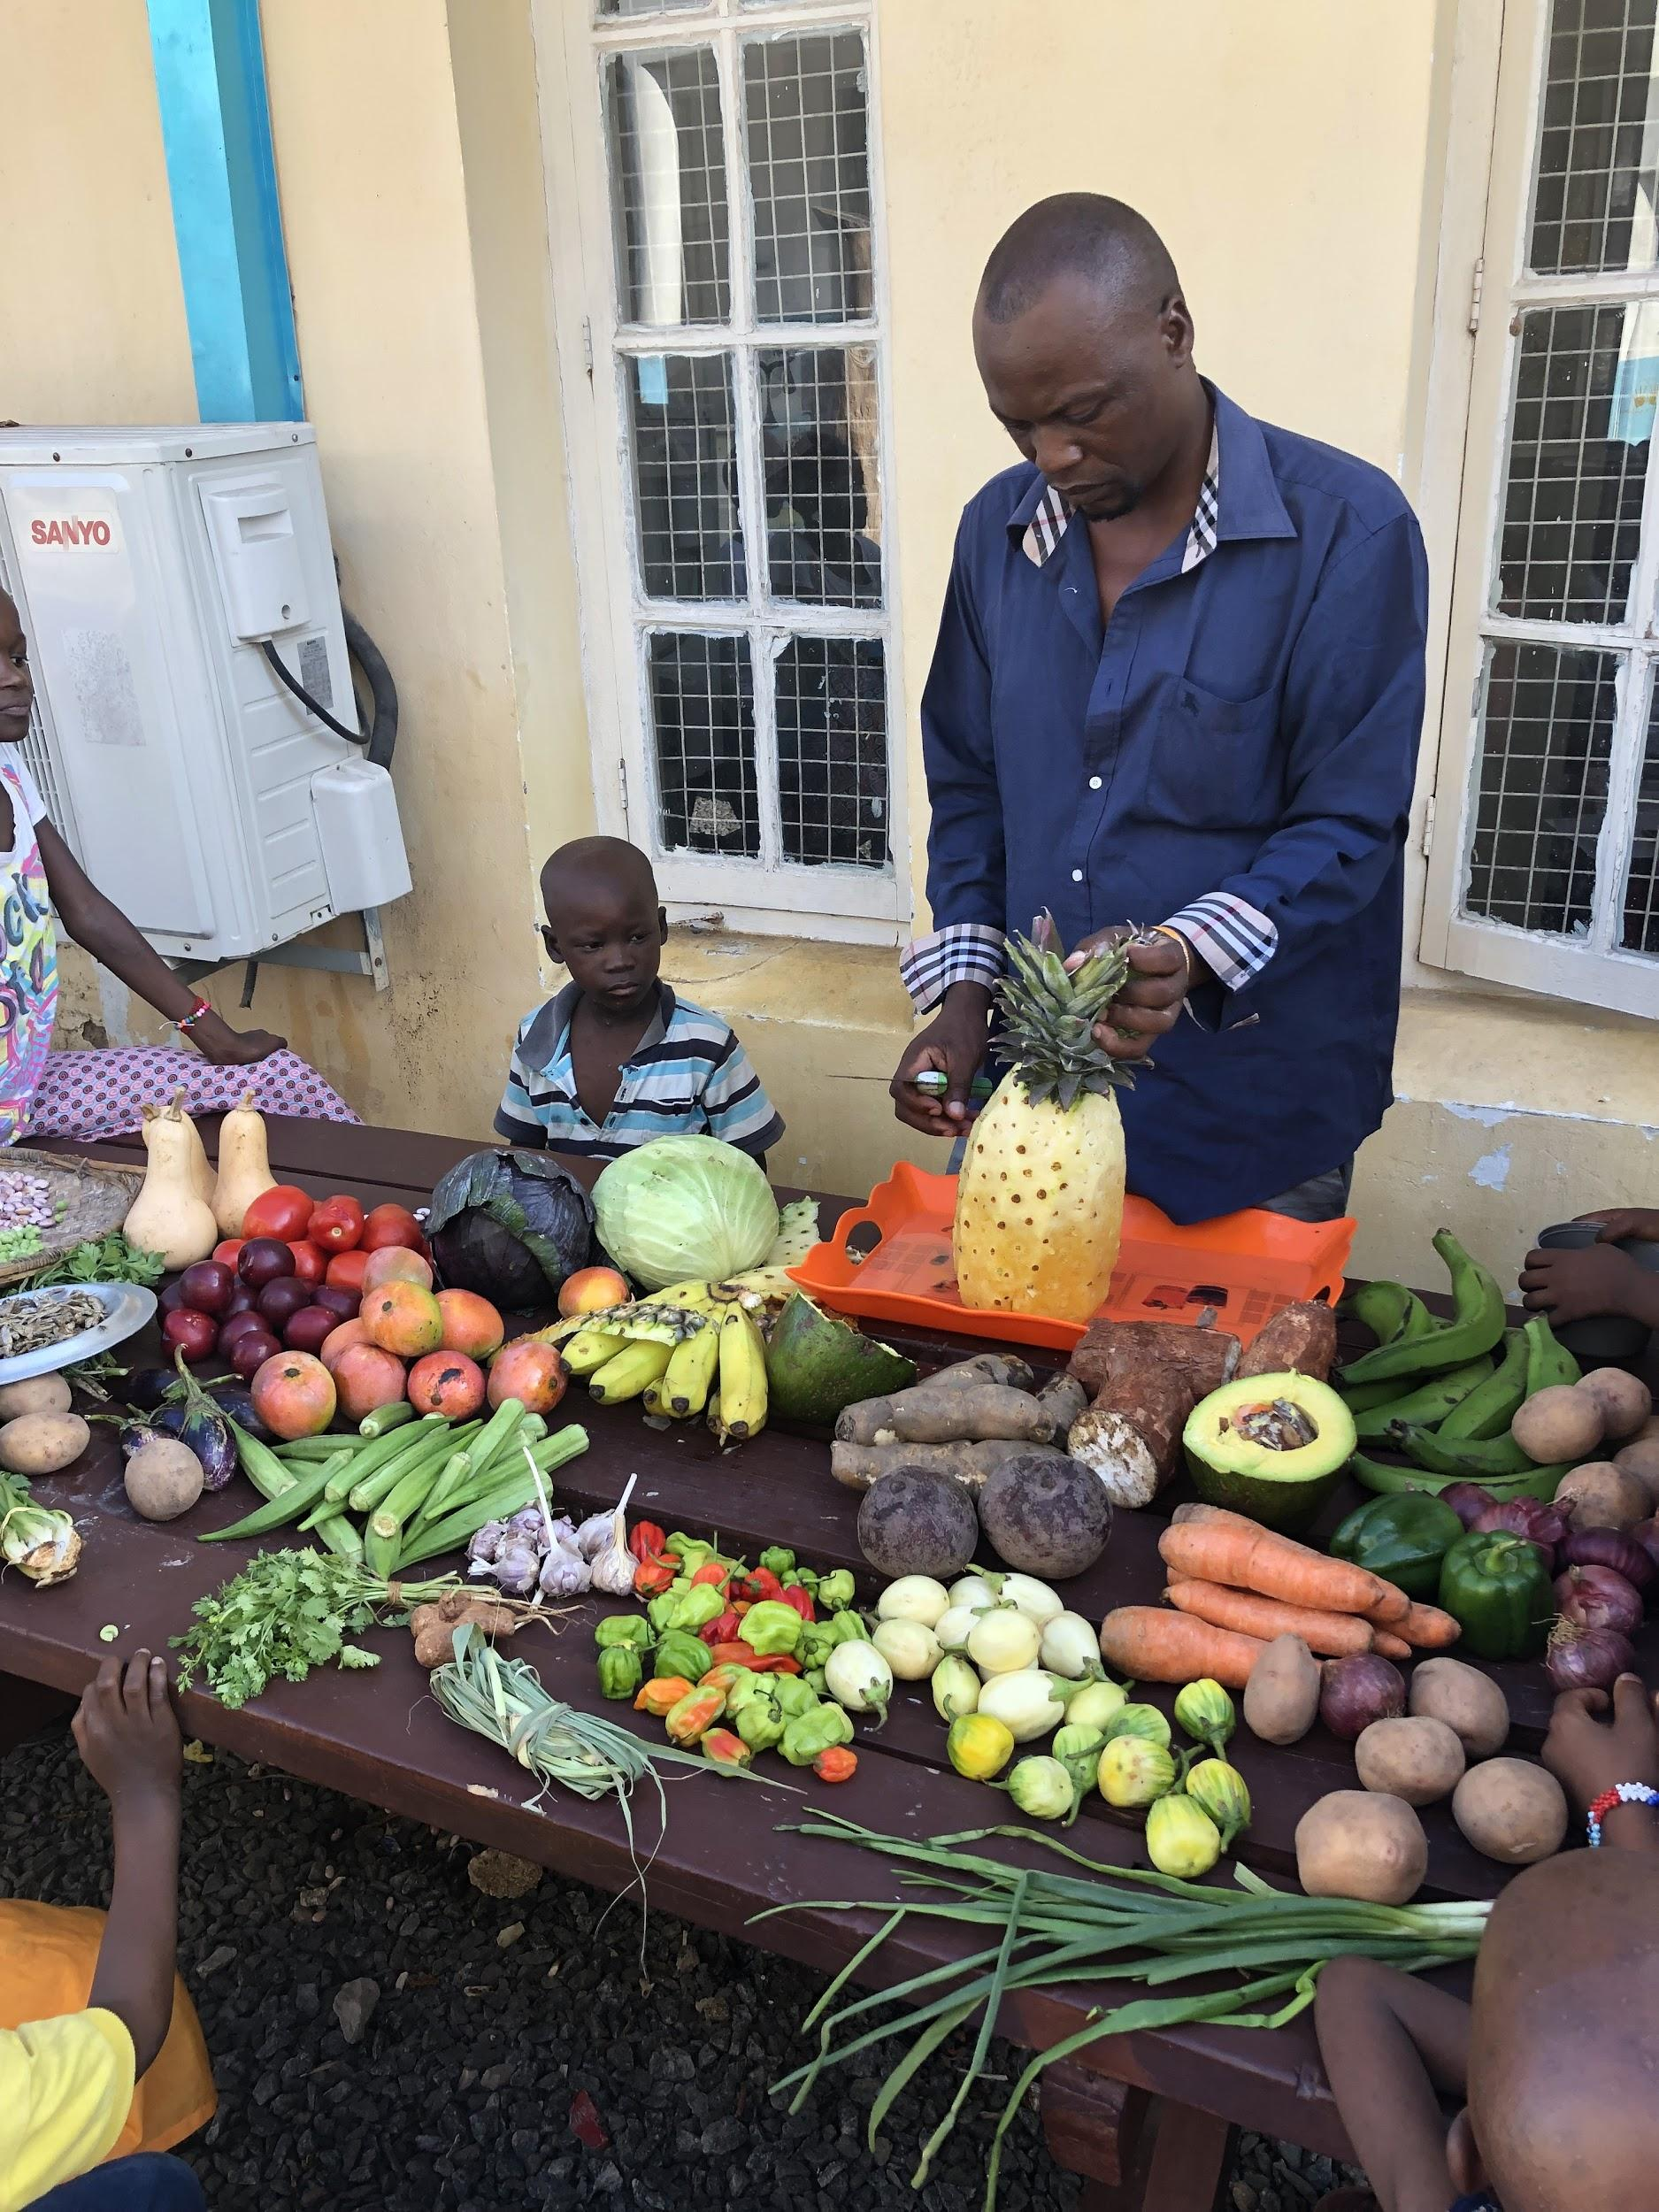
Mums and Dads Involved

Slide 12
Speaker’s notes: Learning by Example
Children copy the habits of their family members and friends. Young children are more likely to eat foods they see others eating, foods that are familiar and food that is available.
If you have good eating habits your child is more likely to follow you
How do we do this?
Encourage family mealtimes and eat with your child regularly
Plan ahead: Young children copy other children when eating at social occasions and children influence each others food preferences and consumption
Try and share new foods with your child
Food preferences may be well developed (but still open to change) by the age of 3 years, so it is important to regularly expose your young child to many different foods
Is it just the parents who are role models?
All family and friends can sit with the children, tell stories and eat healthy food with children

Slide 13
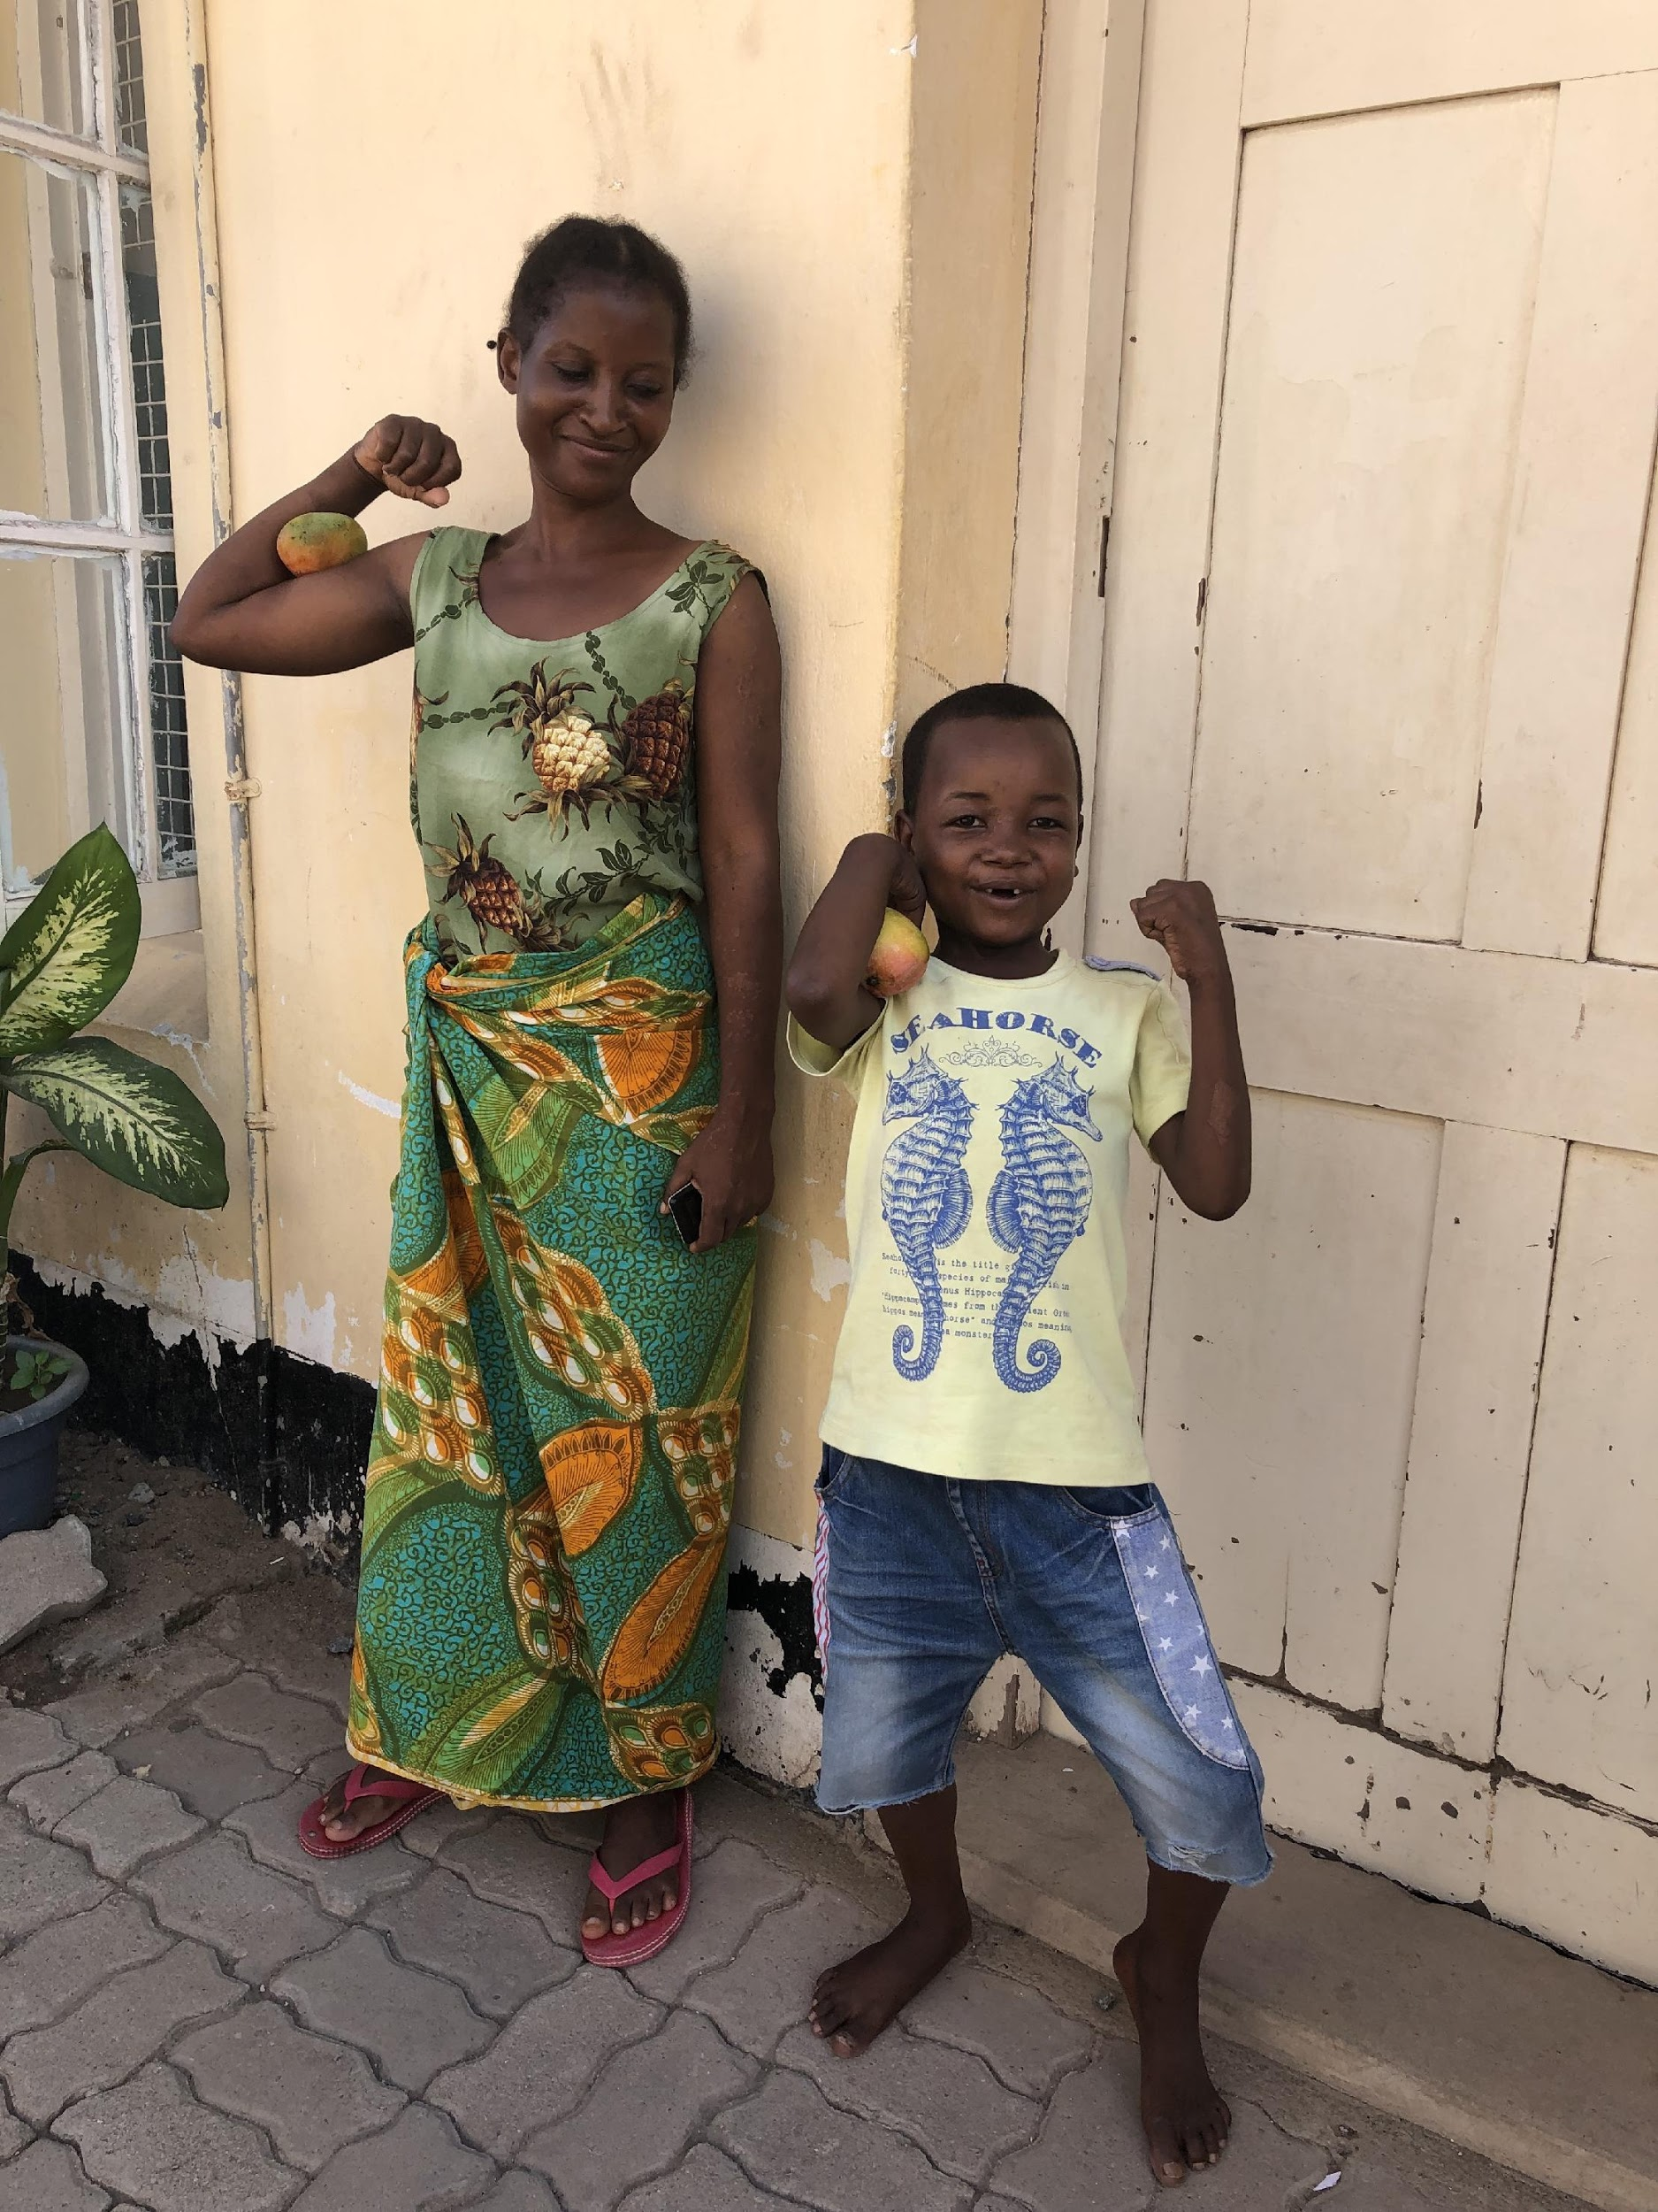
Food for Health:
Be Strong, Think Strong, Fight Sickness!

Slide 14
Speaker’s notes: Food for healthy Growth
Highlight that growth slows down after 12 months. It is normal that appetite change though these periods of growth spurts.
If parents or caregivers are not sure what is normal they can ask the following questions.
Is my child eating a healthy balanced diet from the 5 core food groups (cereal, dairy, protein, fruit and vegetables)?
Is my child growing tall?
Are my child’s gums and teeth healthy?
Does my child’s skin look shiny and healthy?
Is my child strong and happy
Does my child play with others?
If you tick all of these your child is doing well!

Slide 15
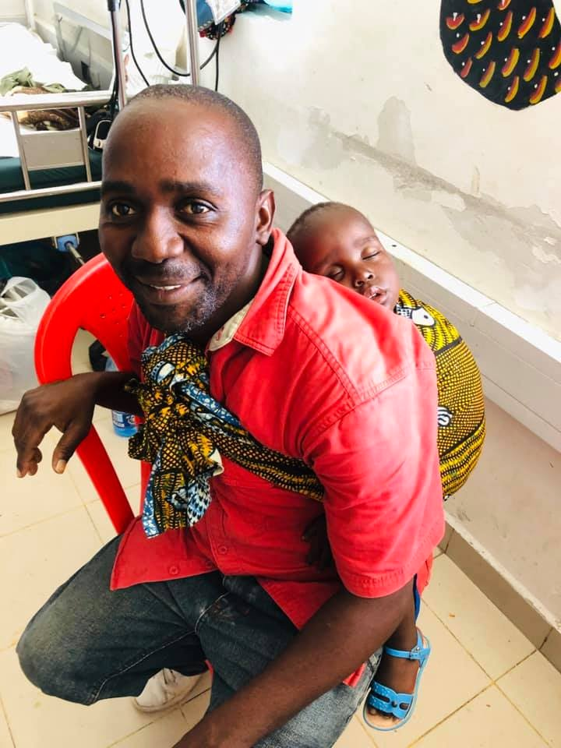
Healthy Growth for Kids

Slide 16
Speaker’s notes: Breast Feeding
Unless you have been specifically advised by a medical professional not to breastfeed, breastfeeding your baby exclusively for the first six months of life is very strongly recommended
It gives all the nutrients your baby needs
It helps your baby to fight infection and stay healthy
It helps your body recover from having your baby
Your baby’s tummy is not ready for any other food
It helps your baby form a strong bond with you
You can continue to breastfeed your baby long after 6 months, even when they start to eat food

Slide 17
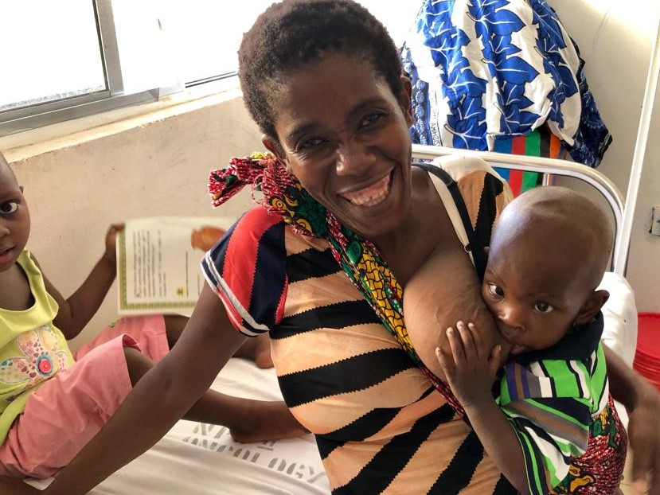
Give only breast milk to your baby for the first 6 months

Slide 18
Speaker’s notes: Introducing solids after 6 months
From six months it is time to introduce solid foods to your baby – your baby’s body starts to need the nutrition from food and will not get everything they need from breast milk
They still need to drink breast milk but should be offered food before milk
At six months old your baby has a strong neck to hold their head up and support swallowing food
Start with very finely mashed foods
You can offer your baby a variety of soft foods including softened fruits and vegetables
Follow your baby’s lead, but persist as it can take many tries for them to like a new food
Gradually introduce more lumpy foods when your baby learns how to swallow well
Your will need to help your baby eat, but as they get towards one year old they will begin to feed themselves. Encourage them to feed themselves when they try to do so.
Start to introduce your baby to drinking water from a cup

Slide 19
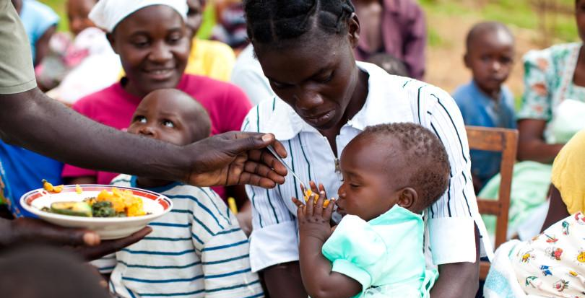
Start food for baby at 6 months old

Slide 20
Speaker’s notes: Toddlers Diet, 1yr old
What can a one year old child do?
Toddler can stand alone and is beginning to toddle
Can sit on a small chair
They can eat as many different kind of foods as we eat
Drinking liquids from a cup, not a bottle or spoon
May need assistance with a cup
Primarily uses fingers to eat
Mealtimes with toddlers involves:
Providing a range of nutritious foods, clean water and some milk
Providing a safe, loving and secure environment where the child can grow and develop.
Making sure the toddler is not having too much milk or dairy as this can displace nutrient rich foods required to grow strong.
Too much dairy can cause weak blood (anaemia) (600ml per day is enough and should only be offered after meals not instead of meals). Do not give bottles during the night as this can rot the teeth unless if it is water.
Being relaxed and ok with changes in the young child’s appetite
Responding to toddler’s hunger and fullness.
Offering and eating a variety of everyday foods
It is normal to have changes at this age which correlate with the slowing of growth or increases in growth. Toddlers may also have less interest in food, and increased awareness of the world around them. “Food jags” occur, these are periods when foods they use to like are refused or they may want a particular food at every meal.

Slide 21
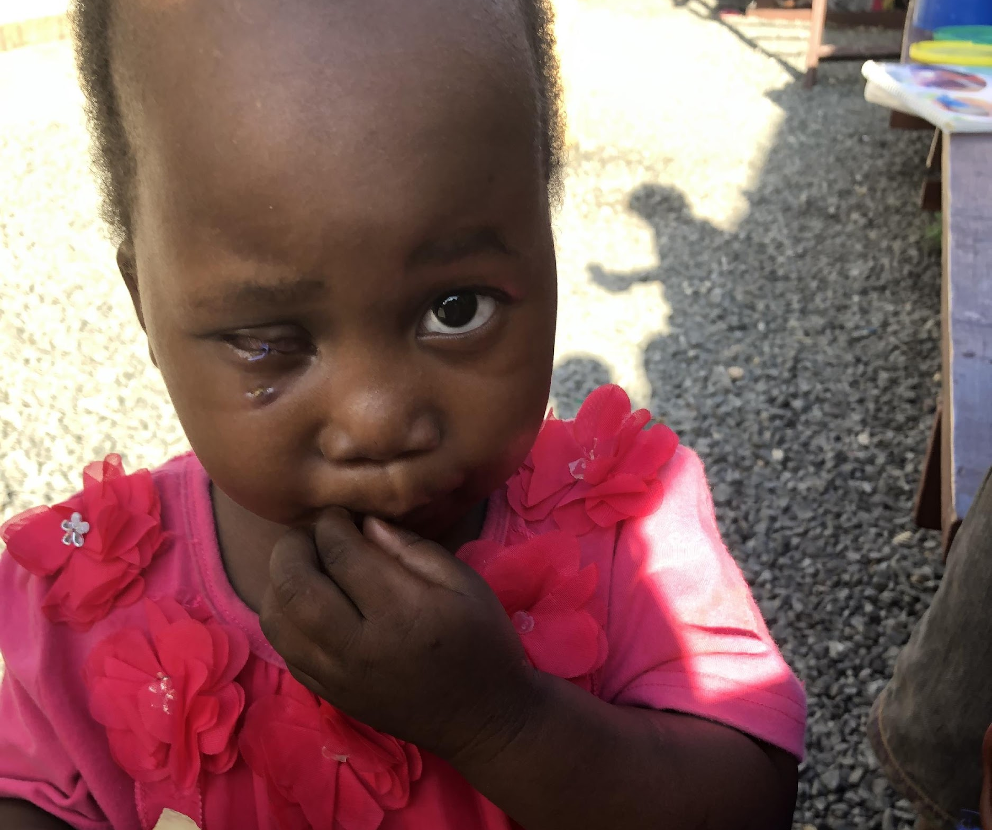
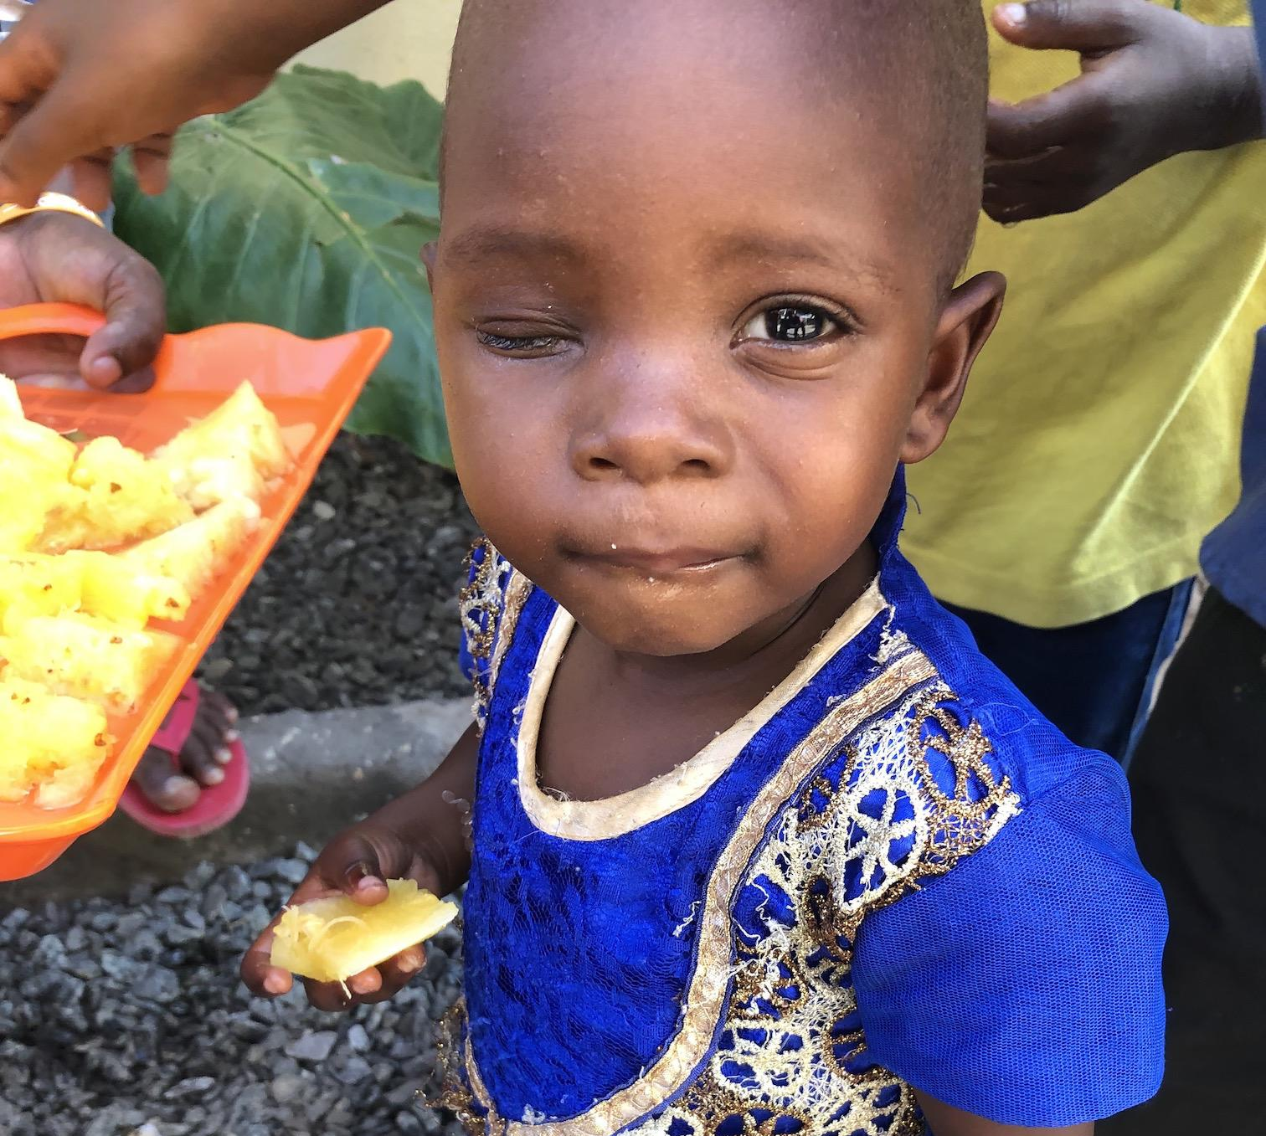
Healthy Food for One Year Old

Slide 22
Speaker’s notes: Toddlers Diet, 2yrs old
What can the two year old child do?
Toddler can walk and is learning to run
Use a short handle spoon, but may prefer to use their hands at times
Helps to self feed
Lifts and drinks from a cup
Helps to scrub, tear, break or dip food
Mealtimes with toddlers:
In the second year toddler growth and appetite slows
You might be surprised at how little they need to eat. Toddlers can have big and small days for eating as they have growth spurts.
Make sure the toddler is not having too much milk – one and a half cups is enough per day
Refer to your community health worker for growth charts to ensure parents and caregivers that their child is doing well.

Slide 23
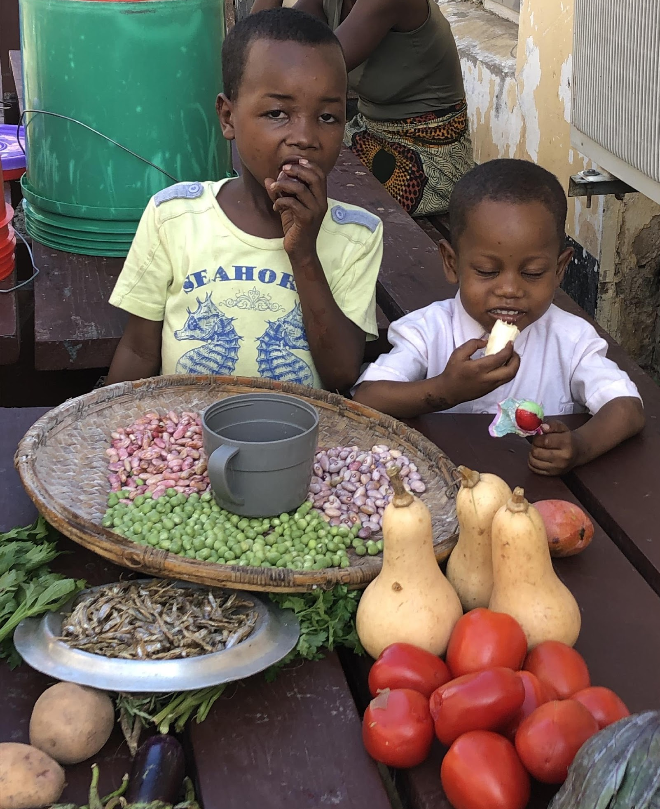
Healthy Food for Two Years Old

Slide 24
Speaker’s notes: Diet, 3yrs old
What can the 3 year old child do?
Jump and climb with confidence
Spear foods with a fork
Feed themselves independently and will say things like “I can do it”
Help, wrap, pour, mix, shake or spread foods
Mealtimes with young children:
Children at 3yrs Eat what we eat
A general rule is to offer one tablespoon of each food for every year of age. Serve more according to appetite.

Slide 25
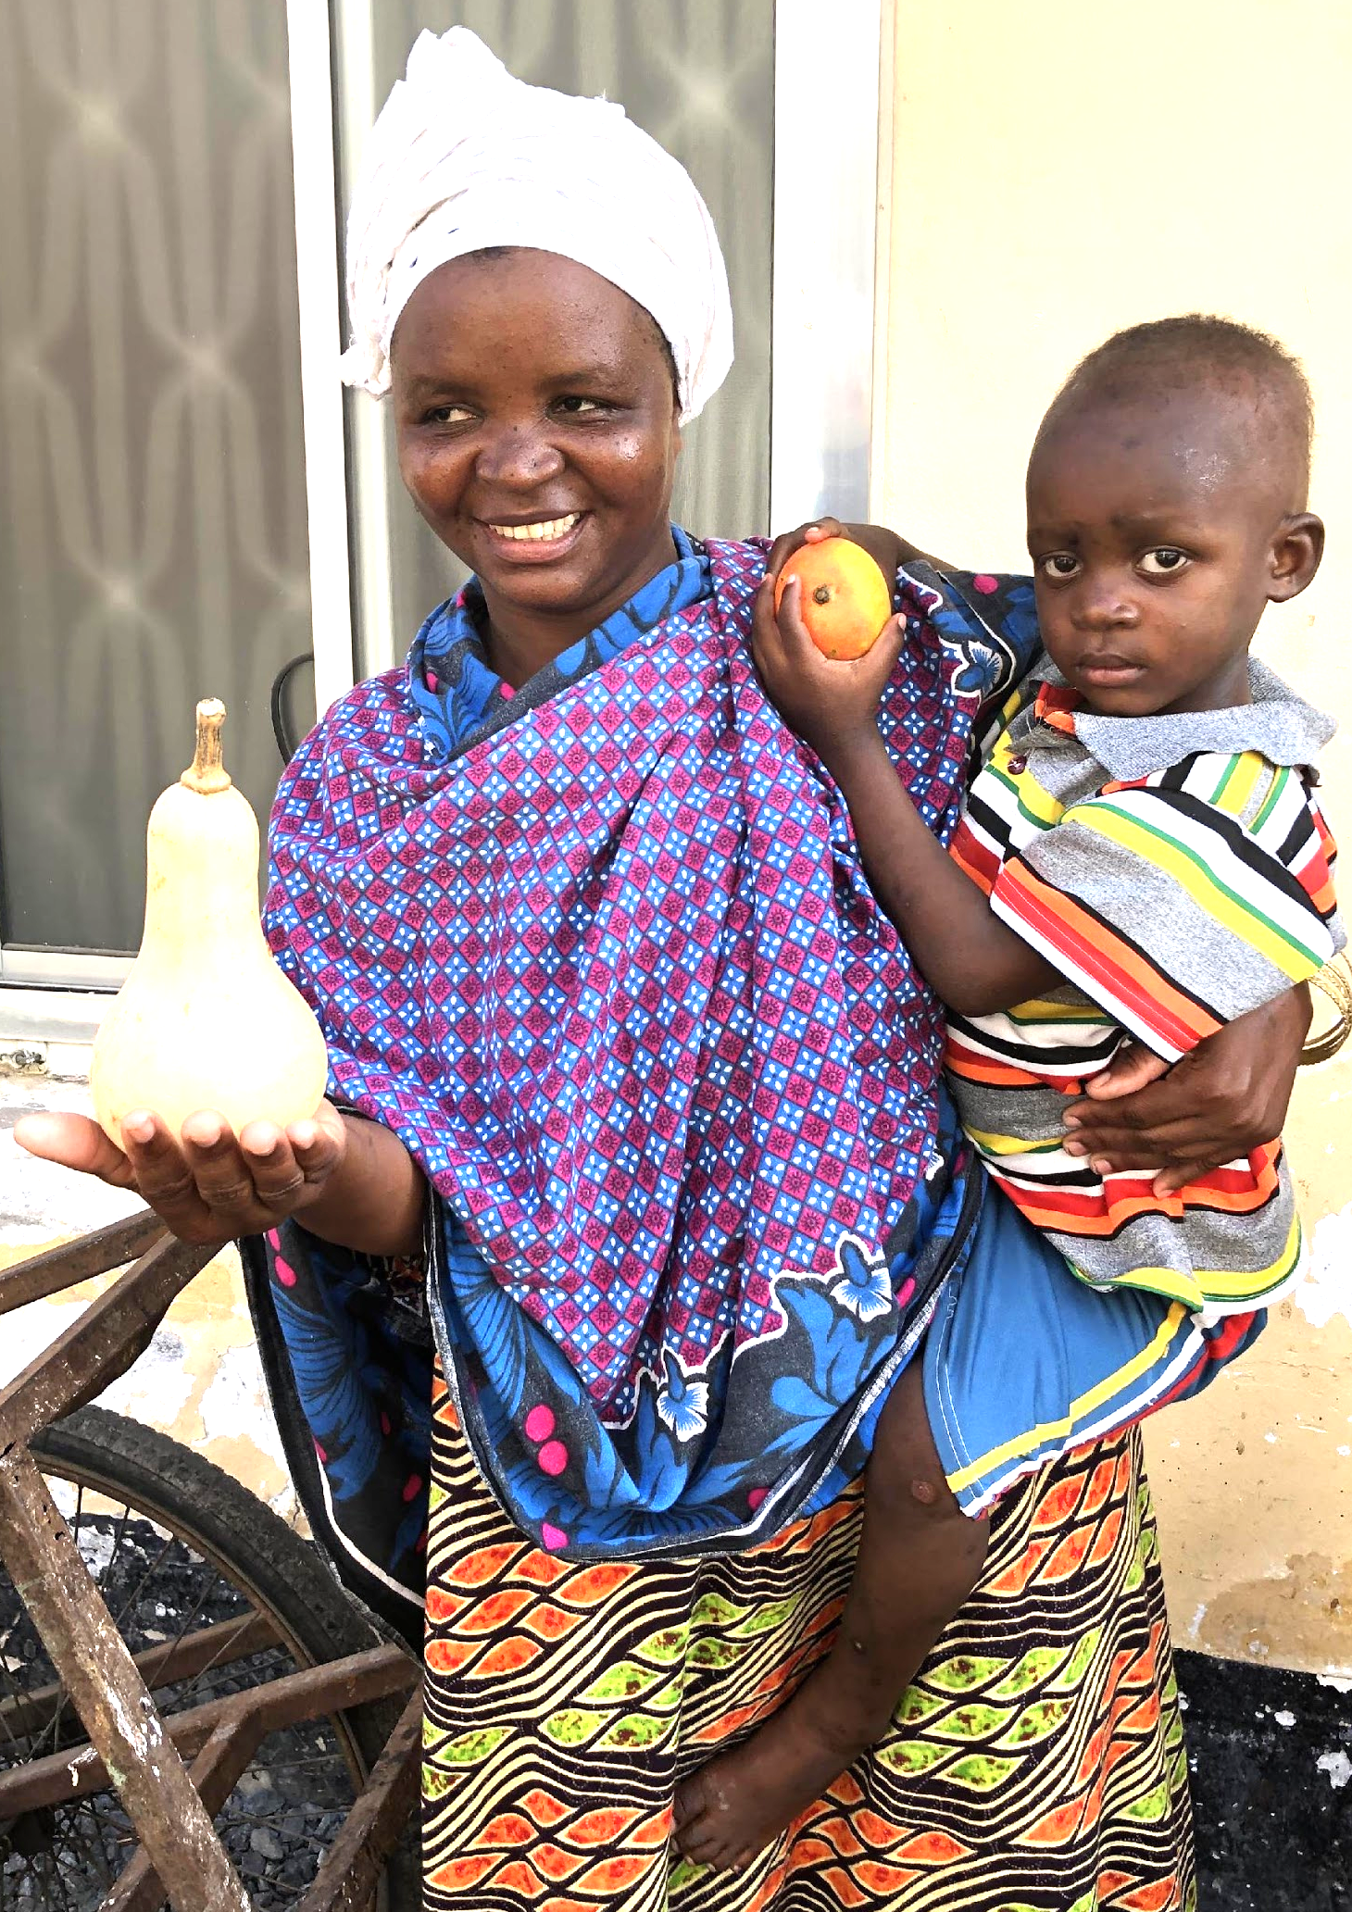
Healthy Food for Three Years Old

Slide 26
Speaker’s notes: General Tips for toddlers
Give small amounts regularly and allow for extra serves if the toddler wants more
Establish good eating patterns by having regular routines for meal and snack times where the toddler can sit down in your company or the company of others.
Ensure there is a variety and nutritional adequacy of foods offered.
Make a healthy snack plate for toddlers, containing healthy snacks such as:
Piece of fruit
Vegetables
Dairy (Milk)
Bread (Chapatis etc)
Nuts
Other ideas from group that could include local foods
Try and serve healthy foods that the toddler enjoys regularly. Keep in mind that likes and dislikes might change over time
If a parent is worried at any time about their child’s health or eating habits, it is important to contact their community health worker or doctor.

Slide 27
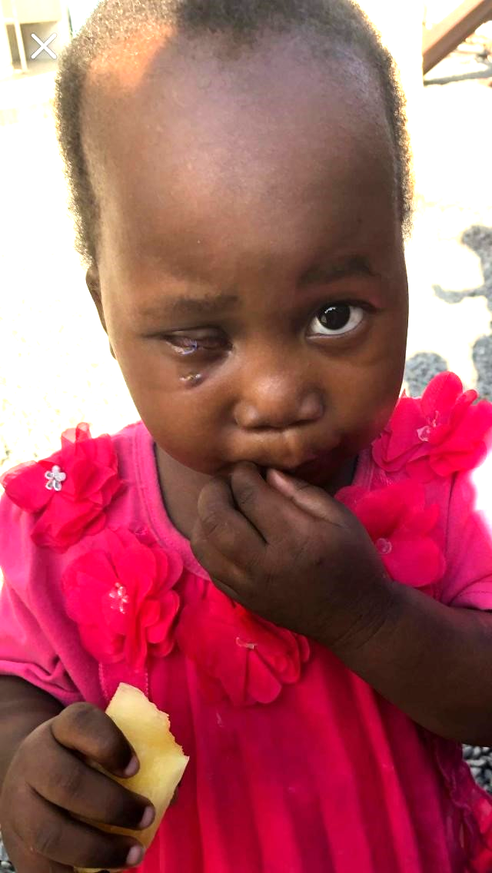
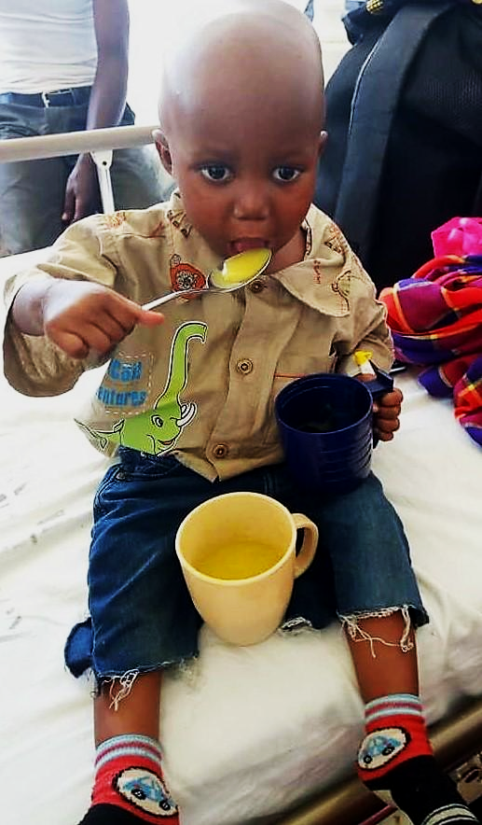
Trust small children to know what to eat and how much

Slide 28
Speaker’s notes: Messy Magic
Expect your toddler to be messy with food, so no need to fuss
Discuss messy eating, have a laugh with stories
To make things easier you can cut food into manageable portions as you may find this easier for your young child to manage.
Offer your toddler the same food that you’re cooking for yourself. Cut it up into smaller pieces or mash. It is also a good idea to serve small portions, just in case the food ends up on the floor.
Young children are messy eaters mainly because they are learning to feed themselves with cutlery, cups and plates. By accepting that accidents happen, it is a lot easier to put up with the mess.
It takes a lot of practice for toddlers to use a spoon without making a mess. Until the toddler can use a spoon properly and feed themselves there will always be a small accidental spills.

Slide 29
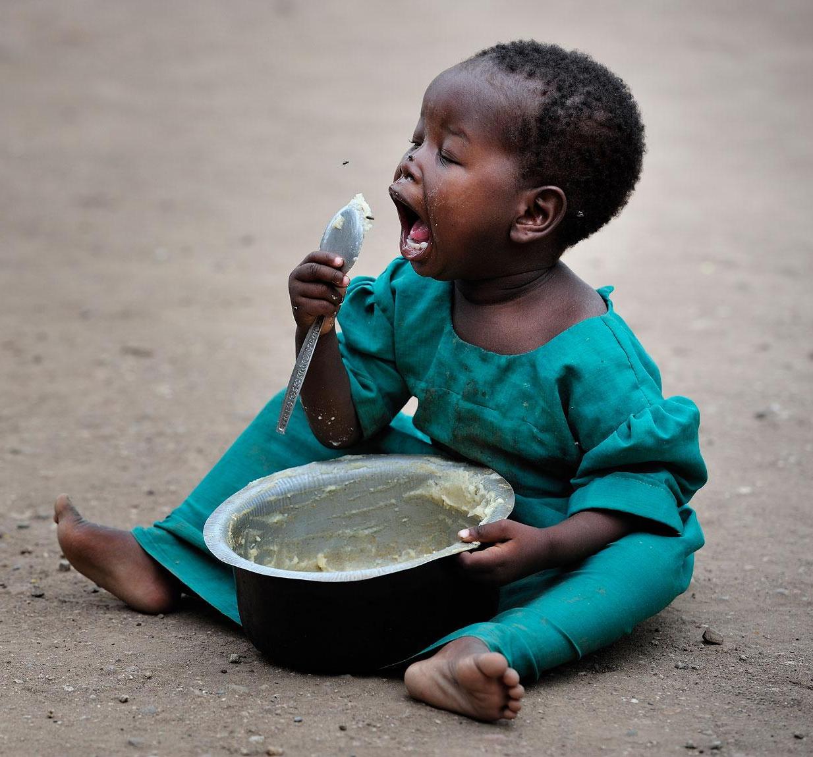
Let your child feed themselves. Toddlers love to explore and play with their food
- SQUISH, SMELL, TASTE

Slide 30
Speaker’s notes: Your little Researcher
Toddlers also like to experiment with their food and may do things like smearing it on their face, this is part of learning and parents should not stress or get upset.
Discuss how children learn about food:
Tasting the food
Feeling it
Seeing the colours
Hearing it crunch
Making their own food
What are other ways children learn about food?

Slide 31
Healthy, Happy Kids

Slide 32
Speaker’s notes:
Additional larger portions may be offered if children are taller or more active.
Five food groups (discuss)
Grain are foods that includes whole grains (wheat breads) and high fibre cereals.
Milk, yoghurt, cheese and alternatives.
Vegetables, choroko and beans.
Fruit
Lean meat include poultry, fish, eggs, nuts, seeds
Points to note
Fruit is better eaten whole as it provides fibre for healthy bowels.
Fruit and vegetables have fibre and nutrients. Eat a variety of fruit and vegetables to maintain healthy body inside and out.
Low fat milk should be avoided in young children.
Think variety, Think Rainbow and offer vegetables such as carrots, peas, beans, pumpkin, sweet potato and fruits such as plums, mangoes, apples, bananas. Wash the fruit and leave the skin on.

Slide 33
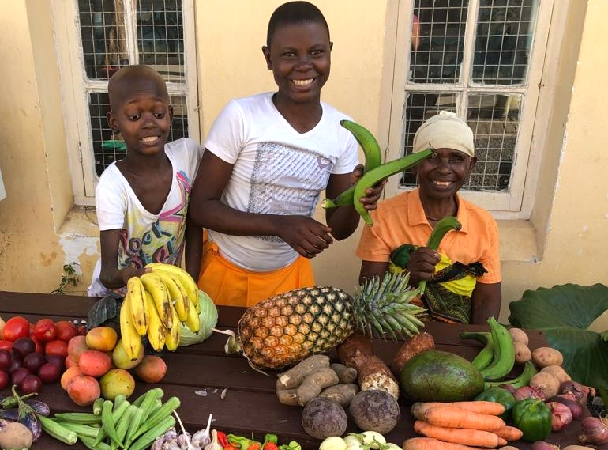
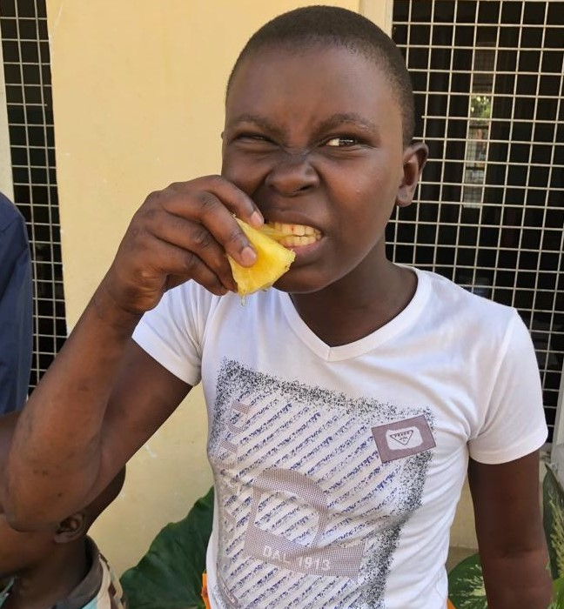
Try Many Foods, Many Times!

Slide 34
Speaker’s notes: Everyday goodness
Bring along and show pictures of the different food groups and the foods needed to grow up strong and healthy that are commonly eaten in your community (or ask participants what are examples of these foods).
Everyday foods are those foods we choose from the 5 food groups.
Some ideas of foods which fit into the five food groups:
Fruit or natural fruit juice
Vegetables
Meat including fish and seafood and eggs
Milk or yoghurt
Cereals and breads (chapati) and grains provide the energy, fibre and minerals you need.
Local foods. Other ideas? You may need to share more appropriate alternatives if participant suggestions are not ideal.
Everyday foods are healthy foods and:
Give you energy
Help you feel happy
Help you feel healthy in mind and body

Slide 35
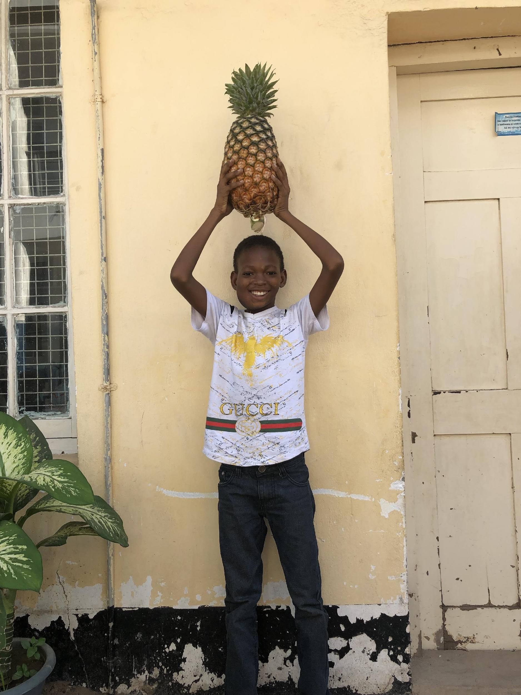
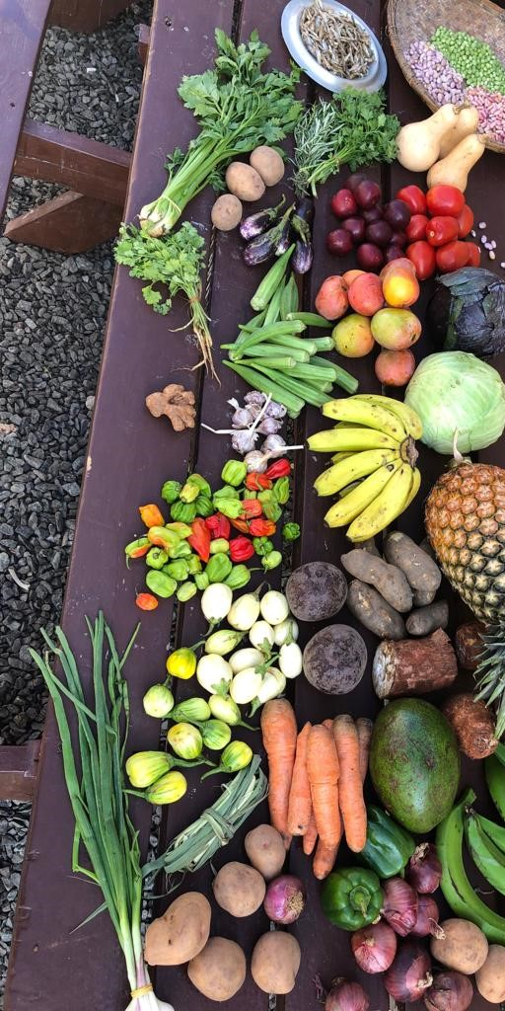
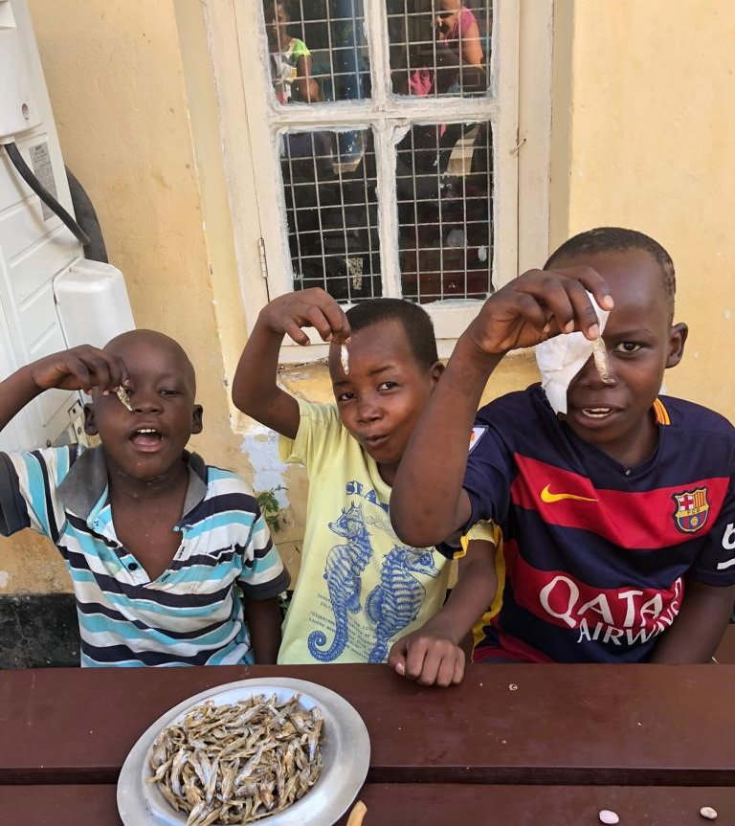
Everyday Foods
EVERYDAY FOODS give you:
Energy!
Happiness!
Health!
Strong bones!
Strong teeth!

Slide 36
Speaker’s notes: 'Sometimes' foods
'Sometimes' foods are foods that we eat occasionally. They tend to:
Taste good but do not contain nutrition
Fill us up without providing the good food building blocks a child needs to grow
Make a toddler feel sick, weak and cranky if they eat too many of these foods or eat them too often.
'Sometimes' foods can:
Make us feel tired with no energy
Make us feel bloated
Make us feel unhappy
And if we eat them too often then the spirit and body gets sick.
'Sometimes' foods to eat less of:
Deep fried foods like chips and other highly greasy foods
Lots of oils and butter in cooking
Snacks like crisps and candy
Discussion point: Discuss foods toddlers don’t need and why….

Slide 37
'Sometimes' Foods – tasty but empty
....Spirit and
Body gets Weak
and Cannot GrOW….

Slide 38
Speaker’s notes: Food Folly
Discuss ideas for not using food as rewards or as a restriction.
Food as a reward of punishment can have both positive and negative influences on children’s food preferences
'Sometimes' foods - Can cause problems if used as a reward for good behaviour.

Slide 39
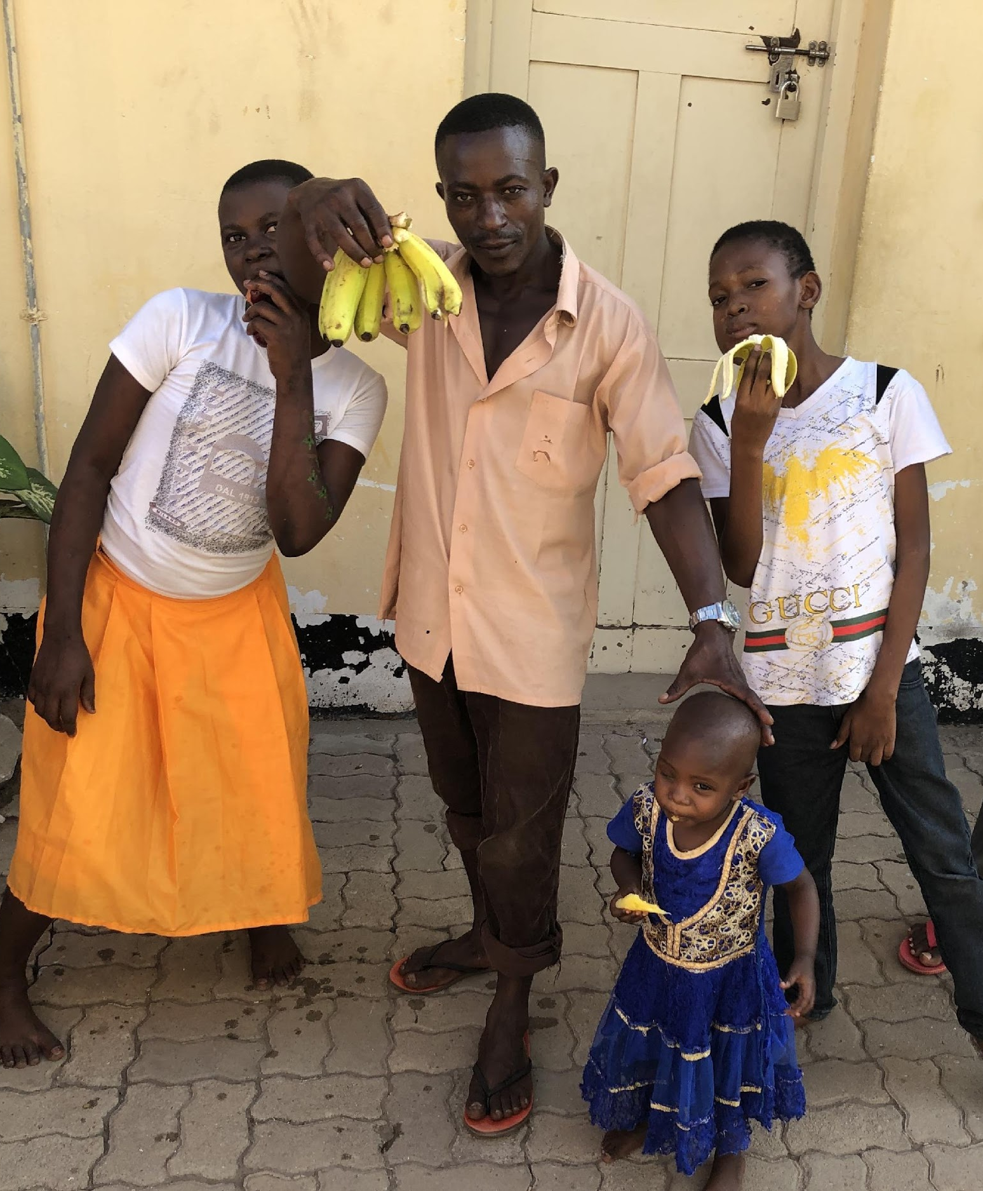
Food for Life -
Neither Reward
nor
Punishment

Slide 40
Speaker’s notes: Water for Life
Water is wonderful:
Water is the best drink for your child
Teach your child to drink from a cup
Give your child water to drink after meals.
Be a good role model: Drink plenty of water yourself and your child will copy you
Water is the best choice as it has no sugar in it to rot their teeth.
Avoid sugary drinks such as tea and soda. Other drinks can contain unhealthy ingredients and additives that are not healthy. Giving your child tea can make them have weak blood (anaemia – low iron).
Contaminated water:
(or water that is not from an ‘improved’ water supply) needs to be treated in the home. Even if it is transported from an ‘improved source’ such as a piped system, transportation and storage in the home can cause further contamination.
Unsafe water increases worms and germs entering the body. This is often a major cause of diarrhea in children. Severe diarrhea has the potential to kill young children. Having diarrhea too often changes the inside of children’s gut so that they cannot absorb the nutrients from their food properly anymore, so they become weak.
Wherever possible, treat all water used for drinking before it is consumed. The common methods are boiling, filtering or solar disinfection (putting water in clear containers in the sun for a minimum 6 hours where the sun’s rays will help kill harmful pathogens).
If water is cloudy (such as if taken from a river) it is important to allow sediment to separate from the water first to make it clearer so that other disinfecting methods work better. You can do this by resting it in a bucket for some time and scooping out the clear water or by using special chemicals or native coagulant plants.
Discussion: What is the best drink for children?
What can you do to encourage your child to drink more water?
How do you treat your drinking water?

Slide 41
Drink Lots of Clean Water!

Slide 42
Speaker’s notes: Happy Teeth
To have strong healthy teeth, we need to look after them. As soon as teeth appear they can get tooth decay. We need to look after teeth as small children need strong healthy teeth to chew food, speak and have a good looking smile.
Dental tips:
Brush your child’s teeth with a toothbrush preferably after each meal, at least twice a day. You can lie your toddler down in your lap if that is easier for you and your child.
0-17 months, no toothpaste.
18months-5 years, use only a little toothpaste.
Small children should be supervised when they are cleaning their teeth. They cannot reach all of the cracks properly.
By 1 year old your child should not be taking a bottle. Offer them a cup from six months old.
Lift the lip and check your toddlers teeth.
What’s BEST to drink?
Mostly water.
Full cream cow’s or goat’s milk after 1 year old (exception is breastfeeding which can continue as long as desired)
Milk has a lot of good nutrients in it such as calcium and protein. Children don’t need too much milk or they will fill up and there will be no room for other healthy foods that are important to make the child grow strong.
Fresh Smoothies – fruit, veg, nuts, spices inside!
Drinks not suitable for small children: Soda, Tea or Coffee, Alcoholic drinks

Slide 43
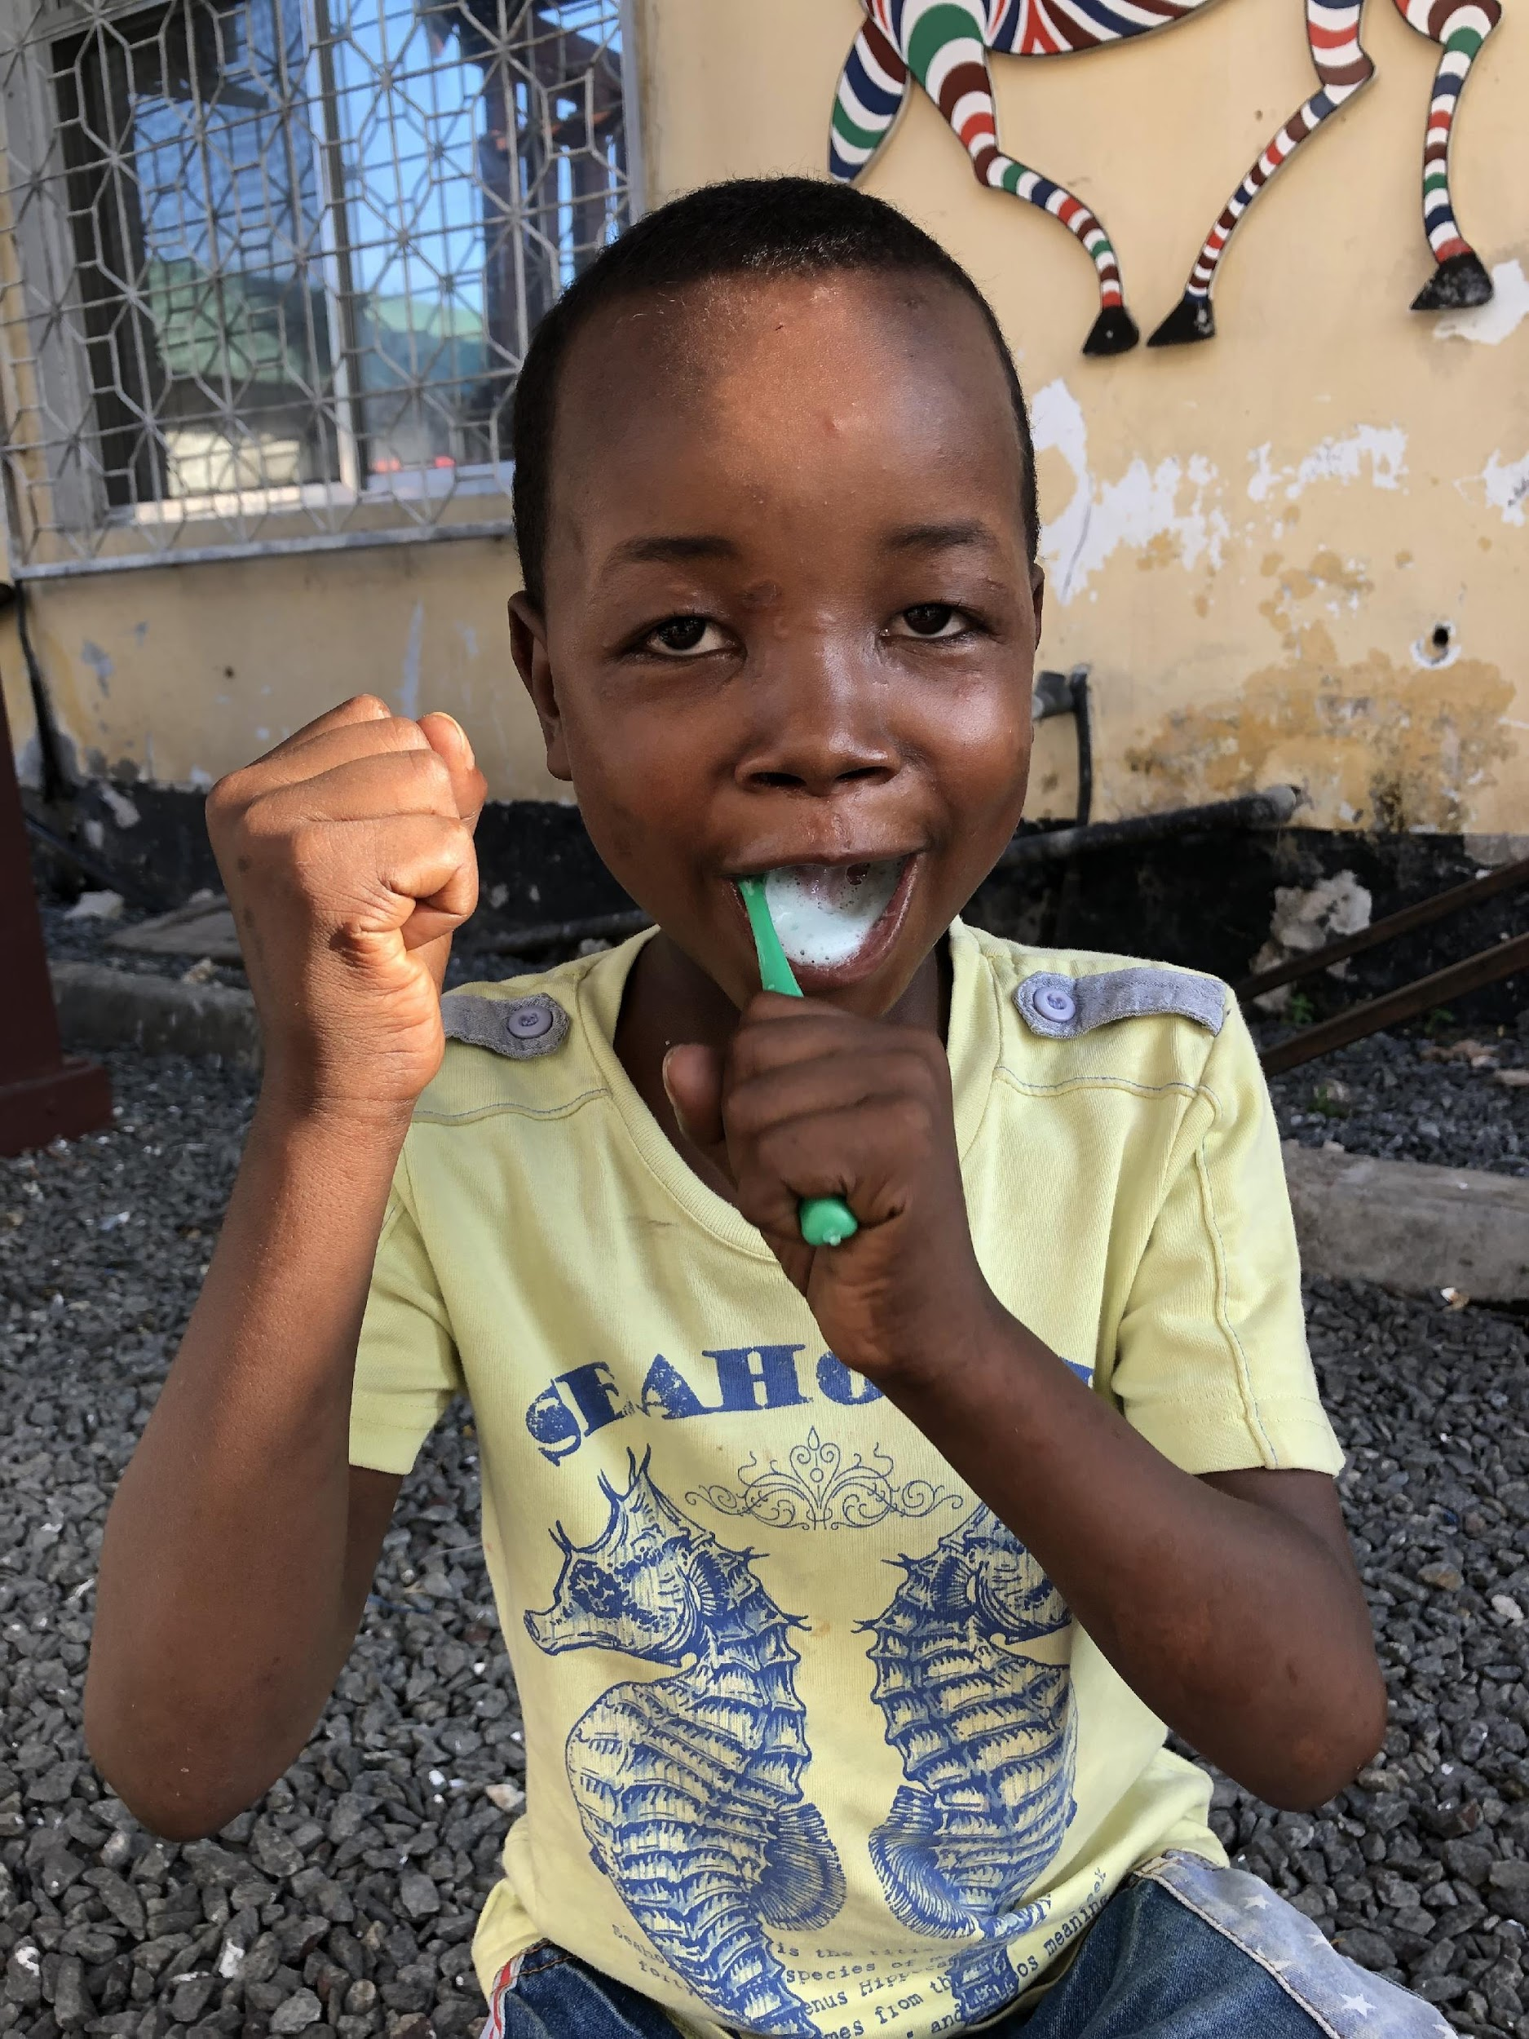
Strong Healthy Happy Teeth
Clean Teeth
after Meals

Slide 44
Speaker’s Notes: Wash your hands!
It is important to wash hands before preparing food, ensure that children clean hands before starting to eat their meal.
Child and adults should wash hands:
Before eating
After going to the toilet, blowing your nose or handling rubbish
Any time your hands look or feel dirty
Other food hygiene tips: Serving utensils and spoons should be used for serving food and not to eat from it
Food dropped on the floor should not be eaten
These can put germs on you that can make you sick e.g diarrhea and vomiting or put you in hospital.
‘No Germs’ protects you and means you can be happy and healthy and strong.

Slide 45
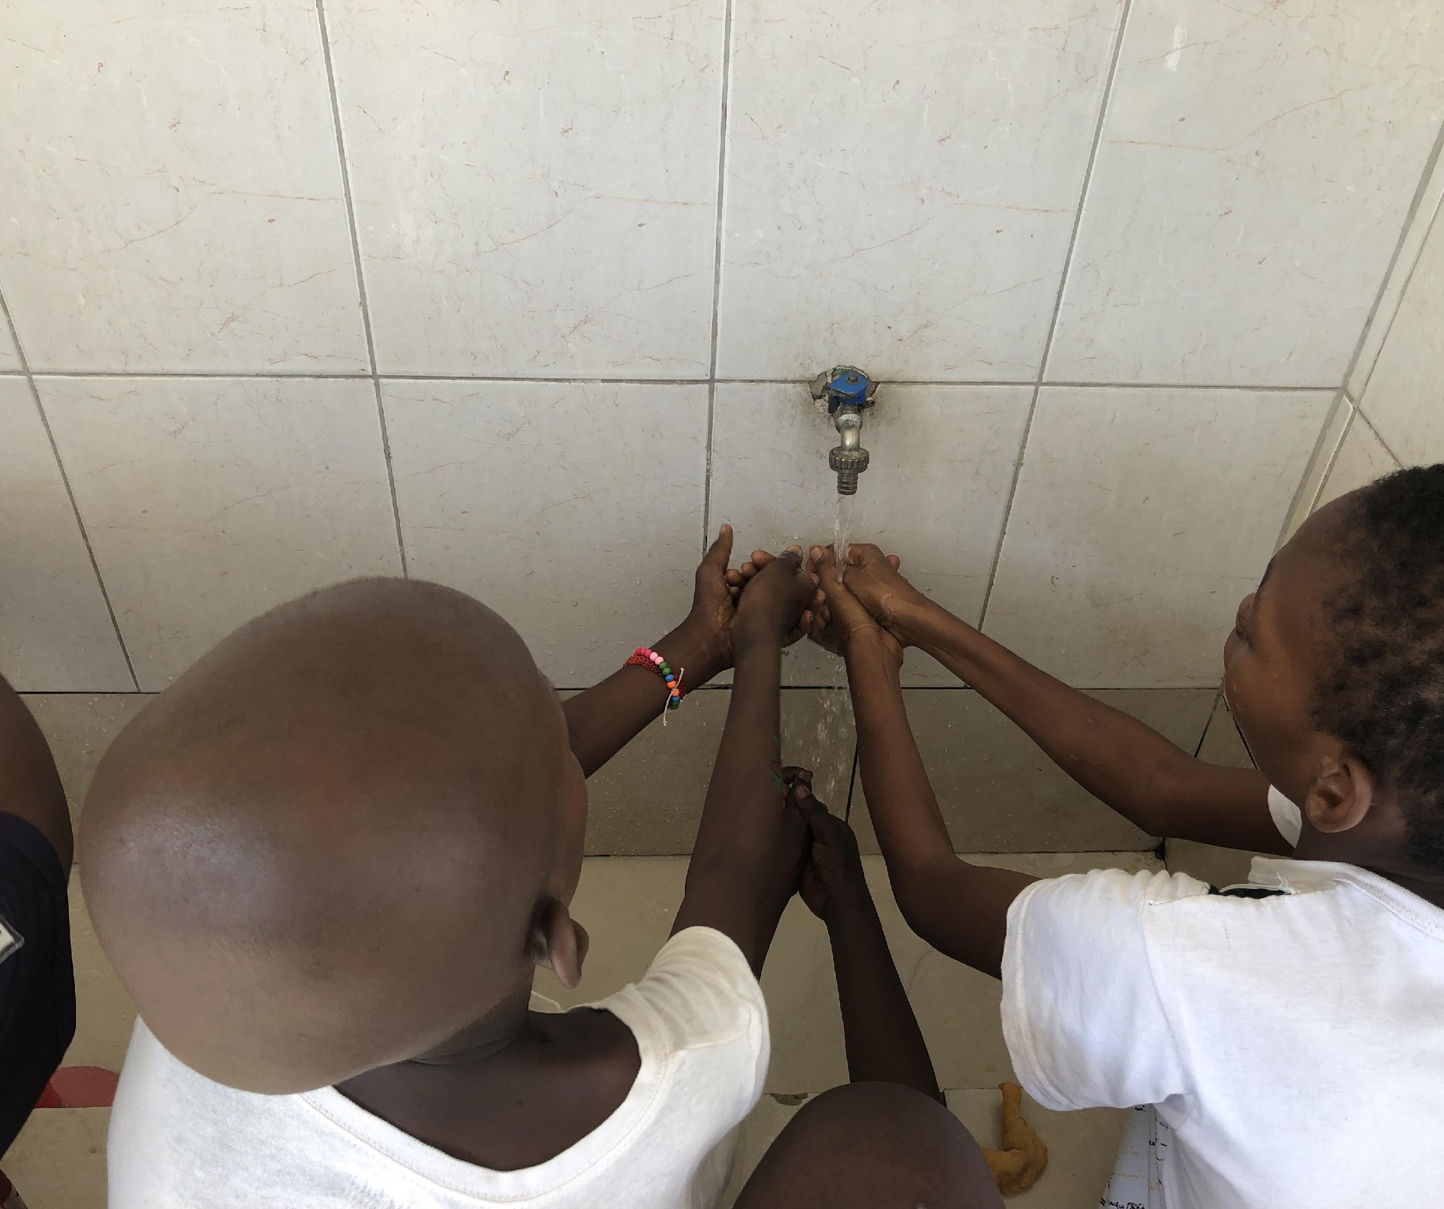
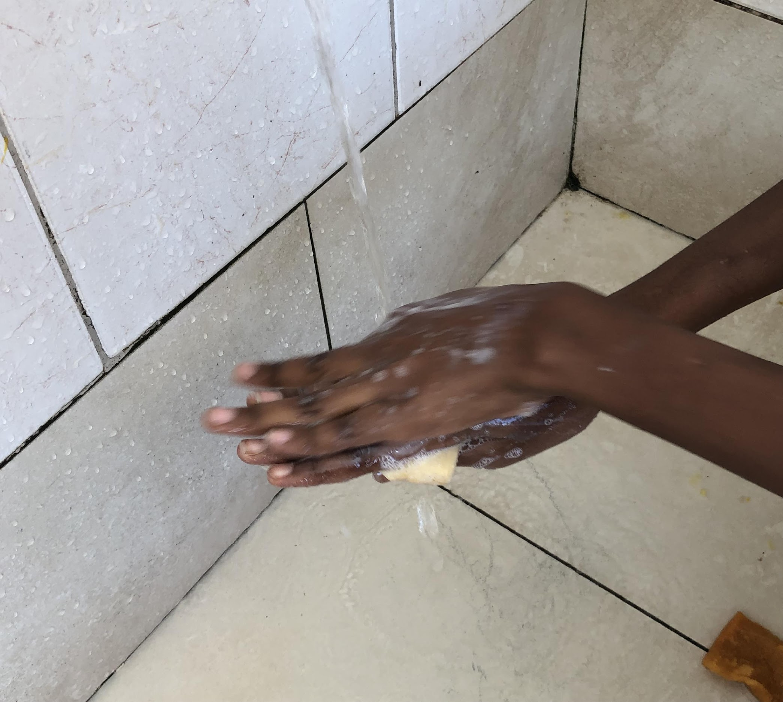
No Germs!
Always wash your hands and face with soap and water!

Slide 46
Speaker’s notes: Keep it clean!
Discuss what ideas participants have for ‘No Germs in the Kitchen’ and why we need to know what to do and how to do this.
How do we make sure there are no germs in the kitchen/wherever food is prepared/served:
It is important to ensure that all cooking surfaces and utensils are clean before use
Always wash your bench top with hot soap and water
Use clean utensils, pots, pans, cutlery
Wash dishes between use with hot soapy water and leave them to dry, rather than using a cloth
Serve and eat food immediately after heating, food should not be left sitting out for too long.

Slide 47
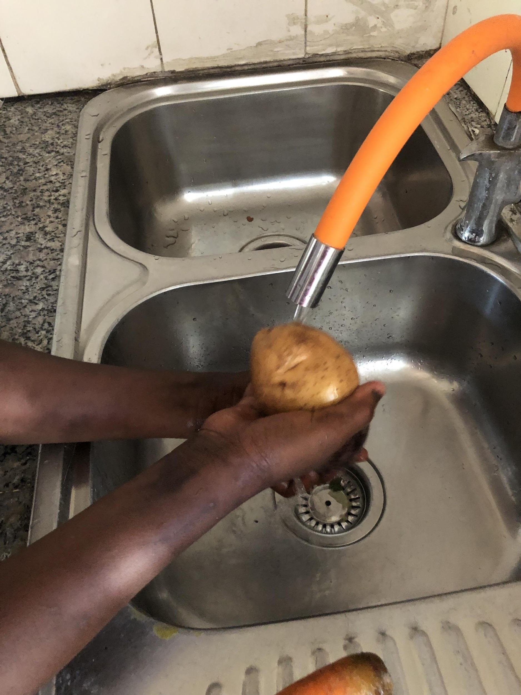
No Germs in the Kitchen! Clean, Safe, Children

Slide 48
Speaker’s notes: Cooking together
Discuss what foods participants make and what fresh ingredients, where possible, the can use to make it healthier.
Fresh ingredients reduce added salt, sugar or fats.
It is very important to involve children in food preparation when they are young, this activity can encourage healthy eating patterns in positive and fun way.
Helping with cooking helps young children learn:
New words
Measuring
To do things step by step
To be patient whilst food is cooking
Doing things together involves mainly watching and learning but small children can help:
Handing the utensils
Put spices and herbs into meals
Decorate salad onto plates
Put cold food onto their own plate
Set the table ready for eating
Help decide what needs to be bought
Put light items away on the shelf
Growing the food (fruit and vegetable garden)
Remember that at this age the small child can’t do a lot, but it is important to give praise and thank them for helping, rather than expecting to teach them to do things perfect.

Slide 49
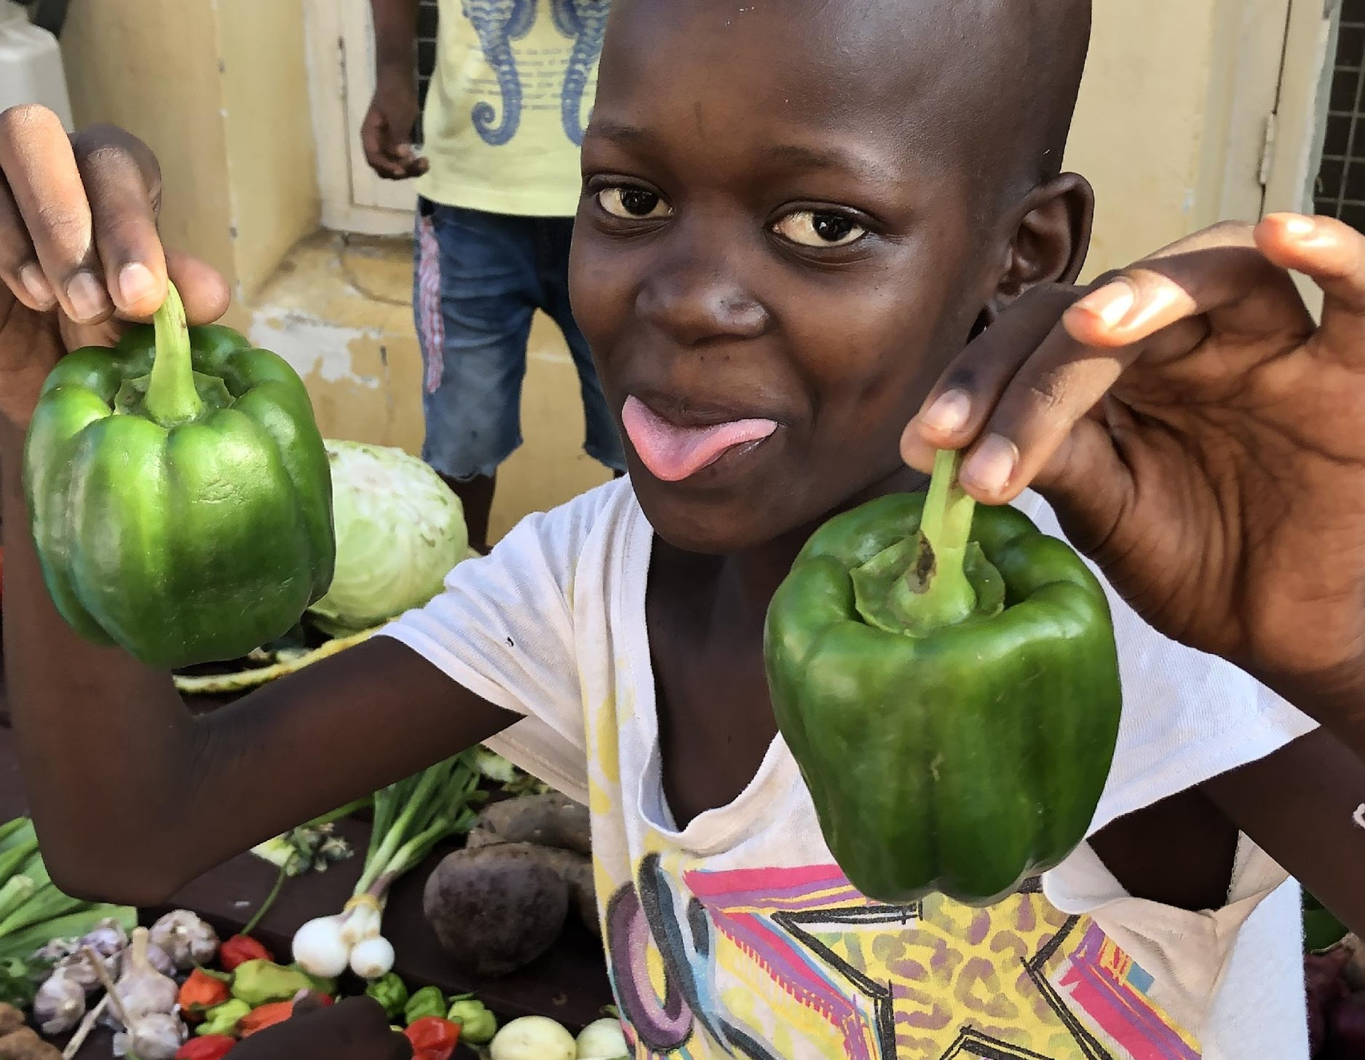
Make your own food
Involve children
in food preparation

Slide 50
Speaker’s notes: Gardening goodness
Growing your own food increases fresh fruit and vegetable intake in a fun and cheap way. It gets you and your child outside in the garden enjoying some physical activity as well.
Discuss and share what you can get from growing your own food?
Create awareness of where food comes from
Growing the food in a fruit and vegetable patch
Your child can help in the garden when planting, weeding and watering
Other ideas?
How can you start? You don’t need to have lots of space, starting with a herb garden in pots is a start.
Community gardens.
School gardens.
Remember to wash your hands after playing in the garden.

Slide 51
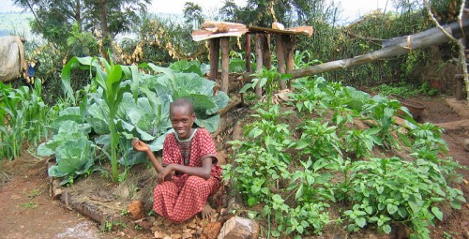
Grow your Own Fruit & Vegetables

Slide 52
Speaker’s notes: Get Moving!
Encouraging physical activity at a young age helps to:
Maintain strong bones and muscles
Improve coordination, balance, posture and flexibility by keeping your child fit and healthy
Maintain a healthy weight and reduce the risk of poor health as children get older.
Enjoy being outside and connect with the land and have fun.
An active child is more likely to:
Be more confident
Be happy and relaxed
Sleep well
How to encourage moving and playing?
At a young age the child should be encouraged to free and unrestricted play rather than specific activities
A young child should have at least three hours of physical activity spread throughout the day
Encourage play and activity outside in the garden or in the park rather than watching TV
Be active yourself and your toddler will follow your example.
Spend time with your toddler doing fun activities like playing in the garden, jumping and catching ball.
How much screen time should a child have?
Under 2 years of age, children should not watch TV
Between 2-5 years children should have not more than 1 hour of screen time a day

Slide 53
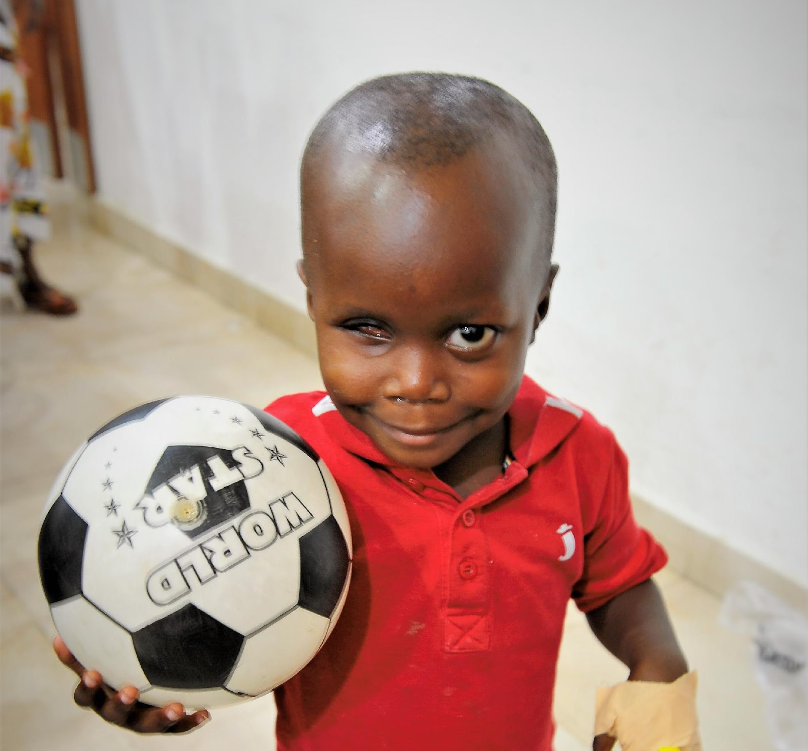
Move and Play Every Day

Slide 54
Speaker’s notes: Health checks
Once you leave Upendo ward please continue on this healthy journey with your children.
It is important as parents and caregivers that you access health services for you and your child regularly.
This will help keep our children growing up strong. Young children are at high risk of early death and higher rates of disease and sickness. Upendo Families know this better than anyone!
What services do you know of and like in your area? Do you know how often you should visit them?

Slide 55
Visit your Health Clinic Regularly... Check your Child is on a Healthy Journey

Slide 56
Speaker’s notes: Role model Parents
Reinforce the importance of parents and caregivers as role models to children
Perhaps ask what they have learned from the presentations about role modelling and what they might like to do better or differently?
Children are more affected by what they parents and caregivers do rather than what they say
Stress the need to make sure they take time to show children how to do things and involve them as well as to explain what the parents and caregivers are doing and why.
Children rely on us to grow them up strong and healthy.
And we want them to:
Feel good
Have strong bones
Have strong teeth
Have strong blood; and
Think smart.

Slide 57
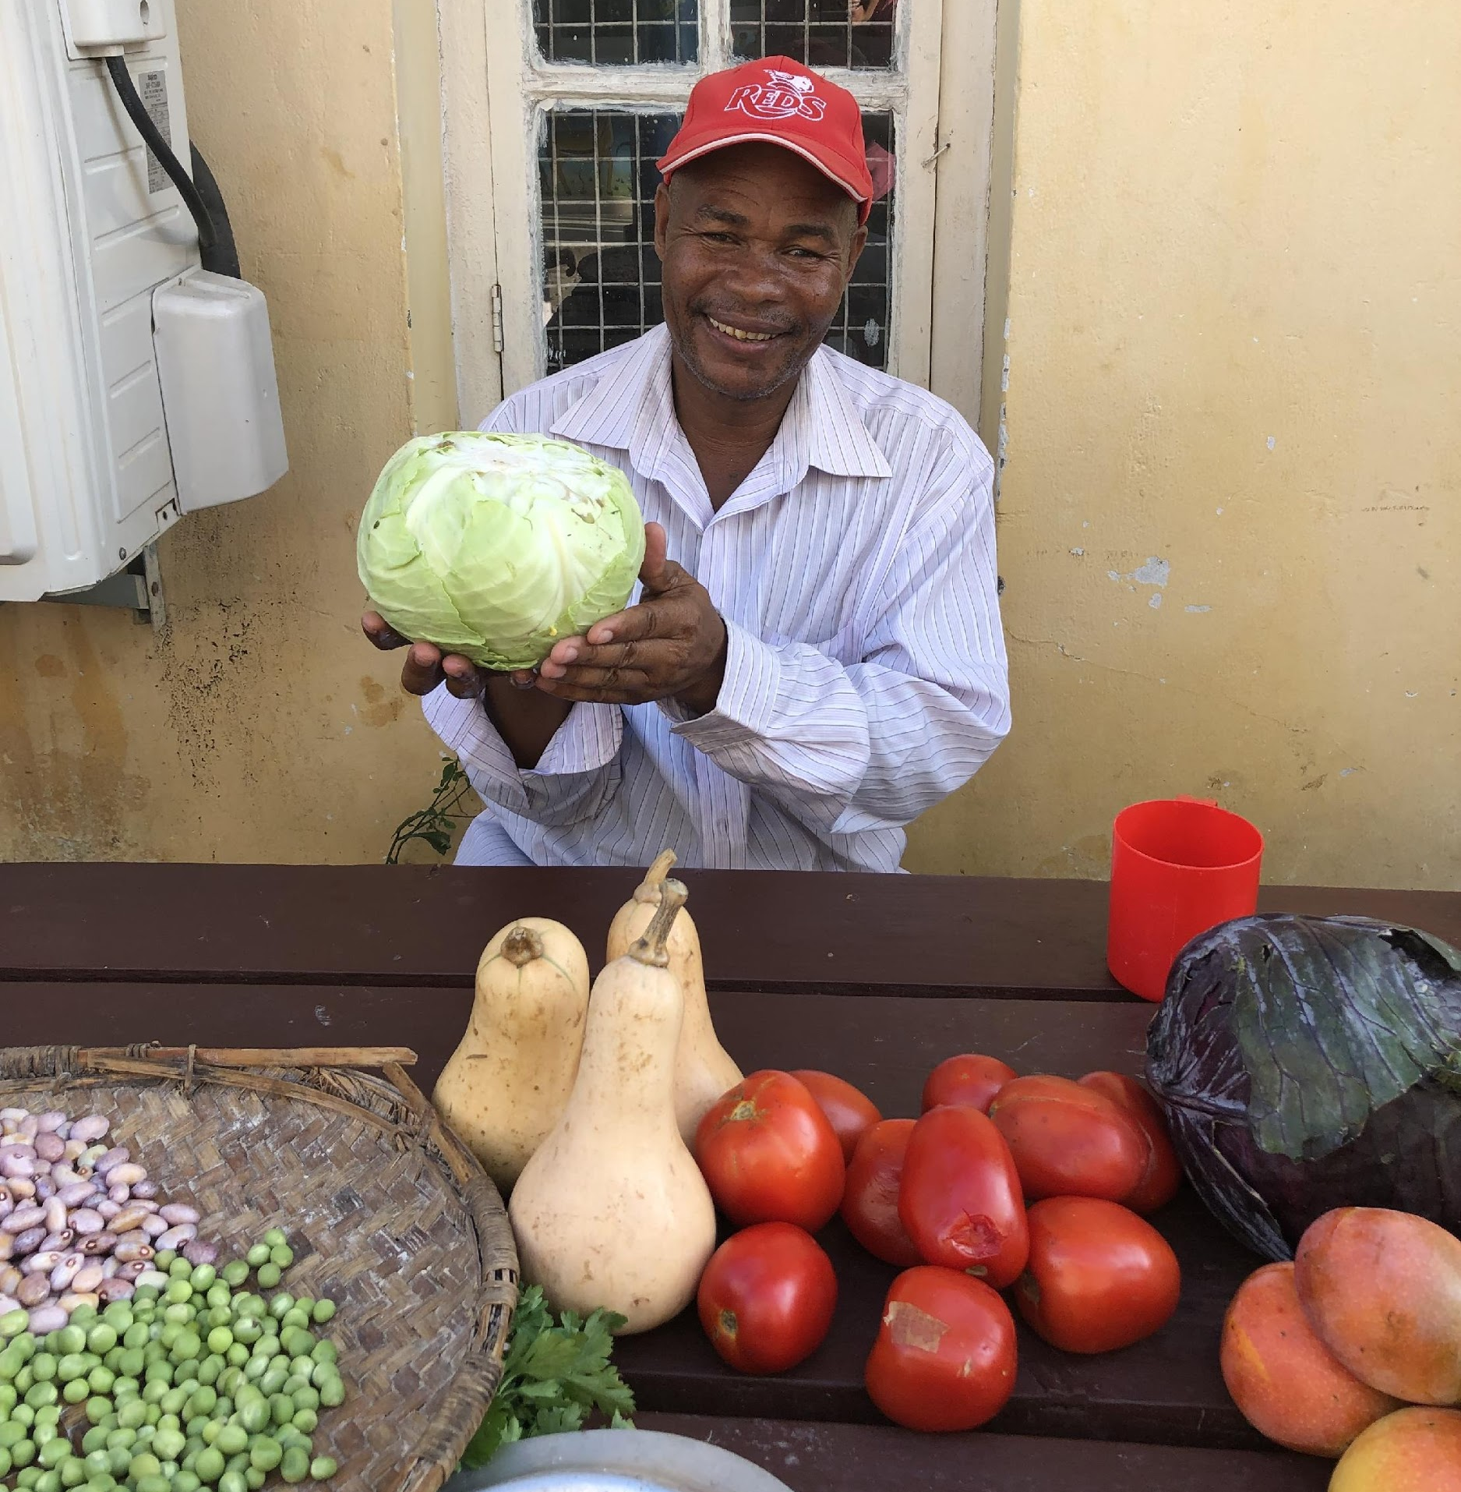
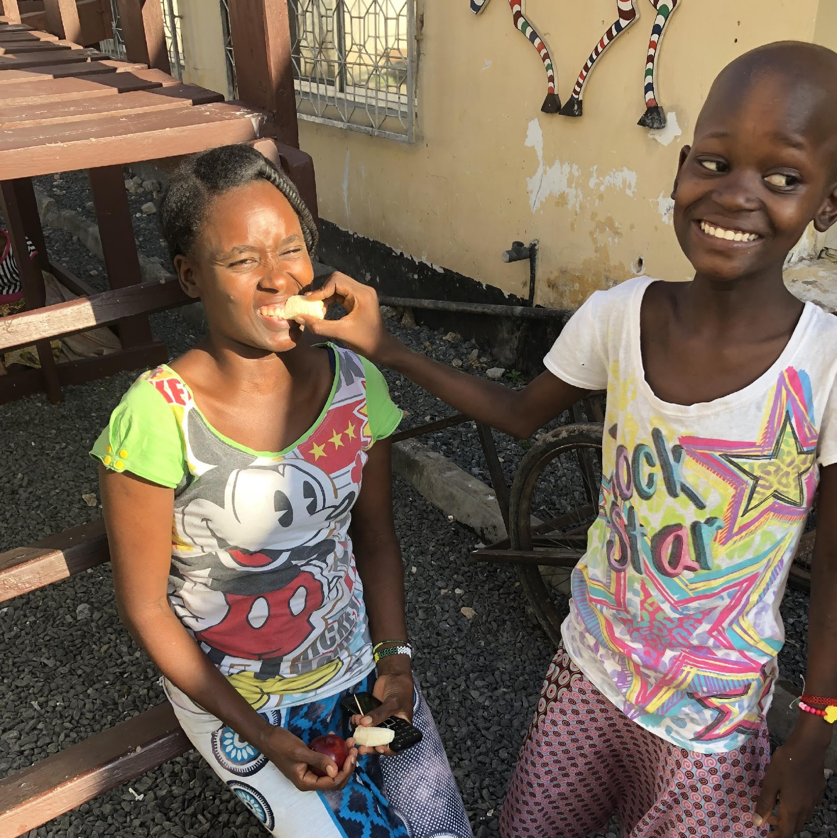
Remember……. you are their role models!
You set the example for healthy eating

Slide 58
Speaker’s notes: Summary
Does anyone have any comments, questions or concerns?
Reinforce with the group that it can seem that everyone is an expert on your child and wants to give advice, but remember that you know your child best. So value yourself as an expert on your child, no one knows your child as well as you do
Your feedback is very valuable and very welcome

Slide 59
Food Comes In a Rainbow of Colours

Slide 60
Speaker’s notes
Thank you for coming along and participating today

Slide 61
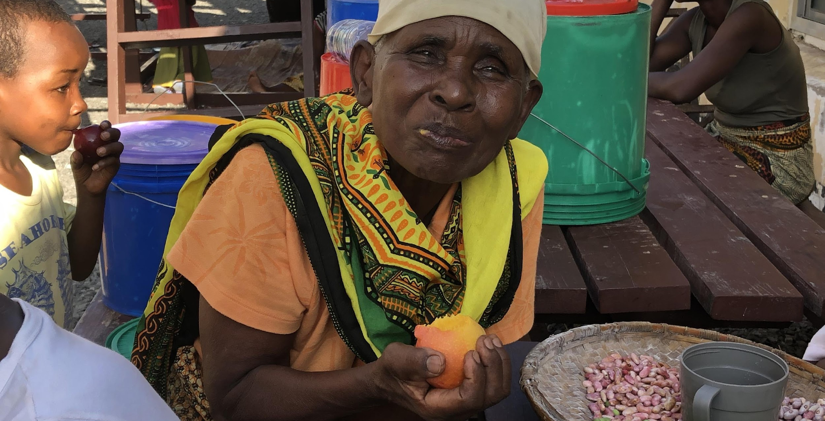
Questions?

Slide 63
Thank you!

