Slide 1


Paediatric
Pocket Guide
Edition 4: Revised August 2020

Slide 2
Cardiac Arrest first steps
1 | Check | Call | Compress
 | Child is unresponsive or only gasping | Shout for help! | Push hard and fast on the chest at a rate of 120 compressions per minute
2 | Check pulse every 2 minutes | Call the senior on-call and ICU for anaesthetic help | Continue effective CPR @ 15:2 Give breaths with Bag-valve-mask

Slide 3
Cardiac Arrest management
Continue CPR
15 compressions : 2 breaths
Give adrenaline IV asap
0.1ml/kg 1:10, 000
Check pulse every 2 minutes
Continue to push adrenaline IV every 4 minutes

Slide 4
Patient assessment
Airway Breathing | Patent airway? | Noisy breathing?
 | Respiratory rate | Too fast or too slow?
 | Respiratory distress | Working too hard? Or not enough?
 | Oxygen saturation | Low?
Circulation | Heart rate | Too fast? Too slow? Irregular?
 | Blood pressure | Too high? Too low? Changed?
 | Capillary refill time | >2 seconds?
 | Skin temperature | Febrile? or Check the feet – cold?
Disability (neurological) | Conscious level | AVPU
Exposure | Temperature | Too warm? Too cold?
 | Pain | Needs more pain relief?
 | Rash | Allergy? Sepsis?
 | Wounds | Bleeding? Discomfort? Infection?

Slide 5
Need to know normal resting heart rates for the age of the child

Slide 6
Reasons heart rate may change in paediatric oncology patients
Respiratory distress
Pain
Pyrexia
Bleomycin may cause pulmonary toxicity
(long term side effect)
Hypovolaemia
Cardiac abnormalities
Pressure from tumours
Fluid volume excess
Anaemia
Hypovolaemia
Anaphylaxis (eg: asparaginase, carboplatin, etoposide)
Medication
Anxiety
Hypoxia
Impending cardiac arrest
Opioids, benzodiazepines
Increase:-
Decrease:-

Slide 7
Important to know normal respiratory rates for the age of the child

Slide 8
Reasons respiratory rate may change in paediatric oncology patients
Respiratory distress
Pain
Pyrexia
Bleomycin may cause pulmonary toxicity
(long term side effect)
Hypovolaemia
Cardiac abnormalities
Pressure from tumours
Fluid volume excess
Anaemia
Anxiety
Respiratory failure
Anaesthetic agents
Opioids
Benzodiazipines
Increase
Decrease

Slide 9
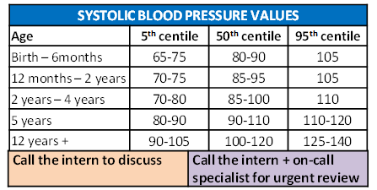
Need to know normal blood pressure ranges

Slide 10
Reasons BP rate may change in Paediatric oncology patients
Fluid overload
Medications (eg: ciclosporin, steroids)
Pain
Anxiety
Renal problems
Sepsis
Shock
Hypovoleamia
Anaphylaxis
Medications (eg: etoposide especially if given too quickly. Best given over 2-4 hours)
Opioids, benzodiazepines
Increase:-
Decrease:-

Slide 11
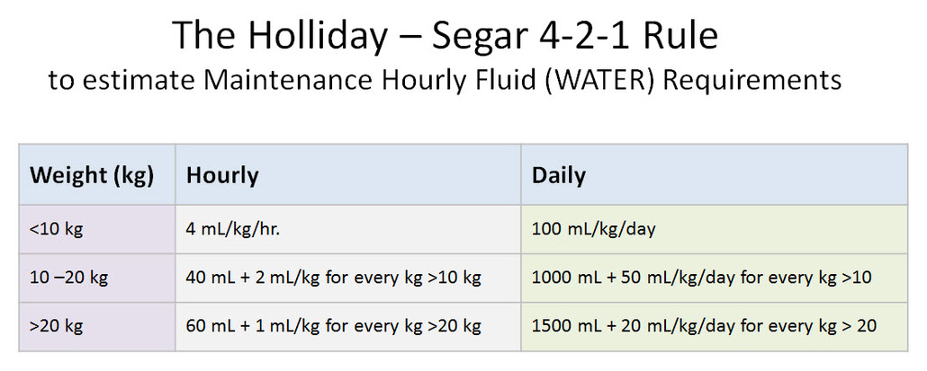
Fluid calculations
I.V. Fluid at Induction of Chemotherapy (Hyperhydration in cycle/phase 1)
3000ml/m²/day DNS X 5 days
i.e. D 0 (Pre-chemo), D1-4 (during and post chemo
Resuscitation fluids in medical emergency:
20ml/kg NaCl IV rapid push
Resuscitation fluids in trauma or neurological emergency:
10ml/kg NaCl rapid push
Adrenaline in anaphylaxis
0.1ml / kg 1:1000
Adrenaline in cardiac arrest
0.1ml / kg 1:10, 000
I.V. Fluid Calculation = drops per min
Volume to be infused (mls) Drop factor
_____________________ X ___________
Time in hours 60 minutes
If RBG <4mmol/l
D10% 2.5ml/kg bolus or D5% 5ml/kg bolus.
Repeat until RBG stable above 4mmol/L

Slide 12
MATHS CONVERSIONS
1 Gram = 1,000 milligrams (mgs)
1 Gram = 1,000,000 micrograms (mcgs)
To convert Milligrams to Micrograms
X milligrams by 1,000
0.01 mgs = 10 mcgs (0.01 X 1,000 = 10)
To convert Grams to Micrograms
X grams by 1,000,000
2 grms = 2,000,000 mcgs (2 x 1,000,000 = 2,000,000)
To convert Micrograms to Milligrams
divide the micrograms by 1,000
500 mcgs = 0.5 mgs ( 500 ÷ 1,000 = 0.5)
FORMULA FOR CALCULATION OF DRUG DOSAGE:
WHAT YOU WANT x VOLUME (mls) = AMOUNT TO
What you have 1 BE GIVEN
(ensure all units are the same)
Example
What you want: 175mg of liquid paracetomol
What you have: Liquid paracetamol 120mg/5ml
175 X 5 = 7.29 mls
120 1

Slide 13
WORK UP FOR NEWLY DIAGNOSED PAEDIATRIC HAEMATOLOGY/ONCOLOGY PATIENTS
Vital information to be recorded on all patients:
Patient’s and parent’s and siblings’ history to be recorded at admission.
Weight, height and MUAC to be recorded in doctors’ notes at each visit.
Size of tumour/lymph nodes; please record whether nodes are palpable, mass is detectable and if so, please measure dimensions if possible.
After each course of chemotherapy all toxicity must be recorded i.e. myelosuppression, nausea, vomiting, alopecia, etc. This toxicity must be graded.
All children who attend for the first time need…
Full blood picture
Blood grouping +/- cross-matching
Coagulation profile
LFT, U&E, Calcium, phosphate, Creatinine, LDH, Uric Acid
Viral titres: HIV and Hepatitis A, B and C screening
AFP for all abdominal tumours

Slide 14
Individual additional Investigations for specific diagnoses
Leukaemia Children
Urgent Chest Xray – please do the SAME DAY as admission to ward.
Peripheral blood
Smear – look for blasts.
  Morphology and Cytochemistry - 6 PS slides (N.B. spread very thinly)
  If blasts present then peripheral blood should be sent for flow cytometry analysis. If this is diagnostic there is no need for a bone marrow examination.
  At the same time special ‘sticky’ PS slides should be prepared for cytogenetic analysis.
Bone marrow aspirate and biopsy (The following is only necessary if the peripheral blood was non-diagnostic):
  Morphology and Cytochemistry - 6 BM slides (N.B. spread very thinly)
  Immunophenotyping/flow cytometry - 1-2 ml in EDTA (FBP) bottles. This test takes 3-4 hours of laboratory time. The sample must be processed immediately or else transferred from the FBP bottle to the transport bottle and stored in the fridge. Please inform the haematology laboratory before taking this sample to alert them so that the sample can be processed in a timely and organised fashion. Please ensure that this sample is delivered by a doctor to the laboratory scientist performing the procedure as if lost it may be impossible to replace if lost. Once treatment has begun this sample cannot be reliably retaken and it may not be possible to confirm the diagnosis.
  At the same time special ‘sticky’ BMA slides should be prepared for cytogenetic analysis.
LP cytospin if platelets are more than 25X10⁹/L. If less than 25X10⁹/L hold LP and order platelets. Do LP immediately platelets have been given. If platelets unavailable then hold LP for a maximum of one week and then do LP/IT regardless of platelet count.
ECHO
    Retinoblastoma
Please fill out form for enucleated/exenterated specimen to go to our lab. Please clearly ask the following questions on the form:
  Is the optic nerve involved?
  Is the cut end of the optic nerve involved?
  Is the anterior chamber involved?
  Is there deep choroidal involvement?
If clearly intraocular – no other investigations. Proceed to chemotherapy or wait for histopathology result.
If possibly or definitely extra-occular (but not obviously metastatic) –
  Lumbar puncture cytospin
  Bone marrow aspirate/biopsy
  If this is normal – MRI/CT brain
  If these are all normal proceed to chemotherapy.
If definitely metastatic:
  No further investigations – please send to palliative care team for counseling.
Audiology

Slide 15
Individual additional Investigations for specific diagnoses
    Burkitt’s and other non-hodgkins lymphoma
Chest Xray
Urgent Ultrasound of abdomen and pelvis
Bone marrow aspirate
Trucut biopsy if diagnosis not confirmed
Lumbar puncture for cytospin.
Other investigations depending on site of disease e.g. Xray jaw.
    Wilms Tumour
CT abdo/pelvis/thorax
If CT not available then order Ultrasound of abdomen and pelvis and CXR
5-10ml of Urine for VMMA – needs to be fresh. 0.5-1ml HCL 6mol/L should be added immediately
Serum for Alpha feto protein
ECHO
    Neuroblastoma
Chest Xray – look for tram-tracking in the ribs, lung mets.
Plain film of the abdomen looking for calcification
Urgent Ultrasound of abdomen and pelvis +/- CT abdomen
5-10ml of Urine for VMMA – needs to be fresh. 0.5-1ml HCL 6mol/L should be added immediately
Serum for Alpha feto protein
If stage 3 also needs a bone marrow aspirate/biopsy to rule out stage 4.
+/- bone scan
    Hodgkins Lymphoma
CT thorax – (if not available - Chest Xray)
CT abdomen and pelvis – (If not available – USS abdo/pelvis)
Bone marrow biopsy
Alpha feto protein in children under 10 years – to outrule ataxia telangiectasia.
ECHO

Slide 16
Individual additional Investigations for specific diagnoses
    Rhabdomyosarcoma
Chest Xray +/- CT thorax
CT abdomen and pelvis – (If not available – USS abdo/pelvis)
Bone marrow aspirate/biopsy
    Osteosarcoma
Plain film Xray of the affected bone
Trucut biopsy if no previous biopsy.
Chest Xray - If normal please do CT thorax
Bone scan
Xray painful bones or hot spots on bone scan.
ECHO
    Brain Tumours
CT brain +/- MRI brain and spine
+/- alpha feto protein and beta hCG.
Lumbar puncture for cytospin
    Nasopharyngeal Carcinoma
CT brain and nasal sinuses
CXR
Audiology
    Hepatoblastoma/Hepatocellular carcinoma
Alpha feto protein
Liver MRI/CT – ask radiology for advice
CXR
Albumin

Slide 17
TUMOUR LYSIS SYNDROME
This is a constellation of biochemical abnormalities resulting from massive tumour cell lysis which may be apparent at diagnosis or during the first few days of induction chemotherapy.
Conditions most likely to cause this include:
Burkitts Lymphoma and other NHL’s
Acute leukaemia with WCC > 50 x 10⁹/l
Large tumour burden e.g. Stage IV NBL
    Principal Biochemical Abnormalities found in Tumour Lysis Syndrome
Hyperuricaemia
Hyperphosphataemia
Hypocalcaemia
Hyperkalemia
Acute renal failure may result from precipitation of urate in renal tubules.

Slide 18
Initial Management of Tumour Lysis Syndrome
Measure weight
Fluids: Commence hydration on admission with DNS at 3L/m²/24hrs
Strict adherence to fluid balance. Aim for a urine output of 3mls/kg/hour. Ask parents to collect all the urine and review this at least daily if not more often initially.
BP 4 hourly or more frequently according to severity of clinical condition.
Blood Investigations
U + E - if possible, 12 hourly but at least every day until stable
Urate - if evidence of massive cell lysis or reduced urine output, monitor 6 hourly, otherwise once daily
Creatinine - as for urate
Inorganic Phosphate
FBP - daily
CXR
Renal ultrasound when a child has an abdominal mass to rule out renal infiltration or obstructive uropathy. Children with the latter are at increased risk of renal failure and may require dialysis at an early stage.
If possible ECG monitoring if hyperkalemic or on calcium infusion if possible.
Allopurinol: 1month-15 years 10-20mg/kg daily. Maximum 400mg daily
15-18years – 10-20mg/kg daily with a maximum of 900mg.
Preferably with food. Doses over 300mg are given in divided doses.
Start from first admission and to continue for 5 days (or longer if child has confirmed Tumour Lysis Syndrome).
Urate oxidase – Although this drug is currently unavailable on the ward it is important to include it here. It is extremely effective and is given at a dose of :
0.2mg/kg daily diluted in 50ml of NaCL 0.9%w/v administered over 30 minutes (for up to 5 days).
For children less than 5yrs with uric acid levels > 400micromol/L
For children more than 5yrs with uric acid levels > 600micromols/L
This should never be mixed with chemotherapy. Uric acid levels should be checked daily.

Slide 19
Management of TL Complications
Fluid Balance
If diuresis is not adequate and there is no evidence of obstructive uropathy, frusemide 1-2mg/kg can be given as a stat dose, or up to every 6 hours under strict consultant supervision and repeated as indicated.
continuing.
NB: Stop infusion if bradycardia develops.
Site of cannula should be left exposed so that area can be inspected at regular intervals (extravasation causes severe tissue necrosis)
Hypocalcaemia
Clinical signs
neuromuscular irritability including (<1.8 mmol/L) tetany as manifested by Chvostek's sign (twitching on tapping of facial muscle) or Trousseau's sign (occlude brachial artery with BP cuff and hand spasms into painful ‘main d’accoucheur), bronchospasm,
electrocardiographic changes
seizures.
Management
Ca gluconate 10% (2.2mmol/10ml) 1-2mmol/kg/day i.e. as separate infusion diluted in 100-200 ml 0.9% w/v NaCI.
If symptomatic, 0.1 mmol/kg Ca gluconate 10% (0.4ml/kg) diluted in 10-20 ml 0.9% w/v NaCI can be given slowly over 10 mins with ECG monitoring if possible. Calcium replacement may need to be continued at a lower dose while lysis is continuing

Slide 20
  HYPERKALAEMIA
  Defined as serum potassium greater than 5.5 mEq/L (mmol/L). Severe hyperkalaemia (potassium > 7mmol/L) is a medical emergency and requires urgent treatment.
Consider cause of hyperkalaemia. Review medication list and check previous blood results.
Repeat an urgent renal profile (including potassium, sodium, chloride, urea and creatinine); inform the lab that this is urgent and ensure the sample is taken to the lab immediately. Do not delay treatment if the clinical picture is in keeping with the blood result.
Perform an ECG if possible but do not delay treatment. Place on a cardiac monitor and pulse oximeter if possible.
Cardiac membrane stabilization.
Calcium should be infused SLOWLY over 5 minutes intravenously to patients with:
Serum potassium >7mmol/L OR
Significant ECG changes
Severe arrhythmias thought to be caused by hyperkalaemia
There are two forms of calcium. Please check carefully which is available in your centre and calculate accordingly. Note the large difference in maximum volumes. (If both are available use calcium gluconate):
IV Calcium Gluconate 10%w/v, 0.5 -1ml/kg (equivalent to 0.11-0.22mmol/kg). The maximum single dose is 4.4mmol or 20ml.
OR
IV Calcium Chloride 10%w/v, 0.2ml/kg (equivalent to 0.14mmol/kg) The maximum single dose is 1.4mmol or 2ml.
Therapy to shift extracellular potassium into cells is needed in conjunction with cardiac membrane stabilization
Inhaled salbutamol (can be repeated after 20 minutes)
Neonates 0.4mg in 2ml of saline
Infants and children > 25kg 2.5mg in 2ml of saline
Children 25-50kg 5mg in 2ml of saline
Children >50kg 10mg in 2-4mL of saline
Intravenous insulin and glucose.
Fast acting insulin (e.g actrapid) is mixed with dextrose 1g/kg and given concurrently IV over 30 minutes as follows:
Insulin (actrapid) 0.1iu/kg
Dextrose: 5mL/kg dextrose 20%w/v or 20ml/kg of 5%w/v dextrose depending on what concentration is available.
This must be double checked with two doctors prior to administration.
Serum glucose should be measured prior to and one hour after commencement of infusion.
Therapy to remove potassium from the body
Frusemide 1mg/kg IV can be given if renal function and volume status are normal in severe hyperkalaemia or for non-urgent levels of hyperkalaemia (5.5-6.5mmol/L)
If enteral cation exchange resins e.g. sodium polystyrene sulfonate or dialysis are considered, senior input is advised
Repeat potassium 2 hours after commencement of therapy

Slide 21
Febrile Neutropenia
Temperature ≥ 38.3° on one occasion
or
Temperature ≥ 38.0° and ≤ 38.2° on at least two occasions, taken at least one hour apart
Defined as per the absolute neutrophil count (ANC) which is the sum of the neutrophils and band forms.
An ANC < 1 x 10⁹/L is the critical value below which all patients should be treated

Slide 22
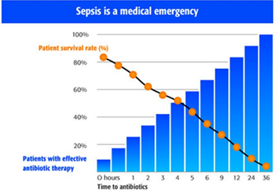
The Golden Hour for Fever and Neutropenia

Slide 23
Febrile Neutropenia Evaluation - examination
Vital signs
Skin, especially folds, areas surrounding nail beds, CVC exit sites, sites of BMA and LP
Sinuses
Oropharynx
Perineum, particularly the perianal and labial regions

Slide 24
Febrile Neutropenia Investigations
Investigations
Complete blood count
Blood smear for malarial parasites
Kidney function
Liver function
Blood cultures
Urine culture (especially younger children)
Additional investigations if needed
CXR if respiratory
Abdominal Xray/ultrasound scan if gastrointestinal
Lumbar puncture for altered mental status or meningitis (if it is safe)
Stool culture and C. difficile toxin test if diarrhoea
Culture and Gram stain of drainage from any site with drainage

Slide 25
Initiate antibiotic treatment if
Patient is febrile and ANC < 1 x 10⁹/L, or
ANC ≥ 1x 10⁹/L and ANC expected to fall below 1 x 10⁹/L within the next 24 to 48 hours, it is advisable to initiate antibiotic treatment.
Patient is febrile and the neutrophil count is unavailable in the acute stage but the patient recently received chemotherapy and therefore is at risk of neutropenia.

Slide 26
Figure 1: INITIAL MANAGEMENT OF FEBRILE NEUTROPENIA: THE GOLDEN HOUR!
ADMINISTER FIRST DOSE TAZOCIN WITHIN 1 HOUR OF FIRST FEVER
FEBRILE and NEUTROPENIC
(ASSUME NEUTROPENIA IF ANC UNAVAILABLE)
ALWAYS CONSIDER MALARIA
FULL ASSESSMENT
(History, examination/PEWS, investigations)
Is the RISK ASSESSMENT abnormal? I.E.:
Neutrophils < 0.2
(Treat as <0.2 if ANC unavailable)
Abnormal PEWS when afebrile
Clinically unwell
YES
NO
HIGH RISK PROTOCOL
+/- focal treatment
See Figure 2.
Are there Focal signs/symptoms (e.g. pneumonia, peritonitis, VZV, cellulitis, fungal infection etc)?
YES
No
Low risk protocol plus
Ie: Tazocin 90mg/kg 6hours iv plus focal treatment (see figure 3)
LOW RISK PROTOCOL:
TAZOCIN MONOTHERAPY 90MG/KG 6HOURS IV
Figure 1

Slide 27
Fig 2: HIGH RISK FN PROTOCOL: INITIAL MANAGEMENT (or if child deteriorates at any time).
NOTE: TAZOCIN has ALREADY been given see Fig 1.
YES!
Consider this
SEPSIS OR SEVERE SEPSIS
Child has ABNORMAL PEWS OR CLINICALLY UNWELL
NO!
Consider this
SEPTIC SHOCK
Give Resuscitation:
IV fluid bolus; transfusion if Hb <8; Correct low glucose; Oxygen supplementation
CNS INVOLVEMENT
Change Tazocin to MEROPENEM (40mg/kg/dose)
and
CIPROFLOXACIN
and
VANCOMYCIN
and
AMPHOTERICIN B
CNS INVOLVEMENT
YES
LP if safe to do so
PEWS NORMALISED?
Defer LP until safe
NO
NO
Yes
RENAL IMPAIRMENT
Change Tazocin to MEROPENEM (40mg/kg/dose) TDS,
And
CIPROFLOXACIN
Consider Vancomycin
Consider anti-fungal
RENAL IMPAIRMENT
ALWAYS CONSIDER MALARIA
NO
YES
NO
YES
MEROPENEM (20mg/kg/dose)
and
CIPROFLOXACIN
and
VANCOMYCIN
and
FLUCONAZOLE
Add GENTAMICIN (5mg/kg/d)
Consider:
Anti-fungal
Vancomycin
Change Tazocin to MEROPENEM (20mg/kg/dose),
and
CIPROFLOXACIN
Consider Vancomycin
Consider anti-fungal
Consider adding other site specific Antimicrobials: See figure 4
Change Tazocin to MEROPENEM (40mg/kg/dose)
and
AMIKACIN
and
VANCOMYCIN
and
AMPHOTERICIN B

Slide 28
Figure 3: FOCAL SYMPTOMS OF INFECTION PRESENT:
SPECIFIC INDICATIONS FOR ADDITIONAL ANTIMICROBIALS
(ADD TO EITHER LOW OR HIGH RISK FEBRILE NEUTROPENIA STANDARD PROTOCOLS)
MOUTH
Severe oral candidiasis
  Add FLUCONAZOLE
Mucositis Grade 2 (ie ulceration but still able to eat), or worse.
  Add METRONIDAZOLE
Severe mucositis and ANC< 0.1
  Add VANCOMYCIN
Severe mucositis with haemorrhagic ulcers suggestive of HSV infection
  Add ACICLOVIR
BRAIN/THORAX/SINUSES
Lesion on CT brain/thorax/other imaging suggestive of invasive mold infection
  Add AMPHOTERACIN B
Leions in brain indicating herpes infection
  Add ACICLOVIR
SKIN
Vesicular skin lesions suggestive of HSV or VZV (either varicella or zoster)
  Add ACICLOVIR
Skin and soft tissue infection/ Recent surgical wound/ Fever with indwelling CVC/PICC/ Tunnel/exit site infection
  Add VANCOMYCIN
Skin nodules suggestive of disseminated fungal infection
  Add AMPHOTERACIN B
ABDOMEN
Abdominal Pain/Perianal Pain/Diarrhoea
  Add METRONIDAZOLE
Peritonitis not improving with antibiotics (48h)
  Add AMPHOTERACIN B
Disseminated hepato-splenic lesions on USS
  Add FLUCONAZOLE
SPECIFIC ANTIBIOTIC TREATMENT INDICATIONS:
ADDITIONAL INDICATION FOR VANCOMYCIN
Recent treatment with high dose cytarabine
ADDITIONAL INDICATION FOR MEROPENEM SWITCH
Infection with ESBL producing organism
Febrile neutropaenia in a patient known to be colonized with ESBL+ organism/previously infected with ESBL+ organism
INDICATION FOR CEFOSO/CEFIPIME SWITCH
Febrile Neutropenia AND DETERIORIATING ON MEROPENEM

Slide 29
Figure 4: INITIAL ANTIBIOTIC OPTIONS FOR SUSPECTED PENICILLIN ALLERGY
(BOTH LOW AND HIGH RISK FEBRILE NEUTROPENIA PROTOCOL
When to avoid Tazocin and/or Meropenem)
SUSPECTED PENICILLIN ALLERGY
No
Mild reaction (rash only)
Yes
Avoid both Tazocin AND Meropenem
Instead give:
Clindamycin (10mg/kg PO/IV q8h)
Ciprofloxacin (10mg/kg PO/IV 8h)
Gentamicin (5mg/kg IV q24h)
(Plus other antimicrobials as indicated in figure 2 & 4)
Avoid Tazocin
Instead use:
Meropenem (20-40 mg/kg 8h as appropriate)
(Plus other antimicrobials as indicated in figure 2 & 4)

Slide 30
Figure 5: DECISION TREE AT 48 HOURS AB’S
(BOTH LOW AND HIGH RISK FEBRILE NEUTROPENIA PROTOCOL)
Continue AB therapy from D1 for 48 hours
Afebrile x 24hr
Persistent fever
Daily assessment (PEWS, history, examination)
Clinically well
Blood cultures negative
ANC > 0.5
Source and nature of infection identified
Clinically stable
At 48hrs of ANTIBIOTIC therapy:
Repeat full assessment (history, examination, investigations)
Review steps in Figure 2.
NEW SIGNS/SYMPTOMS/ CHILD UNSTABLE
Consider culture (sputum/pus/csf/urine)
Consider imaging (CXR/abdo USS/CT brain/CT Thorax)
ALWAYS CONSIDER MALARIA
CLINICALLY STABLE
No source identified
No new symptoms
HIGH RISK
Complete 5-7 DAYS of IV AB’S (in total) then observe overnight without antibiotics
(See Fig 5 for D5 review)
LOW RISK Complete 72 hours of IV Tazocin (in total) then observe overnight without antibiotics
Adjust antibiotics & treat infection as appropriate
e.g. 7 days for pneumonia;
10-14 days for bacteremia. (See Fig 5 for D5 review)
Continue initial antibiotic therapy and daily assessments with formal review D5
(see figure 5)
Consider additional antimicrobials
(See Figures 2 & 3)

Slide 31
Figure 6: DECISION TREE AT 5 DAYS AB’S
(BOTH LOW AND HIGH RISK FEBRILE NEUTROPENIA PROTOCOL)
Continue Daily assessment (PEWS, history, examination); if child deteriorating at any time see Figure 2
Afebrile x 24hr
PERSISTENT FEVER
At 5 days of ANTIBIOTIC therapy:
Clinically well
Blood cultures negative
ANC stable or rising
Source and nature of infection identified
Clinically stable
Repeat full assessment (history, examination, investigations)
ALWAYS CONSIDER MALARIA
NEW SIGNS/SYMPTOMS/ CHILD UNSTABLE
Consider culture (sputum/pus/csf/urine)
Consider imaging (CXR/abdo USS/CT brain/CT Thorax)
Complete 7 days of treatment and observe overnight without antibiotics
Adjust antibiotics & treat infection as appropriate
e.g. 7 days for pneumonia;
10-14 days for bacteremia.
ADD EMPIRICAL AMPHOTERICIN B
AND
Consider additional antimicrobials
(Review Figure 2 & 3)

Slide 32
Diagnosis:
Step 1: Risk of VTE is assessed using Pre-Test Probability (PTP) scoring:
Venous Thrombo-Embolism management
Deep Vein Thrombosis/Pulmonary Embolism/CerebroSinus Venous Thrombosis
Wells Score for Leg DVT
Component | Points
Active cancer Localized tenderness Entire leg swollen Calf swelling > 3 cm Pitting edema Collateral superficial veins Previous DVT Bedridden/surgery Paralysis Alternate diagnosis | 1 1 1 1 1 1 1 1 1 -2
Revised Geneva Score for PE
Component | Points
Pain on limb palpation Previous DVT or PE Unilateral lower limb pain Tachycardia Active cancer Recent surgery or fracture Hemoptysis Age ≥ 65 | 4 3 3 0 / 3 / 5 2 2 2 1
Wells Score for PE
Component | Points
DVT signs / symptoms No alternate diagnosis Tachycardia Immobilization/surgery Previous DVT or PE Hemoptysis Active cancer | 3 3 1.5 1.5 1.5 1 1
Score > 6: high PTP
Score ≥ 2 and ≤ 6: intermediate PTP
Score < 2: low PTP
Score ≥ 11: high PTP
Score 4 to 10: intermediate PTP
Score 0 to 3: low PTP
Score ≥ 3: high PTP (≥ 50% prevalence)
Score 1 to 2: intermediate PTP (~25%)
Score 0 or lower: low PTP (≤ 10%)
Prevalence by PTP for PE:
High PTP: ≥ 50%
Intermediate PTP: ~20%
Low PTP: ≤ 5%
Wells Ann Intern Med 1998
Le Gal Ann Intern Med 2006
Notes:
NOTES:
If using the two-level Wells Score for PE, the scoring is: PE unlikely ≤ 4 points, PE likely > 4 points
If using the revised Geneva score, a simplified version exists (Klok JAMA Intern Med 2008) in which all components are awarded 1 point; scores can be trichotomized (low PTP 0-1 points, intermediate PTP 2-4 points, high PTP 5 or more points)
The scope of this guideline does not include a review of existing clinical decision rules or comparisons between different rules. It is assumed the user will utilize a validated method to determine PTP.
In patients with suspected pulmonary embolism (PE), this guideline assumed the prevalence of PE in patients with low, intermediate and high PTP to be ≤5%, 20% (+/-10%) and ≥50%, respectively.
In patients with suspected deep vein thrombosis (DVT) of the lower extremities, the prevalence of DVT in patients with low, intermediate and high PTP was estimated at ≤10%, 25% (+/-10%) and ≥50%, respectively.
In patients with suspected upper extremity DVT, the prevalence in patients with likely and unlikely probability was estimated at 10% and 40%.

Slide 33
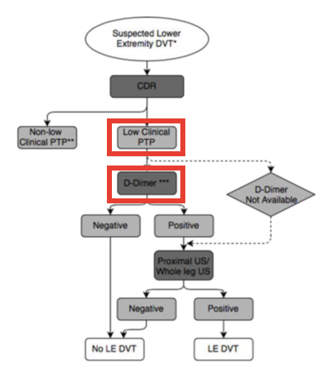
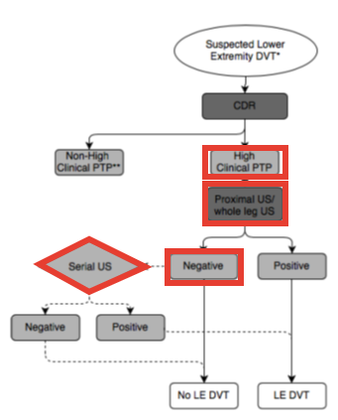
Investigations recommended for low/high PTP for DVT
LOW PTP risk assessment for DVT
High PTP risk assessment for DVT

Slide 34
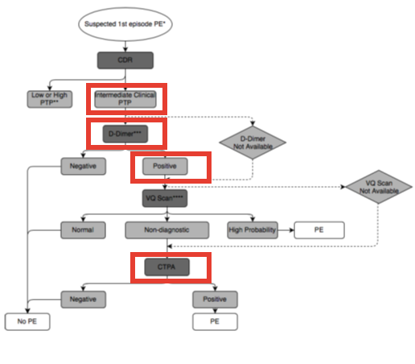
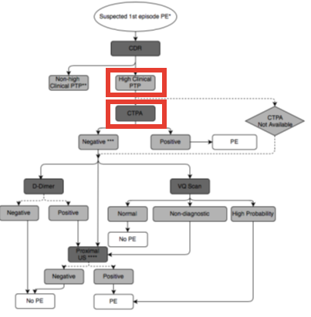
Investigations recommended for low/high PTP for PE
Low/Intermediate PTP risk assessment for PE
High PTP risk assessment for PE

Slide 35
Venous Thrombo-Embolism management
Deep Vein Thrombosis/Pulmonary Embolism/CerebroSinus Venous Thrombosis
Treatment Strategy:
  Low molecular Weight Heparin S/C
    Prophylaxis: 1mg/kg OD
    Treatment: 1mg/kgBD
    High risk treatment:1.5mg/kg BD
  If only High Molecular Weight Heparin Available:
    Heparin 20iu/kg/hr as a continuous infusion
  Once improving on Heparin can transition to Warfarin as follows:
    Continue Heparin as above and add:
    Warfarin 3mg/kg OD X3 days
    D3 check INR aiming for INR>2 – titrate warfarin dose as needed
    Continue both for at least 5 days.
    When INR stable >2 can stop Heparin
    Continue warfarin for 12 weeks if stable throughout.
  Duration of Treatment:
    The ASH guideline panel suggests using anticoagulation for ≤3 months rather than anticoagulation for >3 months in pediatric patients with provoked DVT or PE
    The ASH guideline panel suggests using anticoagulation for 6 to 12 months rather than anticoagulation for >6 to 12 months in pediatric patients with unprovoked DVT or PE

Slide 36
Cardiac Failure Medications
ECHO confirmed CCF (or if the child is new and has very obvious signs of CCF and awaiting urgent ECHO):
Do NOT given anthracyclines – Doxorubicin/Daunorubicin
Request Urgent Cardiology consultation.
Initiate Anti-Failure Medications:
  Spironolactone PO:
    Neonates: 0.75-1.5mg/kg BD
    >1month-12 yrs: 0.75-1.5mg/kg BD; up to 9mg/kg daily in resistant ascites
    12-18yr: 25-50mg BD; up to 9mg/kg daily in resistant ascites
  Amlodipine
    1month -12 yr: 100-200mcg/kg OD increase slowly to max 400mcg/kg OD or 10mg OD
    Over 12yr: Start at 5mg OD up to max of 10mg OD
    May be divided BD
  Digoxin PO
    15mcg/kg stat, then 6hrs later 7.5mcg/kg stat; then 6hrs later 7.5mcg/kg stat then:
    5mcg/kg BD as maintenance treatment
  Frusemide 0.5-1mg/kg once, twice or three times per day.
  Captopril
    Test dose:1month-18yr: 0.1mg/kg (max 6.25mg)
    Maintenance dose:
    1month-1yr: 0.1-03mg/kg 8-12 hourly (max 4mg/kg/day)
    1yr-12yr:0.1-03mg/kg 8-12 hourly (max 2mg/kg/day)
    Over 12yr:12.5mg-25mg 8-12 hourly (max 150mg daily)

Slide 37
Management of Hypertension
BP should be assessed daily for all admitted children and at each outpatient review
Acceptable BP is below the 95th centile for age/height
Use the Ped(z) app to determine the BP centile.
Check BP 3 times over 24 hours.
If persistently high needs investigation and treatment
Investigations:
  Bloods – FBP Urea, Creatinine, electrolytes
  ECHO
  Renal Doppler USS to assess renal artery for stenosis
  Urine for protein and blood
Treatment
  Amlodipine PO:
    1month -12 yr: 100-200mcg/kg OD increase slowly to max 400mcg/kg OD or 10mg OD
    Over 12yr: Start at 5mg OD up to max of 10mg OD
    May be divided BD
  Captopril PO
    Test dose:1month-18yr: 0.1mg/kg (max 6.25mg)
    Maintenance dose:
    1month-1yr: 0.1-03mg/kg 8-12 hourly (max 4mg/kg/day)
    1yr-12yr:0.1-03mg/kg 8-12 hourly (max 2mg/kg/day)
    Over 12yr:12.5mg-25mg 8-12 hourly (max 150mg daily)
  If not stable despite both these treatments – call RENAL

Slide 38
ACUTE EMETOGENIC POTENTIAL OF SINGLE ANTINEOPLASTIC AGENTS
AGENT | EMETOGENICITY | RANK
(dose = cumulative dose/cycle | (anticipated rate of emesis if no antiemetic given)
cisplatin ≥50 mg/m²* | VERY HIGH | 4
cyclophosphamide >1500 mg/m²* | > 90%
Combination cyclophosphamide >750 to 1500 mg/m² AND anthracycline (any dose)
dacarbazine
carboplatin* | HIGH | 3
cisplatin <50 mg/m²* | 60 - 90%
cyclophosphamide >750 to 1500 mg/m²*
cytarabine >1000 mg/m²
dactinomycin
daunorubicin >60 mg/m²
doxorubicin >60 mg/m²
methotrexate >1000 mg/m²
procarbazine
topotecan
cyclophosphamide ≤750 mg/m²* | MODERATE | 2
cyclophosphamide: oral | 30 - 60%
cytarabine > 100 to 1000 mg/m²
daunorubicn ≤60 mg/m²
doxorubicin ≤60 mg/m²
etoposide ≥60 mg/m²
etoposide: oral
intrathecal chemotherapy
ifosfamide
imatinib
methotrexate 250-1000 mg/m²
temozolamide
radiation to upper abdomen

Slide 39
ACUTE EMETOGENIC POTENTIAL OF SINGLE ANTINEOPLASTIC AGENTS
AGENT | EMETOGENICITY | RANK
(dose = cumulative dose/cycle | (anticipated rate of emesis if no antiemetic given)
etoposide <60 mg/m² | LOW | 1
fluorouracil | 10 - 30%
methotrexate 51-249 mg/m²
radiation to lower thorax/pelvis/craniospinal
asparaginase | MINIMAL | 0
bleomycin | < 10%
chlorambucil
cytarabine <100 mg/m²
hydroxyurea
mercaptopurine
methotrexate ≤50 mg/m²
methotrexate: oral
rituximab
thioguanine (oral)
vinblastine
vincristine
radiation to head/neck/extremities/cranium
* associated with delayed nausea/vomiting

Slide 40
INITIAL ANTIEMETIC SELECTION BASED ON EMETOGENICITY OF ANTINEOPLASTIC REGIMEN
EMETOGENIC RANK | RECOMMENDED ANTIEMETIC AGENTS DURING ACUTE PHASE
VERY HIGH Rank ≥ 4
 | Ondansetron PO (see Table 3 for dose) or IV 5 mg/m² (max 8mg) pre-chemo and then 8 hourly
 | AND
 | dexamethasone* 6 mg/m² (max 12 mg/dose) pre-chemo PO/IV over at least 10 minutes and 12hourly thereafter, for duration of chemotherapy administration and 48 hours thereafter if risk of delayed nausea/vomiting (aim for maximum period ≤ 6 total days administration)
 | Children ≥ 12 yrs
 | If Aprepitant is available it may be added into the above regimen as 125mg PO one hour pre chemotherapy on Day 1, followed by 80mg PO in the morning Day 2 and 3 only. If this is given then reduce the dexamethasone dose by 50%
HIGH | Ondansetron PO (see Table 3 for dose) or IV 5 mg/m² (max 8mg) pre-chemo and 8 hourly
Rank 3 | AND
 | dexamethasone* 4 mg/m² (max 8 mg/dose) pre-chemo PO/IV over at least 10 minutes and 12 hourly thereafter for duration of chemotherapy administration and 48 hours thereafter if risk of delayed nausea/vomiting (aim for maximum period ≤ 6 total days administration)
MODERATE | ondansetron PO (see Table 3 for dose) or IV 5 mg/m² (max 8mg) pre-chemo and 8 hourly
Rank 2
LOW | ondansetron PO (see Table 3 for dose) or IV 3 mg/m² (max 8mg) pre-chemo and 8 hourly
Rank 1
MINIMAL | None
Rank 0
* Use of dexamethasone may be contraindicated if the protocol prohibits its use as an antiemetic or in patients receiving treatment for brain tumours.

Slide 41
ORAL ONDANSETRON DOSE
Weight | Oral Ondansetron dose
< 5 kg | 1 mg
6 - 15 kg | 2 mg
16 - 35 kg | 4 mg
> 35 kg | 8 mg
ADDITIONAL CHOICES FOR PATIENTS WHO HAVE
FAILED RECOMMENDED PROPHYLAXIS DURING ACUTE PHASE
MANAGEMENT OF BREAKTHROUGH AND ANTICIPATORY
NAUSEA/VOMINTING
DRUG | DOSE
Metoclopramide | 0-10kg: 100microgs/kg to max of 1mg PO/IV 12 hourly
 | 10-14kg: 1mg PO/IV 2-3 times daily
 | 15-19kg: 2mg PO/IV 2-3 times daily
 | 20-29kg: 2.5mg PO/IV 3 times daily
 | 30-60kg: 5mg PO/IV 3 times daily >60kg: 10mg PO/IV 3 times daily
Promethazine | 0.25-0.5mg/kg to maximum of 25mg 4-6hourly PO/slow IV (over at least 5 minutes
Cyclizine (Valoid) | By mouth or by IV injection over 3-5mins
 | 1month -6yrs: 0.5-1mg/kg 8 hourly
 | 6-12yrs: 25mg 8 hourly
 | 12-18yrs: 50mg 8 hourly
 | By continuous IV or subcutaneous infusion
 | 1month-2yrs: 3mg/kg over 24hours
 | 2-5yrs: 50mg over 24hours
 | 6-12yrs: 75mg over 24hours
 | 12-18yrs: 150mg over 24hours
ANTIEMETIC FAILURE | RECOMMENDED MANAGEMENT
Breakthrough nausea/vomiting | Consider increasing ondansetron dose to 5 mg/m² (max 8 mg) IV 8 hourly
 | AND
 | Consider addition of dexamethasone or increase dexamethasone dose to 6 mg/m²/dose (max 12 mg/dose) 12 hourly if applicable
 | AND
 | Select antiemetics for next cycle of chemo as emetogenicity level + 1 ranking
 | If patient fails despite the above interventions, consider additional antiemetics (see Table 5)
Anticipatory nausea/vomiting | Lorazepam (5-10 yrs: 0.5 mg/dose; >10 yrs: 1 mg/dose) PO the night before chemo and/or the morning of chemo
 | AND
 | Select antiemetics as emetogenicity level + 1 ranking

Slide 42
SEPTRIN PROPHYLAXIS FOR HIGH RISK CHEMOTHERAPY
Diagnosis | Protocol | Prescribed Septrin
ALL ALCL LCH Hepatoblastoma Wilms | -MNH ALL -ALCL -LCH III -SIOPEL 3 (HR & post lung RT only) | Commence Septrin on Day 1 of treatment. For prolonged neutropenia (>3 weeks) and off treatment check with Consultant prior to stopping Septrin Surface Area Dose <0.5m² 24mg/kg b.d. Sat & Sun 0.5 – 0.75m² 240mg b.d. Sat & Sun 0.76 – 1.0m² 360mg b.d. Sat & Sun >1.0m² 480mg b.d. Sat & Sun
Patients with solid tumours:
IF neutrophil counts have not recovered in time for next course of chemotherapy should discontinue Septrin until count recovers. Septrin should be recommenced at 50% dose.
Duration of Treatment
Continue Septrin for 3 months after completion of treatment.

Slide 43
PCP Prophylaxis and Treatment of Pneumocystis Pneumonia
Treatment of Pneumocystis Pneumonia:
Septrin 120mg/kg/day IV (or PO if IV not available) in 2-4 divided doses for 10 days.
Continue p.o. for further 7-14 days.
OR
If the patient fails to respond to the septrin within 72 hours change to pentamidine isothionate 4mg/kg/d IV over 1 hour and continue for 14 days.
The patient must also be given bronchodilator prior to and or during the procedure (to improve the blood flow to the lungs during the infusion.
Salbutamol:
6months-5yrs 2.5mg
5-12 years 5mg
>12 years 5-10mg.

Slide 44
Blood transfusion
It is acceptable to allow patients have a Hb level of 8g/dl before RCC transfusion is required. Aim to increase haemoglobin to 10g/dl
Formula for Calculating Amount of RCC Required :
3 x weight in kilo x desired increase in g of Hb = number of millilitre needed.
eg. A 20 kg child with a Haemoglobin of 5 gs/dl. The desired rise is to 10 g/dl, therefore
3 x 20 x 5 = 300mls.
Formula for Calculating Amount of whole blood Required
6 x weight in kilo x desired increase in g of Hb = number of millilitre needed.
eg. A 20 kg child with a Haemoglobin of 5g/dl. The desired rise is to 10 g/dl, therefore:
6 x 20 x 5 = 600mls.
Haemoglobin Target :Normally – 10g/dl
Special Circumstances:
WCC >75,000 (ie risk of hyperviscosity) – 6g/dl
Cardiac Failure – Aim to increase Hb by 1-2 g/dl per transfusion per day and watch for cardiac symptoms.

Slide 45
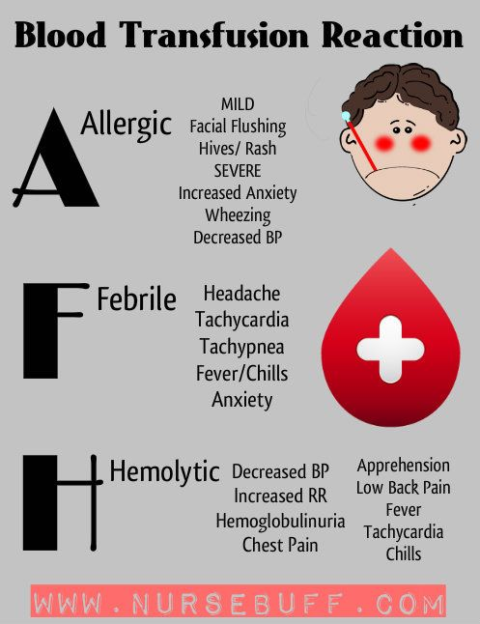
Blood transfusion reaction
Some children may develop a minor reaction to blood or platelets e.g. mild allergic or urticarial reaction
Review by Doctor
If a minor reaction occurs intravenous Chlorpheniramine (Piriton) and Hydrocortisone should be prescribed and given promptly.
Piriton < 2 years old = 2 mg IV
> 2 years old = 4 mg IV
Hydrocortisone
< 4 years old = 25 mg IV
> 4 years old = 50 mg IV

Slide 46
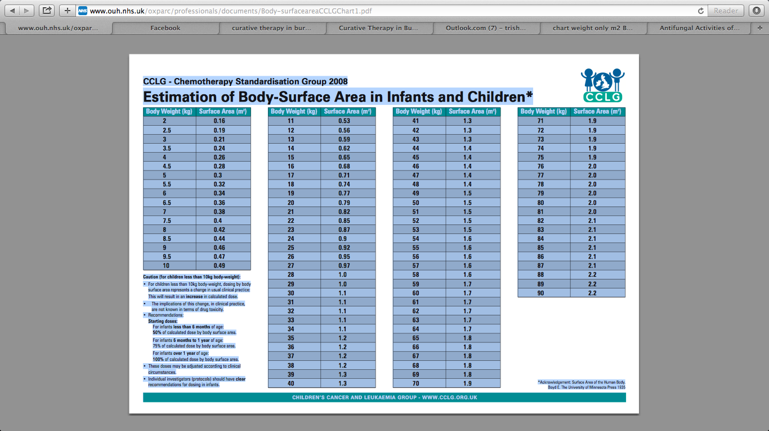

Slide 47
Pain Management Non Opioids- Step 1
Drug | Single dose for child >1month | Freq. | Forms available | Comment
Paracetamol (Calpol/Panadol) | 10–15mg/kg PO or 20mg/kg PR or 3–12mth: 60mg – 120mg PO 1– 5yrs: 120mg – 250mg PO 6–12yrs: 250mg – 500mg PO 12–Adult: 500mg – 1g PO | 4– 6hrly | Tablets 500mg Liquid 120mg/5ml 250mg/5ml | Maximum: 60mg/kg/day or 4g/day whichever is lower
Ibuprofen (Brufen/Nurofen) | 5mg/kg PO or 1– 2yrs: 50mg 3– 7yrs: 100mg 8–12yrs: 200mg >12yrs: 200 – 600mg | 6– 8hrly | Tablets: 200mg, 400mg 600mg,800mg retard Liquid 100mg in 5ml Granules 600mg sachet | Maximum: 2.4g daily or 20-30mg/kg which ever is lower.
Diclofenac (Voltarol/Difene) | 300microgs – 1mg/kg PO/PR | 8hrly | Tablets 25mg, 50mg | Not recommended for children less than 6 months. Maximum dose: 3mg/kg/day or 150mg which ever is lower
Please do not give suppositories to PAEDIATRIC HAEMATOLOGY/ONCOLOGY patients.

Slide 48
Pain Management Weak Opioid Step 2
Drug | Single dose for child > 1 month | Frequency | Forms available | Comment
Codeine Phosphate | 0– 12mth: 0.5mg/kg/dose >12mth:0.5–1mg/kg/dose >12yrs: 30–60mg/dose | 4– 6hrly | Codeine Linctus 15mg/5ml Codeine phosphate tabs (Codant) 30mgs | Maximum dose: 240mg daily or 60mg per dose.
Dihydrocodeine (DF 118 Tablets / Paracodin Liquid) | 1– 4yrs: 0.5mg/kg 4–12yrs: 0.5mg – 1mg/kg > 12yrs: 30mg | 4– 6hrly | Tablets 30mg Liquid: 12mg/5ml | Not for children <1 year. 90% effective at 30mg dose – no need to increase dose above this. Do not prescribe with other opiates.
There is a ceiling effect with weak opioids i.e. a max dose is reached beyond which further dose escalation doesn’t improve analgesia.
Notes: Constipation should be anticipated and laxatives prescribed. Injections of both dihydrocodeine and codeine are available but should be avoided in paediatrics.

Slide 49
Pain Management Strong Opioid – Step 3
Oral morphine is the drug of choice in the majority of children with severe pain. Children can tolerate very large doses of morphine if titrated appropriately.
MORPHINE DOSE TITRATION:
There is no such thing as a standard dose of morphine; no upper limit.
To obtain control initially:
The dose has to be adjusted for each child until their pain is controlled.
Prescribe an appropriate dose, according to weight (usually give a range).
Start low and work up
Use an immediate release morphine preparation (oral morphine suspension) for dose titration.
Give it regularly every 4 hours.
At the same time prescribe the same dose for ‘breakthrough’ pain to be repeated as often as necessary between regular doses.
Review after 24 – 48 hours and adjust regular dose according to breakthrough requirements.
A common dose increment is between 25 – 30% of the previous dose. (minimum increase 20%, maximum increase 50%).
Starting dose: 1 – 12 months 0.1mg/kg 4 hourly
1 – 12 years 0.2 – 0.5mg/kg 4 hourly
To calculate total amount of morphine given in a 24 hr period:
5mg oral morphine suspension given 4hrly for 24hrs:
= 5 x 6 = 30mg
5mg breakthrough dose needed twice in 24hrs:
5 x 2 = 10mg
30mg + 10mg = 40mg = total morphine in that 24hrs
(If it is available it may be possible to convert to 12hrly sustained release preparation (MST):
40mg ÷ 2 = 20mg twelve hourly dose as sustained release PLUS
Now calculate breakthrough dose = 1/6th of total daily dose:
40mg ÷ 6 = 5mg PRN given as instant release morphine.
Intravenous / Subcutaneous morphine if available:
Conversion from oral to I.V/S.C route: Divide oral dose by 2 to obtain equianalgesic dose.
Initial Morphine Loading Dose I.V:
0.05 – 0.1mg/kg (50 – 100 microg/kg) over 10 minutes.
Infusion Rates:
0 – 3 months: Average initial rate 10microg/kg/hr
Range 5 – 15 microg/kg/hr
3 – 6 months: Average initial rate 15 microg/kg/hr
Range 5 – 20 microg/kg/hr
6 months – 18 years: Average initial rate 25 microg/kg/hr
Range 10 – 40 microg/kg/hr
Must titrate amount to severity of pain.
Recommendation for preparation of infusion of morphine:
Patient must be pain free by bolus morphine before commencing infusion.
Weight (kg) = mg morphine (e.g. 10kg child draw up 10mg of morphine)
Mix in 5% dextrose to a total volume of 50ml
This gives a concentration such that an infusion rate of 1ml/hr = 20microg/kg/hr. Max concentration 50mg/50ml.
Use syringe pump for delivery
Transdermal:
Fentanyl patches are sometimes available.

Slide 50
  CO ANALGESICS – Step 3
  A co-analgesic is a drug which may or may not have intrinsic analgesic activity, but which may when used with conventional analgesics contribute significantly to pain relief.
Bone Pain
Neuropathic Pain
Nonsteroidal Anti-inflammatory Drugs (NSAIDs):
NSAIDs are of particular benefit for pain associated with inflammation e.g. soft tissue infiltration and bone metastases.
Inflammation leads to central sensitization and increased pain, NSAIDs will sometimes play a crucial role in relieving cancer-related neuropathic pain.
Corticosteroids:
Steroids have specific benefits for pain management because of their anti-inflammatory effect and ability to produce euphoria, improve appetite and weight gain.
They often result in an increased sense of well being. They have anti-inflammatory effects on certain tumors.
Dexamethasone has advantages over prednisolone because of its weaker mineralocorticoid effect with a lesser tendency to cause oedema and weight gain.
However, side effects can be severe in children and they should only be used when benefits outweigh the disadvantages.

Slide 51
