Slide 1


Paediatric
Pocket Guide

Slide 2
Cardiac Arrest first steps
1 | Check | Call | Compress
 | Child is unresponsive or only gasping | Shout for help! | Push hard and fast on the chest at a rate of 120 compressions per minute
2 | Check pulse every 2 minutes | Call the senior on-call and ICU for anaesthetic help | Continue effective CPR @ 15:2 Give breaths with Bag-valve-mask

Slide 3
Cardiac Arrest management
Continue CPR
15 compressions : 2 breaths
Give adrenaline IV asap
0.1ml/kg 1:10, 000
Check pulse every 2 minutes
Continue to push adrenaline IV every 4 minutes

Slide 4
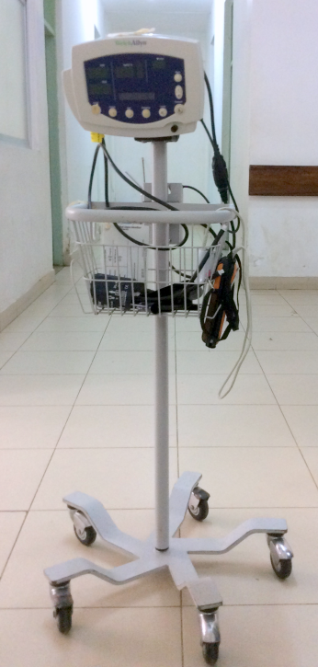
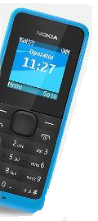
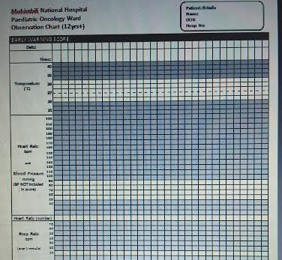
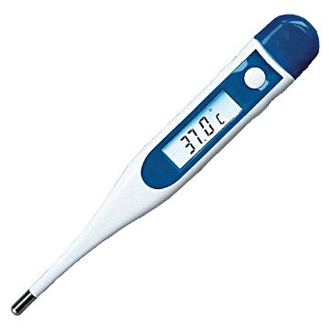
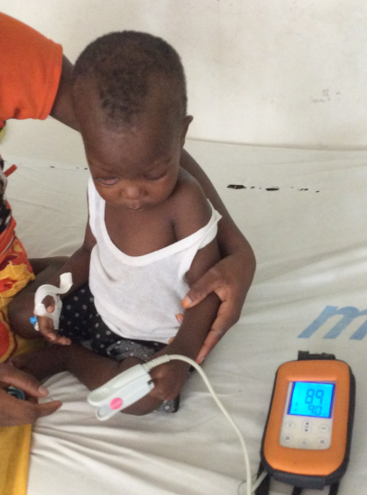
What do you need for PEWS?
Correct age chart
Phone or watch
Thermometer
Portable BP machine (charged)
O₂ saturation monitor

Slide 5
1
Select correct age PEWS chart
2
Patient assessment, record vital signs
3
Document vital signs in Orange or Purple boxes
4
5
Escalate appropriately
Take action: Trigger specific action

Slide 6
Patient assessment
Airway Breathing | Patent airway? | Noisy breathing?
 | Respiratory rate | Too fast or too slow?
 | Respiratory distress | Working too hard? Or not enough?
 | Oxygen saturation | Low?
Circulation | Heart rate | Too fast? Too slow? Irregular?
 | Blood pressure | Too high? Too low? Changed?
 | Capillary refill time
 | Skin temperature | Too hot? Too cold?
Disability (neurological) | Conscious level | AVPU
Exposure | Temperature | Too warm? Too cold?
 | Pain | Needs more pain relief?
 | Rash | Allergy? Sepsis?
 | Wounds | Bleeding? Discomfort? Infection?

Slide 7
Need to know normal resting heart rates for the age of the child

Slide 8
Reasons heart rate may change in paediatric oncology patients
Respiratory distress
Pain
Pyrexia
Bleomycin may cause pulmonary toxicity
(long term side effect)
Hypovolaemia
Cardiac abnormalities
Pressure from tumours
Fluid volume excess
Anaemia
Hypovolaemia
Anaphylaxis (eg: asparaginase, carboplatin, etoposide)
Medication
Anxiety
Hypoxia
Impending cardiac arrest
Opioids, benzodiazepines
Increase:-
Decrease:-

Slide 9
Important to know normal respiratory rates for the age of the child

Slide 10
How to assess Respiratory Effort
How to assess Respiratory Effort
 | Mild | Moderate | Severe
Airway | Stridor on exertion or crying | Mild stridor at rest | Stridor at rest
Behaviour and feeding | Normal Talks in sentences | Some intermittent irritability Difficulty talking/crying Difficulty feeding or eating | Increased irritability or lethargy Looks exhausted Unable to talk or cry Unable to feed or eat
Respiratory rate | Mildly increased | Respiratory rate in orange box on PEWS | Respiratory rate in purple box Increased or markedly reduced respiratory rate as the child is tired
Accessory muscle use | Mild intercostal and suprasternal recession | Marked intercostal, suprasternal and sternal recession Nasal flaring | Marked intercostal, suprasternal and sternal recession
Oxygen | No oxygen requirement | Mild hypoxaemia corrected by oxygen Increasing oxygen requirement | Hypoxaemia may not be corrected by oxygen
Other | Child seems well | Child seems unwell | Gasping, grunting Extreme pallor, cyanosis Apnoea
 |  | Call the intern to discuss the findings | Call the intern to urgently review the child and tell the on-call specialist

Slide 11
Reasons respiratory rate may change in paediatric oncology patients
Respiratory distress
Pain
Pyrexia
Bleomycin may cause pulmonary toxicity
(long term side effect)
Hypovolaemia
Cardiac abnormalities
Pressure from tumours
Fluid volume excess
Anaemia
Anxiety
Respiratory failure
Anaesthetic agents
Opioids
Benzodiazipines
Increase
Decrease

Slide 12
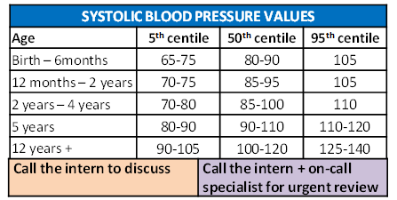
Need to know normal blood pressure ranges

Slide 13
Reasons BP rate may change in Paediatric oncology patients
Fluid overload
Medications (eg: ciclosporin, steroids)
Pain
Anxiety
Renal problems
Sepsis
Shock
Hypovoleamia
Anaphylaxis
Medications (eg: etoposide especially if given too quickly. Best given over 2-4 hours)
Opioids, benzodiazepines
Increase:-
Decrease:-

Slide 14
ISBAR Effective Clinical Communication
Observation in Orange zone | Observation in purple zone
Call the intern to discuss the observations | Call the intern to urgently review the child and tell the on-call specialist
Use ISBAR to escalate the PEWS to the doctor
I | Identify | Your name, the doctor, the patient
S | Situation | I am calling because…
B | Background | The relevant background is…
A | Assessment | I think the problem is… I am worried about…
R | Recommendation | I need you to…

Slide 15
Fluid calculations
I.V. Fluid Calculations (based on 20 drops/ML – check giving set)
1 Litre of Fluids over... | ​ml/hour | ​drops/min
​12 hours | ​83.3 | ​28
​10 hours | ​100 | ​33
​8 hours | ​125 | ​42
​6 hours | ​166.6 | ​56
I.V. Fluid Calculation = drops per min
Volume to be infused (mls) Drop factor
_____________________ X ___________
Time in hours 60 minutes
Resuscitation fluids in medical emergency
20ml/kg NaCl IV rapid push
Resuscitation fluids in trauma or neurological emergency
10ml/kg NaCl rapid push
Adrenaline in cardiac arrest
0.1ml / kg 1:10, 000
Adrenaline in anaphylaxis
0.1ml / kg 1:10, 000

Slide 16
MATHS CONVERSIONS
1 Gram = 1,000 milligrams (mgs)
1 Gram = 1,000,000 micrograms (mcgs)
To convert Milligrams to Micrograms
X milligrams by 1,000
0.01 mgs = 10 mcgs (0.01 X 1,000 = 10)
To convert Grams to Micrograms
X grams by 1,000,000
2 grms = 2,000,000 mcgs (2 x 1,000,000 = 2,000,000)
To convert Micrograms to Milligrams
divide the micrograms by 1,000
500 mcgs = 0.5 mgs ( 500 ÷ 1,000 = 0.5)
FORMULA FOR CALCULATION OF DRUG DOSAGE:
WHAT YOU WANT x VOLUME (mls) = AMOUNT TO
What you have 1 BE GIVEN
(ensure all units are the same)
Example
What you want: 175mg of liquid paracetomol
What you have: Liquid paracetamol 120mg/5ml
175 X 5 = 7.29 mls
120 1

Slide 17
5 MOMENTS OF HAND HYGIENE
1 | BEFORE PATIENT CONTACT | WHEN? Clean your hands before touching a patient when approaching him/her WHY? To protect the patient against harmful germs carried on your hands
2 | BEFORE AN ASEPTIC TASK | WHEN? Clean your hands immediately before any aseptic task WHY? To protect the patient against harmful germs, including the patient’s own germs, entering his/her body
3 | AFTER BODY FLUID EXPOSURE RISK | WHEN? Clean your hands immedicately after an exposure to body fluids (and after glove removal) WHY? To protect yourself and the health-care environment from harmful patient germs
4 | AFTER PATIENT CONTACT | WHEN? Clean your hands after touching a patient and his/her immediate surroundings when leaving WHY? To protect yourself and the health-care environment from harmful patient germs
5 | AFTER CONTACT WITH PATIENT SURROUNDINGS | WHEN?Clean your hands after touching any object or furniture in the patient’s immediate surroundings, when leaving – even without touching the patient WHY?To protect yourself and the health-care environment from harmful patient germs

Slide 18
Visual Infusion Phlebitis Score
IV site appears healthy | 0 | No signs of phlebitis OBSERVE CANNULA
One of the following is evident: *Slight pain at IV site *Redness near IV site | 1 | Possible first sign of phlebitis OBSERVE CANNULA
Two of the following are evident: *Pain *Erythema * Swelling | 2 | Early stage of phlebitis RESITE CANNULA
All of the following signs are evident: *Pain along the path of the cannula *Erythema *Induration | 3 | Medium stage of phlebitis RESITE CANNULA CONSIDER TREATMENT
All of the following signs are evident and extensive: *Pain along the path of the cannula *Erythema *Induration *Palpable venous cord | 4 | Advanced stage of phlebitis or start of thrombophlebitis RESITE CANNULA CONSIDER TREATMENT
All of the following signs are evident and extensive: *Pain along the path of the cannula *Erythema *Induration *Palpable venous cord *Pyrexia | 5 | Advanced stage of thrombophlebitis INITIATE TREATMENT RESITE CANNULA

Slide 19
Blood transfusion
It is acceptable to allow patients have a Hb level of 8g/dl before RCC transfusion is required. Aim to increase haemoglobin to 10g/dl
Formula for Calculating Amount of RCC Required :
3 x weight in kilo x desired increase in g of Hb = number of millilitre needed.
eg. A 20 kg child with a Haemoglobin of 5 gs/dl. The desired rise is to 10 gs/dl, therefore
3 x 20 x 5 = 300mls.
Formula for Calculating Amount of whole blood Required
6 x weight in kilo x desired increase in g of Hb = number of millilitre needed.
eg. A 20 kg child with a Haemoglobin of 5g/dl. The desired rise is to 10 g/dl, therefore:
6 x 20 x 5 = 600mls.

Slide 20
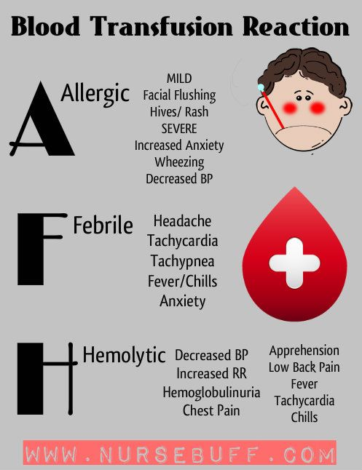
Blood transfusion reaction
Some children may develop a minor reaction to blood or platelets e.g. mild allergic or urticarial reaction
Review by Doctor
If a minor reaction occurs intravenous Chlorpheniramine (Piriton) and Hydrocortisone should be prescribed and given promptly.
Piriton < 2 years old = 2 mg IV
> 2 years old = 4 mg IV
Hydrocortisone
< 4 years old = 25 mg IV
> 4 years old = 50 mg IV

Slide 21
Febrile Neutropenia
Temperature ≥ 38.3° on one occasion
or
Temperature ≥ 38.0° and ≤ 38.2° on at least two occasions, taken at least one hour apart
Defined as per the absolute neutrophil count (ANC) which is the sum of the neutrophils and band forms.
An ANC < 1 x 10⁹/L is the critical value below which all patients should be treated

Slide 22
Febrile Neutropenia Evaluation - examination
Vital signs
Skin, especially folds, areas surrounding nail beds, CVC exit sites, sites of BMA and LP
Sinuses
Oropharynx
Perineum, particularly the perianal and labial regions

Slide 23
Febrile Neutropenia Investigations
Investigations
Complete blood count
Blood smear for malarial parasites
Kidney function
Liver function
Blood cultures
Urine culture (especially younger children)
Additional investigations if needed
CXR if respiratory
Abdominal Xray/ultrasound scan if gastrointestinal
Lumbar puncture for altered mental status or meningitis (if it is safe)
Stool culture and C. difficile toxin test if diarrhoea
Culture and Gram stain of drainage from any site with drainage

Slide 24
Initiate antibiotic treatment if
Patient is febrile and ANC < 1 x 10⁹/L, or
ANC ≥ 1x 10⁹/L and ANC expected to fall below 1 x 10⁹/L within the next 24 to 48 hours, it is advisable to initiate antibiotic treatment.
Patient is febrile and the neutrophil count is unavailable in the acute stage but the patient recently received chemotherapy and therefore is at risk of neutropenia.

Slide 25
Febrile Netropenia Guidelines for initial (first-line) and subsequent (second-line – deteriorating patients) empiric antibiotic selection.
Patient Condition | Antibiotics & Doses | Comments
PATIENTS with no significant beta-lactam reactions: | Piperacillin-tazobactam (Tazocin) 90 mg/kg/dose IV 6 hourly (max single dose: 4.5g) | Adjust Tazocin doses for renal impairment. Tazocin usually provides adequate coverage for G positive organisms including viridans streptococci. However, if additional coverage against resistant G positive organisms (e.g. coagulase negative staph, MRSA) is desired, the addition of Vancomycin is recommended. Consider discontinuation of Vancomycin once culture and susceptibility results are available.
DETERIORATING PATIENTS on first line treatment with no history of anaphylaxis to Beta Lactams (i.e. if history of rash only, can still use Meropenem) | Meropenem 20 mg/kg/dose IV 8 hourly AND Amikacin 7mg/kg/dose OD (OR Ciprofloxacin 10 mg/kg/dose IV 12 hourly OR Gentamicin 7mg/kg once daily in 50-100ml 0.9% w/v NaCI by infusion over at least 30minutes) AND Vancomycin 12mg/kg/dose 8 hourly | Meropenem: Max single dose: 1g Ciprofloxacin: dose reduce if creatinine clearance <20ml/min/1.73m², use half normal dose. Max single dose: 400mg Maximum dose of GENTAMICIN is 400mg daily.

Slide 26
PATIENTS with history of definite anaphylaxis to Beta Lactams | Ciprofloxacin 10 mg/kg/dose IV 12 hourly AND Metronidazole 7.5mg/kg/dose IV 8 hourly AND Amikacin dose as above AND Vancomycin dose as above | Adjust ciprofloxacin doses for renal impairment. Max single dose: 400mg Metronidazole max single dose: 500mg.
PATIENTS deteriorating despite the above treatment where you suspect or confirm resistant gram negative bacteria. | CEFOSO (cefoperizone and sulbactam 1g+1g) Doses are expressed in terms of cefoperazone. 20-40 mg/kg/day, given in equally divided doses every 6-12 hours. For serious infections: Up to 160 mg/kg/day, given in 2-4 equally divided doses may be used. Max dose of sulbactam: 80 mg/kg/day | May cause pseudomembranous colitis. Renal impairment: Dose adjustments may be needed. Reconstitution: sterile water for injection/normal saline/ 5% dextrose in water, and then diluted to 20 ml using the same diluent followed by admin over 15-60 minutes.
In an effort to avoid or minimize aminoglycoside-induced hearing loss, patients with known, significant, pre-existing hearing loss (sensorineural hearing loss ≥ 30dBHL at one or more frequencies between 250Hz-4000Hz) or renal impairment (i.e. GFR ≤ 60mL/min/1.73m², serum creatinine 1.5 times upper limit of normal for age, or Hepatoblastoma protocol-directed chemotherapy and no significant beta lactam allergy should receive single agent Ceftazidime only (with the addition of oral Metronidazole if anaerobic infection suspected) rather than gentamicin. Similar patients with significant beta lactam allergy may receive one dose of aminoglycoside.

Slide 27
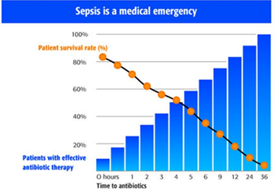
The Golden Hour for Fever and Neutropenia

Slide 28
Management of Pain

Slide 29
Non Opioids- Step 1
Drug | Single dose for child >1month | Freq. | Forms available | Comment
Paracetamol (Calpol/Panadol) | 10–15mg/kg PO or 20mg/kg PR or 3–12mth: 60mg – 120mg PO 1– 5yrs: 120mg – 250mg PO 6–12yrs: 250mg – 500mg PO 12–Adult: 500mg – 1g PO | 4– 6hrly | Tablets 500mg Liquid 120mg/5ml 250mg/5ml | Maximum: 60mg/kg/day or 4g/day whichever is lower
Ibuprofen (Brufen/Nurofen) | 5mg/kg PO or 1– 2yrs: 50mg 3– 7yrs: 100mg 8–12yrs: 200mg >12yrs: 200 – 600mg | 6– 8hrly | Tablets: 200mg, 400mg 600mg,800mg retard Liquid 100mg in 5ml Granules 600mg sachet | Maximum: 2.4g daily or 20-30mg/kg which ever is lower.
Diclofenac (Voltarol/Difene) | 300microgs – 1mg/kg PO/PR | 8hrly | Tablets 25mg, 50mg | Not recommended for children less than 6 months. Maximum dose: 3mg/kg/day or 150mg which ever is lower
Please do not give suppositories to PAEDIATRIC HAEMATOLOGY/ONCOLOGY patients.

Slide 30
Weak Opioid Step 2
Drug | Single dose for child > 1 month | Frequency | Forms available | Comment
Codeine Phosphate | 0– 12mth: 0.5mg/kg/dose >12mth:0.5–1mg/kg/dose >12yrs: 30–60mg/dose | 4– 6hrly | Codeine Linctus 15mg/5ml Codeine phosphate tabs (Codant) 30mgs | Maximum dose: 240mg daily or 60mg per dose.
Dihydrocodeine (DF 118 Tablets / Paracodin Liquid) | 1– 4yrs: 0.5mg/kg 4–12yrs: 0.5mg – 1mg/kg > 12yrs: 30mg | 4– 6hrly | Tablets 30mg Liquid: 12mg/5ml | Not for children <1 year. 90% effective at 30mg dose – no need to increase dose above this. Do not prescribe with other opiates.
There is a ceiling effect with weak opioids i.e. a max dose is reached beyond which further dose escalation doesn’t improve analgesia.
Notes: Constipation should be anticipated and laxatives prescribed. Injections of both dihydrocodeine and codeine are available but should be avoided in paediatrics.

Slide 31
Strong Opioid – Step 3
Oral morphine is the drug of choice in the majority of children with severe pain. Children can tolerate very large doses of morphine if titrated appropriately.
MORPHINE DOSE TITRATION:
There is no such thing as a standard dose of morphine; no upper limit.
To obtain control initially:
The dose has to be adjusted for each child until their pain is controlled.
Prescribe an appropriate dose, according to weight (usually give a range).
Start low and work up
Use an immediate release morphine preparation (oral morphine suspension) for dose titration.
Give it regularly every 4 hours.
At the same time prescribe the same dose for ‘breakthrough’ pain to be repeated as often as necessary between regular doses.
Review after 24 – 48 hours and adjust regular dose according to breakthrough requirements.
A common dose increment is between 25 – 30% of the previous dose. (minimum increase 20%, maximum increase 50%).
Starting dose: 1 – 12 months 0.1mg/kg 4 hourly
1 – 12 years 0.2 – 0.5mg/kg 4 hourly
To calculate total amount of morphine given in a 24 hr period:
5mg oral morphine suspension given 4hrly for 24hrs:
= 5 x 6 = 30mg
5mg breakthrough dose needed twice in 24hrs:
5 x 2 = 10mg
30mg + 10mg = 40mg = total morphine in that 24hrs
(If it is available it may be possible to convert to 12hrly sustained release preparation (MST):
40mg ÷ 2 = 20mg twelve hourly dose as sustained release PLUS
Now calculate breakthrough dose = 1/6th of total daily dose:
40mg ÷ 6 = 5mg PRN given as instant release morphine.
Intravenous / Subcutaneous morphine if available:
Conversion from oral to I.V/S.C route: Divide oral dose by 2 to obtain equianalgesic dose.
Initial Morphine Loading Dose I.V:
0.05 – 0.1mg/kg (50 – 100 microg/kg) over 10 minutes.
Infusion Rates:
0 – 3 months: Average initial rate 10microg/kg/hr
Range 5 – 15 microg/kg/hr
3 – 6 months: Average initial rate 15 microg/kg/hr
Range 5 – 20 microg/kg/hr
6 months – 18 years: Average initial rate 25 microg/kg/hr
Range 10 – 40 microg/kg/hr
Must titrate amount to severity of pain.
Recommendation for preparation of infusion of morphine:
Patient must be pain free by bolus morphine before commencing infusion.
Weight (kg) = mg morphine (e.g. 10kg child draw up 10mg of morphine)
Mix in 5% dextrose to a total volume of 50ml
This gives a concentration such that an infusion rate of 1ml/hr = 20microg/kg/hr. Max concentration 50mg/50ml.
Use syringe pump for delivery
Transdermal:
Fentanyl patches are sometimes available.

Slide 32
  CO ANALGESICS – Step 3
  A co-analgesic is a drug which may or may not have intrinsic analgesic activity, but which may when used with conventional analgesics contribute significantly to pain relief.
Bone Pain
Neuropathic Pain
Nonsteroidal Anti-inflammatory Drugs (NSAIDs):
NSAIDs are of particular benefit for pain associated with inflammation e.g. soft tissue infiltration and bone metastases.
Inflammation leads to central sensitization and increased pain, NSAIDs will sometimes play a crucial role in relieving cancer-related neuropathic pain.
Corticosteroids:
Steroids have specific benefits for pain management because of their anti-inflammatory effect and ability to produce euphoria, improve appetite and weight gain.
They often result in an increased sense of well being. They have anti-inflammatory effects on certain tumors.
Dexamethasone has advantages over prednisolone because of its weaker mineralocorticoid effect with a lesser tendency to cause oedema and weight gain.
However, side effects can be severe in children and they should only be used when benefits outweigh the disadvantages.

Slide 33
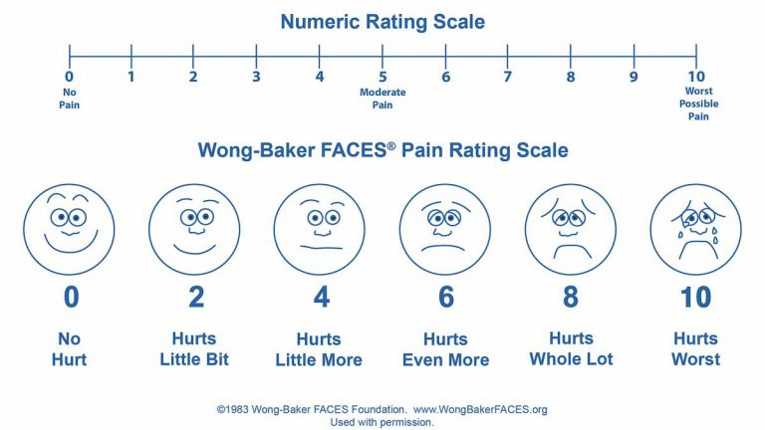

Slide 34
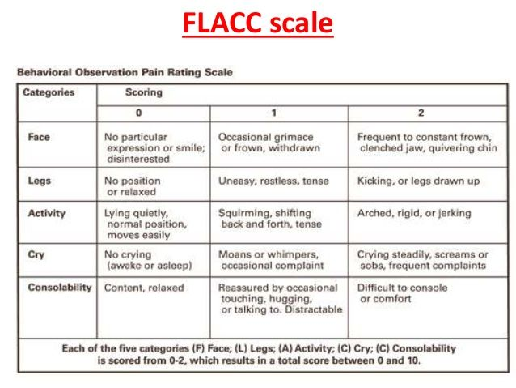

Slide 35
TUMOUR LYSIS SYNDROME
This is a constellation of biochemical abnormalities resulting from massive tumour cell lysis which may be apparent at diagnosis or during the first few days of induction chemotherapy. Conditions most likely to cause this include:
Burkitts Lymphoma and other NHL’s
Acute leukaemia with WCC > 50 x 10⁹/l
Large tumour burden e.g. Stage IV NBL
    Principal Biochemical Abnormalities found in Tumour Lysis Syndrome
Hyperuricaemia
Hyperphosphataemia
Hypocalcaemia
Hyperkalemia
Acute renal failure may result from precipitation of urate in renal tubules.

Slide 36
Initial Management
Measure weight
Fluids: Commence hydration on admission with DNS at 3L/m²/24hrs
Strict adherence to fluid balance. Aim for a urine output of 3mls/kg/hour. Ask parents to collect all the urine and review this at least daily if not more often initially.
BP 4 hourly or more frequently according to severity of clinical condition.
Blood Investigations
U + E - if possible, 12 hourly but at least every day until stable
Urate - if evidence of massive cell lysis or reduced urine output, monitor 6 hourly, otherwise once daily
Creatinine - as for urate
Inorganic Phosphate
FBP - daily
CXR
Renal ultrasound when a child has an abdominal mass to rule out renal infiltration or obstructive uropathy. Children with the latter are at increased risk of renal failure and may require dialysis at an early stage.
If possible ECG monitoring if hyperkalemic or on calcium infusion if possible.
Allopurinol: 1month-15 years 10-20mg/kg daily. Maximum 400mg daily
15-18years – 10-20mg/kg daily with a maximum of 900mg.
Preferably with food. Doses over 300mg are given in divided doses.
Start from first admission and to continue for 5 days (or longer if child has confirmed Tumour Lysis Syndrome).
Urate oxidase – Although this drug is currently unavailable on the ward it is important to include it here. It is extremely effective and is given at a dose of :
0.2mg/kg daily diluted in 50ml of NaCL 0.9%w/v administered over 30 minutes (for up to 5 days).
For children less than 5yrs with uric acid levels > 400micromol/L
For children more than 5yrs with uric acid levels > 600micromols/L
This should never be mixed with chemotherapy. Uric acid levels should be checked daily.

Slide 37
Management of Complications
Fluid Balance
If diuresis is not adequate and there is no evidence of obstructive uropathy, frusemide 1-2mg/kg can be given as a stat dose, or up to every 6 hours under strict consultant supervision and repeated as indicated.
continuing.
NB: Stop infusion if bradycardia develops.
Site of cannula should be left exposed so that area can be inspected at regular intervals (extravasation causes severe tissue necrosis)
Hypocalcaemia
Clinical signs
neuromuscular irritability including (<1.8 mmol/L) tetany as manifested by Chvostek's sign (twitching on tapping of facial muscle) or Trousseau's sign (occlude brachial artery with BP cuff and hand spasms into painful ‘main d’accoucheur), bronchospasm,
electrocardiographic changes
seizures.
Management
Ca gluconate 10% (2.2mmol/10ml) 1-2mmol/kg/day i.e. as separate infusion diluted in 100-200 ml 0.9% w/v NaCI.
If symptomatic, 0.1 mmol/kg Ca gluconate 10% (0.4ml/kg) diluted in 10-20 ml 0.9% w/v NaCI can be given slowly over 10 mins with ECG monitoring if possible. Calcium replacement may need to be continued at a lower dose while lysis is continuing

Slide 38
  HYPERKALAEMIA
  Defined as serum potassium greater than 5.5 mEq/L (mmol/L). Severe hyperkalaemia (potassium > 7mmol/L) is a medical emergency and requires urgent treatment.
Consider cause of hyperkalaemia. Review medication list and check previous blood results.
Repeat an urgent renal profile (including potassium, sodium, chloride, urea and creatinine); inform the lab that this is urgent and ensure the sample is taken to the lab immediately. Do not delay treatment if the clinical picture is in keeping with the blood result.
Perform an ECG if possible but do not delay treatment. Place on a cardiac monitor and pulse oximeter if possible.
Cardiac membrane stabilization.
Calcium should be infused SLOWLY over 5 minutes intravenously to patients with:
Serum potassium >7mmol/L OR
Significant ECG changes
Severe arrhythmias thought to be caused by hyperkalaemia
There are two forms of calcium. Please check carefully which is available in your centre and calculate accordingly. Note the large difference in maximum volumes. (If both are available use calcium gluconate):
IV Calcium Gluconate 10%w/v, 0.5 -1ml/kg (equivalent to 0.11-0.22mmol/kg). The maximum single dose is 4.4mmol or 20ml.
OR
IV Calcium Chloride 10%w/v, 0.2ml/kg (equivalent to 0.14mmol/kg) The maximum single dose is 1.4mmol or 2ml.
Therapy to shift extracellular potassium into cells is needed in conjunction with cardiac membrane stabilization
Inhaled salbutamol (can be repeated after 20 minutes)
Neonates 0.4mg in 2ml of saline
Infants and children > 25kg 2.5mg in 2ml of saline
Children 25-50kg 5mg in 2ml of saline
Children >50kg 10mg in 2-4mL of saline
Intravenous insulin and glucose.
Fast acting insulin (e.g actrapid) is mixed with dextrose 1g/kg and given concurrently IV over 30 minutes as follows:
Insulin (actrapid) 0.1iu/kg
Dextrose: 5mL/kg dextrose 20%w/v or 20ml/kg of 5%w/v dextrose depending on what concentration is available.
This must be double checked with two doctors prior to administration.
Serum glucose should be measured prior to and one hour after commencement of infusion.
Therapy to remove potassium from the body
Frusemide 1mg/kg IV can be given if renal function and volume status are normal in severe hyperkalaemia or for non-urgent levels of hyperkalaemia (5.5-6.5mmol/L)
If enteral cation exchange resins e.g. sodium polystyrene sulfonate or dialysis are considered, senior input is advised
Repeat potassium 2 hours after commencement of therapy

Slide 39
